Slide 1
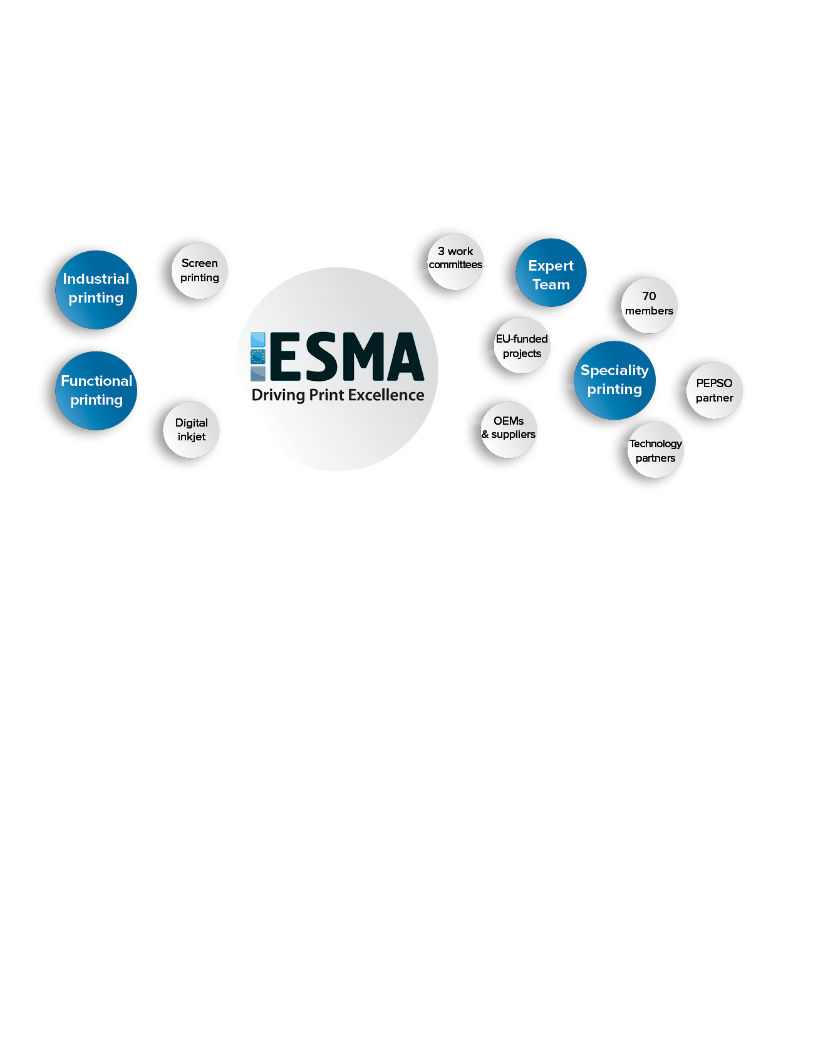
Make your packaging Smarter
Breakthrough with Intelligent Packaging (IP)
Peter Buttiens
25 April 2017

Slide 2
Overview
ESMA introduction
Functional vs smart packaging
Intelligent packaging = smart packaging
Intelligent packaging?
How to break through the magic wall?
What are the applications of smart packaging?
Conclusions
ESMA conferences

Slide 3
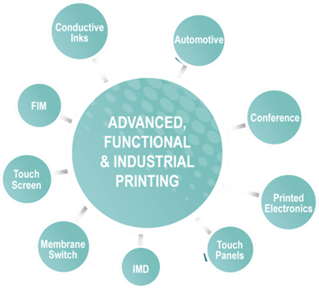
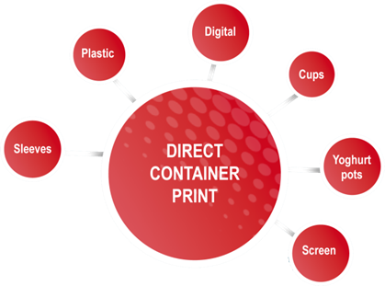
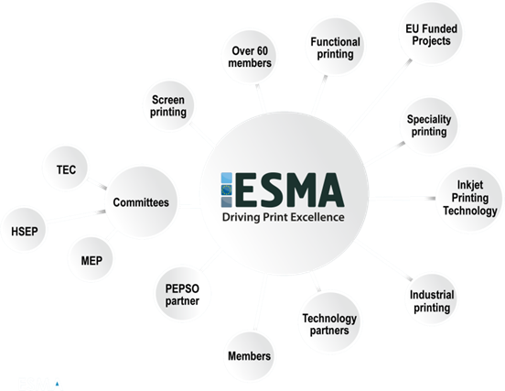
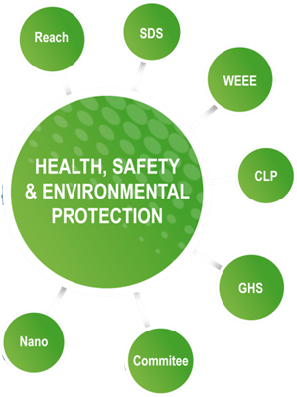
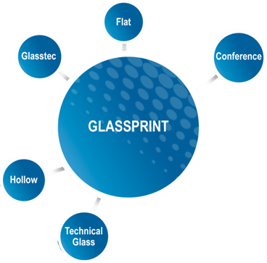
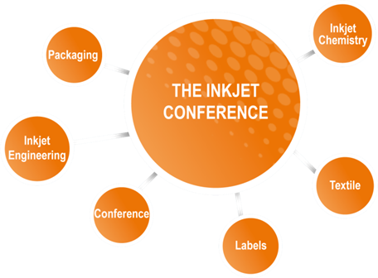
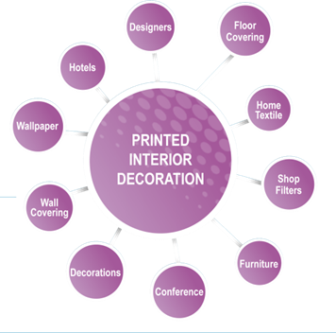
ESMA: Connecting the dots IN the industry

Slide 4
Functional vs smart packaging
Nice features
No interaction
No data collection
Coors Light: Summer edition
Link: https://youtu.be/J0s0gjgWoZw

Slide 5
Personalised packaging with Internet
interaction
data collection
They know you and your pet
They know all about the pet
Nestlé Purina launches personalised dog food
http://www.nestle.com/media/newsandfeatures/purina-personalised-dog-food-us

Slide 6
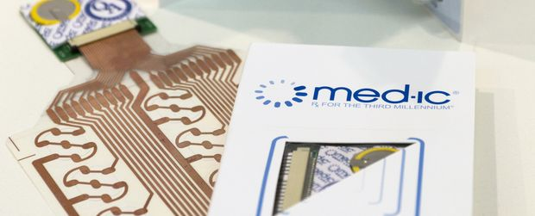
Intelligent Packaging = smart packaging
What can make your packaging intelligent?
Printed electronic circuits:
OLED (Organic Light-Emitting Diode)
RFID (Radio-Frequency Identification)
NFC (Near Field Communication)
Sensors
Image recognition or Augmented Reality with a smartphone app
LINK TO SMARTPHONE IS A MUST
Results are smart labels, smart packaging, intelligent blisters…

Slide 7
Intelligent packaging
Customer data PULL
BRAND OWNER
Marketing Provider
PACKAGING
USER
CONSUMER
BUYER
THE MAGIC WALL
Customer data PUSH

Slide 8
How to break through the magic wall?
BRAND
NFC
PACKAGING
RFID
INSTALLED
APP
AUTO
WEB
LINK

Slide 9
What are the applications of smart packaging?
Brand protection, identification and security
Smart tags and labels (tracking)
Smart labels
Product information
Product feedback
Product promotion
Smart blisters (medical)
Smart packaging for IoT (Inter of Things)

Slide 10
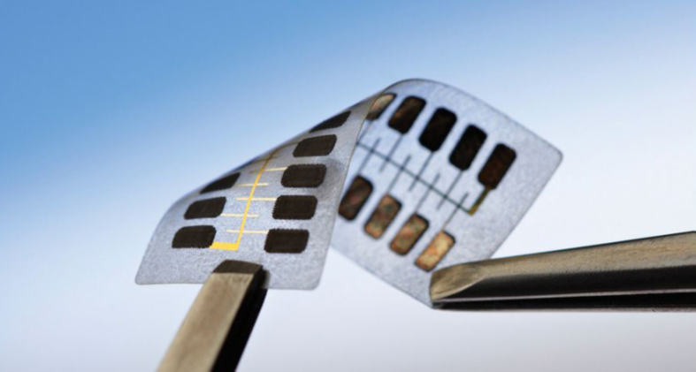
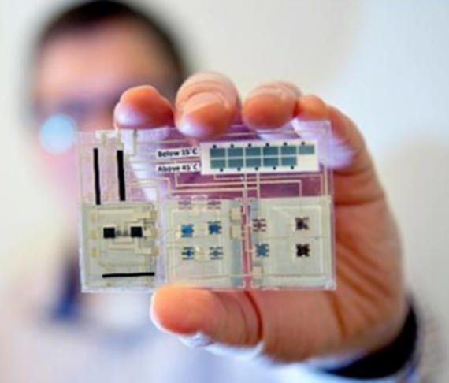
What are the applications of smart packaging?
Brand protection and security?
Xerox developed a flexible circuit
36 bit Rewriteable encoded key
Can store 68 billion points of data
NFC connection
smart label
Smart tags and Labels (tracking)
sensors (temp, shock, chemicals…)
logging in memory
reading out via NFC

Slide 11
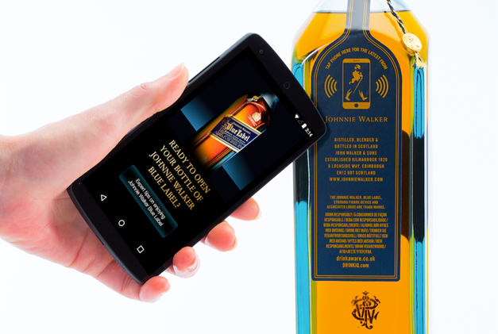
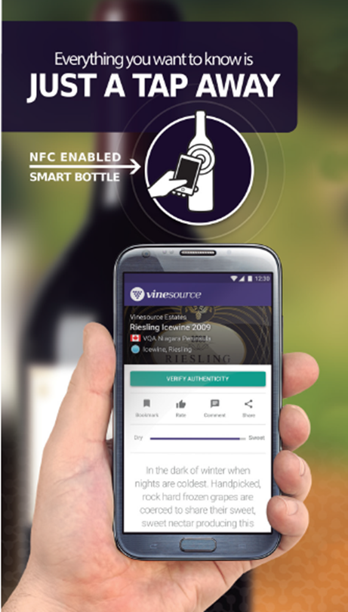
What are the applications of smart packaging?
Smart labels for product information
RFID based
app installed on smartphone
access to more information
brands knows you now 100%
Smart labels for product information
NFC based
open direct link to brand
access to more information
brands knows you now 100%

Slide 12
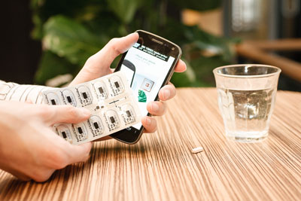
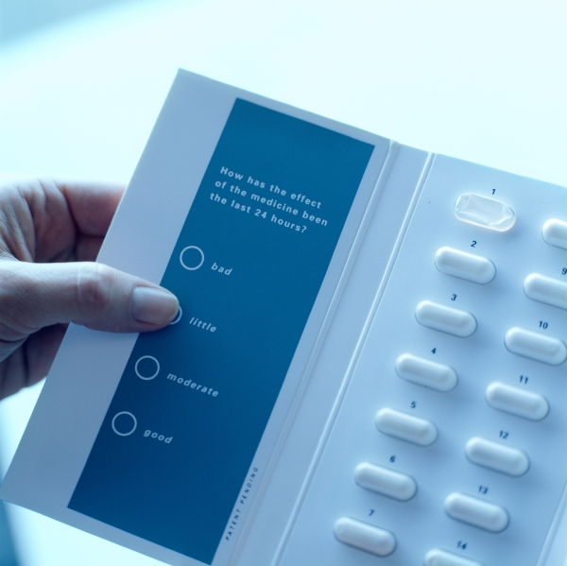
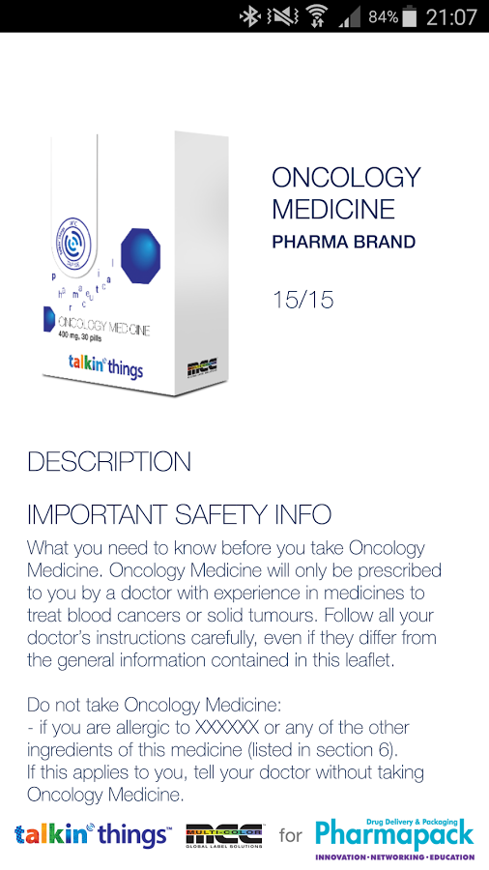
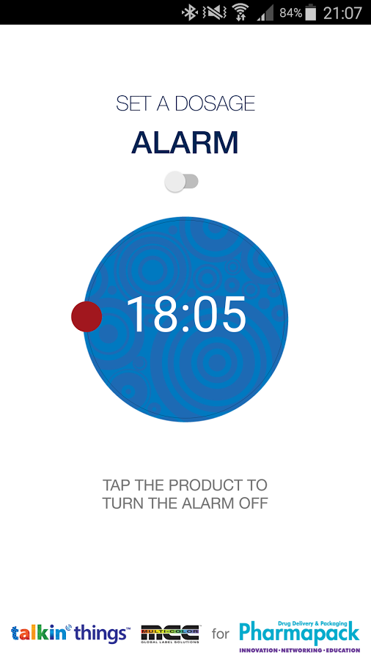
What are the applications of smart packaging?
Smart blisters (pharmaceuticals)
RFID/NFC based
app installed on smartphone
helps to track
optimised medical treatment
Smart medical packaging
NFC based
opens direct link to brand
monitoring & feedback

Slide 13
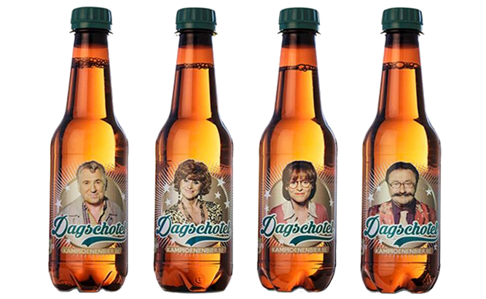
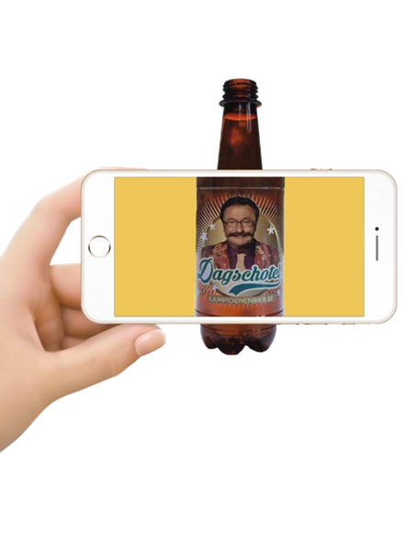
What are the applications of smart packaging?
Augmented Reality
standard image
app installed on smart phone
Brand provides more information
Brands knows you 100%

Slide 14
What are the applications of smart packaging?
Image Recognition (ex. http://www.linkz-im.com)
standard or Unique coded image
app installed on smart phone
brand provides more information
brands knows you 100%

Slide 15
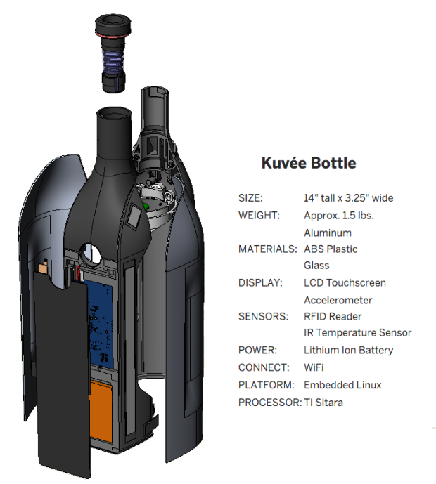
Advanced Packaging: the new approaches
sustainable
ecological
user-friendly
IoT concept
break-away concept
Nespresso concept
YouTube video: https://youtu.be/BBzHPjxU_c0

Slide 16
The Nespresso of wine (thanks to PE)
KUVEE: the smart wine Bottle
https://youtu.be/i3XpP6qdKac

Slide 17
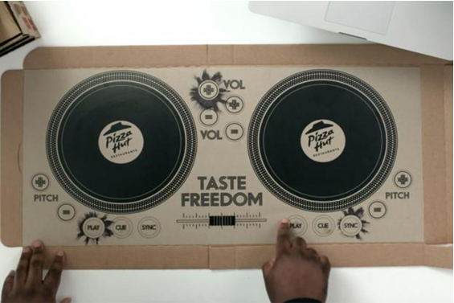
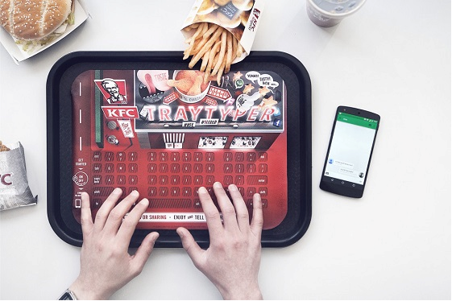
Videos of inspirational projects for brands
DJ set in a pizza box by Pizza Hut
Wireless keyboard by KFC
https://youtu.be/7H7RkIzNCJs
https://youtu.be/1xVepNA60tM

Slide 18
Conclusions of Intelligent packaging:
Making your packaging smarter is SMART!
Customer information, retention…
Product promotion, support, selection
Product fun for families
Biggest marketing tool and combine with IoT
Know your customer
Know more about your customer
Know more about their needs
Know more about when, where, what, how…
Enhancement of packaging as a new possibilities at all levels!

Slide 19
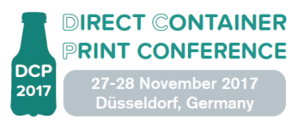
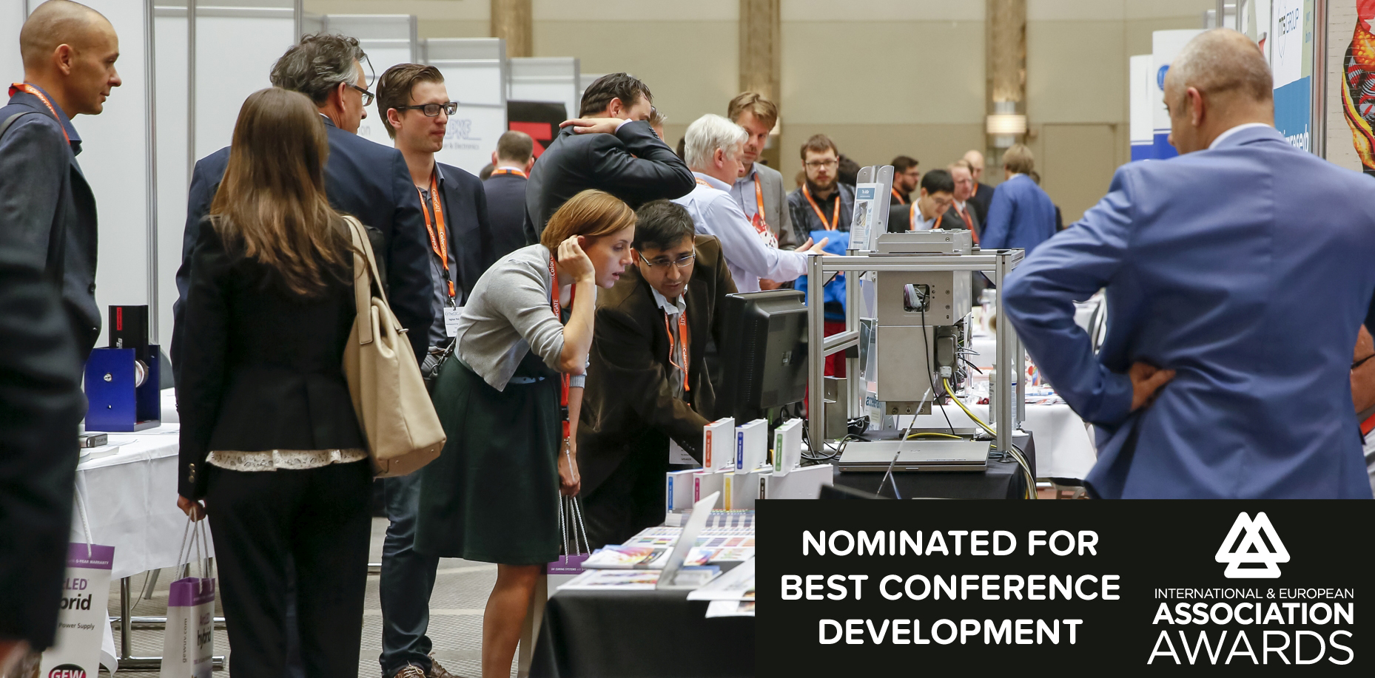
The 2017 ESMA Conferences
The Inkjet Conference, 24-25 October 2017, Neuss (Düsseldorf), Germany
World’s largest inkjet chemistry & inkjet engineering event
Direct Container Print, 27-28 November 2017, Düsseldorf, Germany
Direct to shape printing on plastics with screen and digital inkjet
GlassPrint, 29-30 November 2017, Düsseldorf, Germany
All about flat & hollow glass decoration with screen and digital inkjet

Slide 20
Thank you for your Attention! Q&A And See you soon at one of our events
Peter Buttiens
pb@esma.com
+32 16 894 353

