Slide 1
FEST.A CROPAK 2017
Packaging that Saves Food
Developments and Solutions awarded by WPO

Slide 2
Food Losses and Food Waste
1/3 of the food produced for human consumption is either lost or wasted globally along the food supply chain
Despite sufficient world production: One in seven people are starving!
Environmental impact: CO₂, water, land area, biodiversity
Economic loss and costs to society
Population growth: 2050 – 9 billion people (need to raise the food production by 60 %)
Get Active – Save Food!
Source: http://www.fao.org/food-loss-and-food-waste/en/
2/28

Slide 3
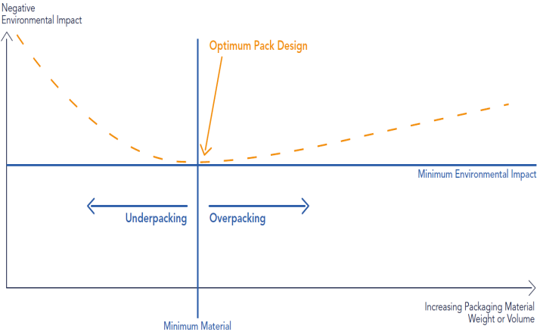
Optimum Packaging
= Waste of Food
= Waste of Packaging Material
3/28
Notes:
Lars Waste of food and packaging

Slide 4
4/28

Slide 5
5/28

Slide 6
6/28

Slide 7
7/28

Slide 8
8/28

Slide 9
9/28

Slide 10
10/28

Slide 11
11/28

Slide 12
12/28

Slide 13
13/28

Slide 14
14/28

Slide 15
15/28

Slide 16
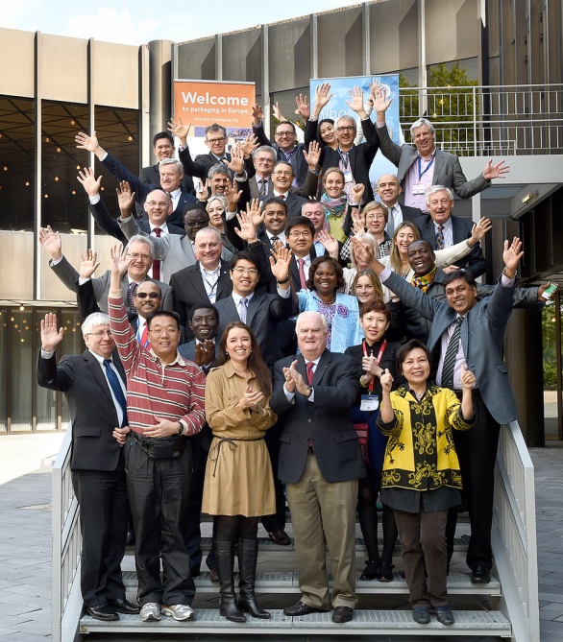
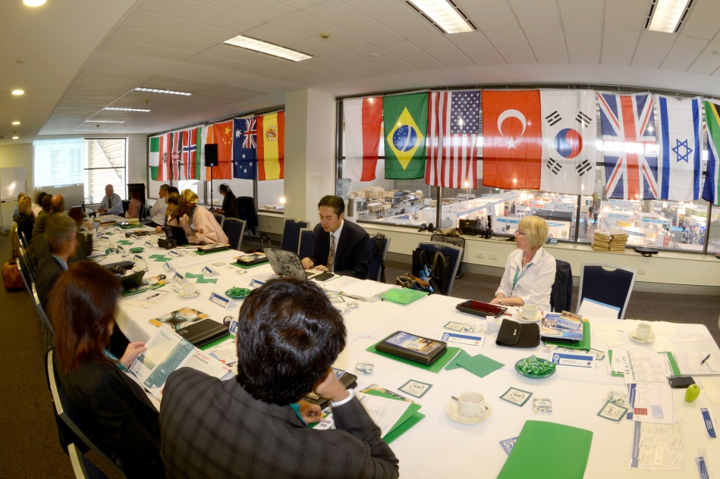
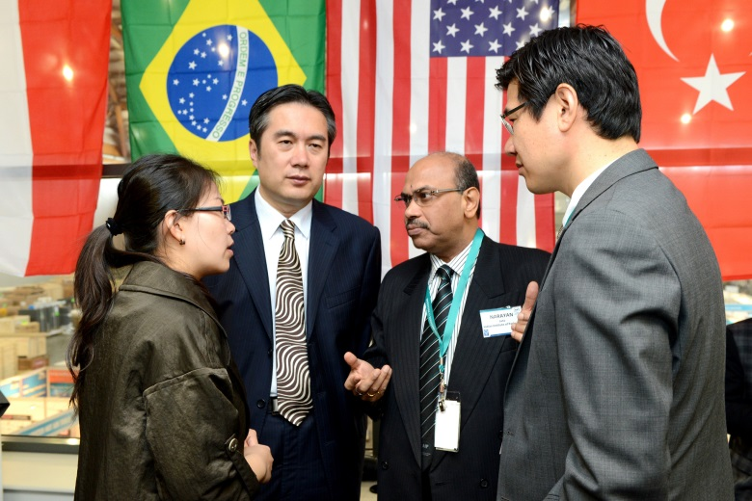
WPO
WORLD PACKAGING ORGANISATION
WPO Vision
Better Quality Of Life
Through Better Packaging
For More People
16/28

Slide 17
Actions of WPO @ Interpack 2017
Using the appropriate packaging (material) is regarded to be a key element of a set of technologies to reduce food losses and food waste.
First worldwide exhibition of national award winners and WorldStar winners for Packaging that Saves Food
17/28

Slide 18
18/28

Slide 19
19/28

Slide 20
20/28

Slide 21
21/28

Slide 22
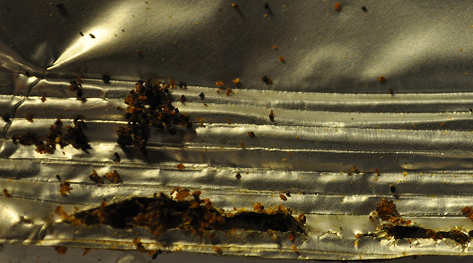
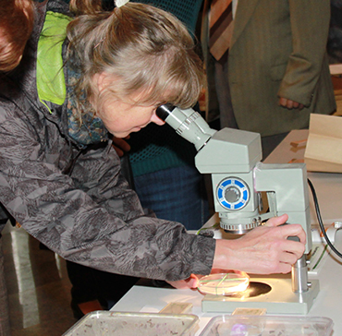
Identify the package foil resistance to penetration of pest
improve the protective function by application of natural compounds to the surface of primary or secondary package
Develope the new package foil with higher protective function against pests
© 2016 CZECH PACKAGING INSTITUTE SYBA
22/28

Slide 23
23/28

Slide 24
24/28

Slide 25
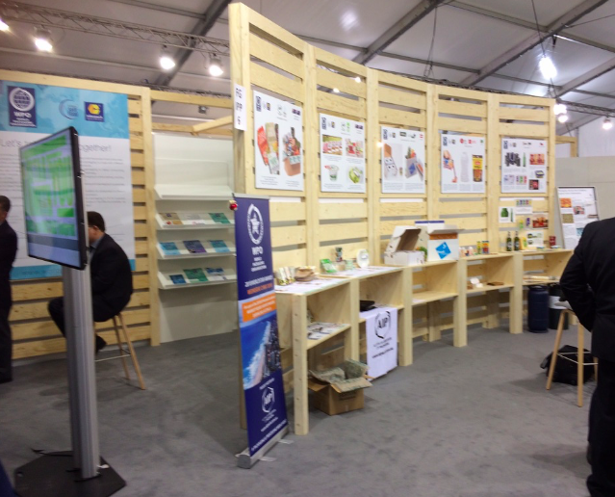
25/28

Slide 26
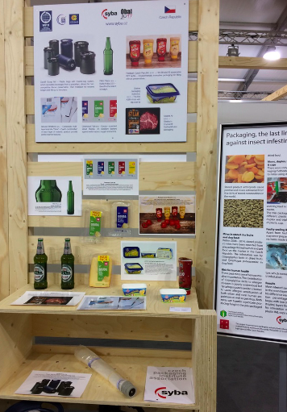
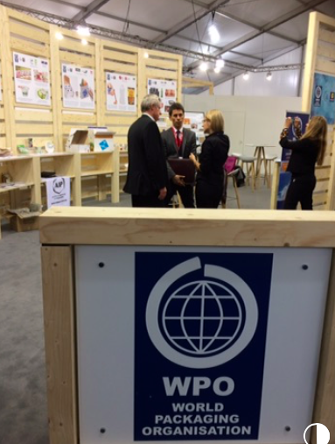
26/28

Slide 27
Conclusions
Appropriate packaging (material) is a key element to reduce food losses and food waste
WPO has collected and awarded solutions around the world and shown on Interpack 2017
Solutions are wide spread: from simple “pack it at all” to active/intelligent packaging
But: Still a long way to go! Not enough solutions, not enough awareness
WPO continues the program
27/28

Slide 28
Contact Details
PACK EXPERTS
DI Dr. Johannes BERGMAIR
WPO Vice President Sustainability & Food Safety
johannes.bergmair@chello.at
+43 676 5711388
www.worldpackaging.org
DI Dr. Johannes Bergmair
johannes.bergmair@ofi.at
OFI
Brehmstraße 14A
1110 Wien
+43-(0)1-798 16 01 - 976
+43-(0)1-798 16 01 - 480
28/28

