Slide 2
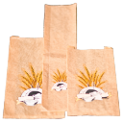
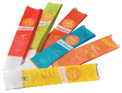
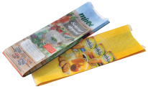
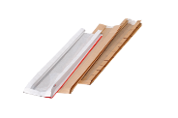
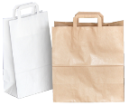
leader in the manufacture of
paper bags in the region
unquestionable quality
innovative solutions
customer satisfaction
constant attention for our impact
on nature and the environment
trustworthy partner
2
/10

Slide 3
Our Mission and Vision
Driven by the idea of preserving clean and healthy environment, project C packaging-manufacturing of paper bags started in 2009 as a Greenfield investment. C Packaging opened its company’s regional center and production plant in Saint Helena - Zagreb. In the period from mid-2011 until today the company C packaging has become the leading Croatian and regional manufacturer paper bags with a confirmed European quality products and services. C packaging
distributed their products in
leading European supermarket
chains Lidl Germany, REWE
Austria, Kaufland Germany,
SPAR Austria, Billa East,
Konzum Croatia, Mlinar Croatia,
Lidl Croatia, Lidl Slovenia,
Kaufland Croatia, Profipac
Austria, Bagman Germany, etc.
3
/10

Slide 4
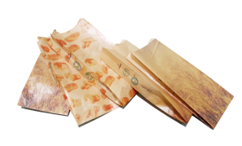
FSC®- Forest Stewardship Council
The FSC promotes environmentally appropriate, socially beneficial and economically viable management of the world’s forests. C packaging is committed to the protection of the earth through recycling and promotion of sustainable products. C packaging is proud Forest Stewardship Council – FSC certificate holder.
Initiative SAVE FOOD
More than 100 global companies from across the food chain, from production, sales and packaging to logistics, already participates in the Save Food initiative, a joint project of FAO (Food and Agriculture Organization), the UN Environment Programme (UNEP) and Messe Düsseldorf GmbH, which aims to encourage dialogue among representatives of industry, research, the political sphere and civil society on the subject of preventing the loss of food. Our products promote and support efforts to prevent losses and food waste by highlighting the importance and role of packaging.
4
/10

Slide 5
Cropak Award
Our product Eco I Love Nature was pronounced the winner in the „ECO PACKAGING” category at the Croatian market competition CROPAK 2012. Award for contribution to environmental protection from the aspect of packaging and packaging waste menagement. Our product paper bag "C Window Bag Eco" was awarded in the category "ECO CROPAK - Eco packaging" at the market competition CROPAK 2014.
ISO Certificate
C Packaging Ltd. became the proud holder of certificate ISO 9001:2008 and for set high criteria of quality management and business processes. By implementing an Environmental Management System and confirming its compliance with the International Standard ISO 14001 we shown that work and care for the environment are not a result of chance rather than a result of a planned business.
5
/10

Slide 6
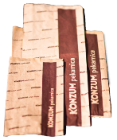
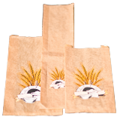
C Bread & Bagel Bag
From small bakeries to major retail chains, they can all find their perfect C B&B bag for bread and bagels. An extensive choice of sizes, paper types and print according to your design using the flexographic technique with up to 6 colors provides your imagination with unlimited creativity. It is made from white or brown kraft paper, which may be specially treated to make it grease-proof, and from environmental friendly 100% recycled paper. C packaging distributed their products in leading European supermarket chains Lidl Germany, REWE Austria, Kaufland Germany, SPAR Austria, Billa East, Konzum Croatia, Mlinar Croatia, Lidl Croatia, Lidl Slovenia, Kaufland Croatia, Profipac Austria, Bagman Germany, etc
6
/10

Slide 7
Shopping bag
C Bag & Carry
Pleasure of shopping is always ruined when carefully selected groceries need to be packed. Even bigger problem is carrying the load. C Bag&Carry handle bags make the checkout counter environmentally-friendly and provides an easier consumer carryout. Available with 3-ply or 5-ply flat paper handles these bags assure a reliable grip and a comfortable load. Plain or with customized printing on four sides, C Bag&Carry bags are available in our standard sizes and can be made from unbleached or bleached Kraft or Eco-friendly paper.
7
/10

Slide 8
C Window Bag
Bread bags made with a see-through window panel allow your customers to see and smell the freshly baked bread and bagels. The bags are made from 30 to 40 g/m² bleached or unbleached Kraft, plain or with customized Flexo print.
They are available in perforated or noon-perforated PP window-panel.
C Xlong Bag
Bread bags made with a see-through window panel allow your customers to see and smell the freshly baked bread and bagels. The bags are made from 30 to 40 g/m² bleached or unbleached Kraft, plain or with customized Flexo print.
up to 660 mm
They are available in perforated or noon-perforated PP window-panel.
8
/10

Slide 9
C Bread & Bagel Bag
C Take Away Bag is ideal for every fast food restaurant that cares enough and wants to enable its customers to enjoy in fresh food at the comfort of their home or work place. Surprise your marketing department with this bag, custom printed, because this can be an amazing promotional tool. It can be made from Eco-friendly paper, in our various standard sizes.
9
/10

Slide 10
IN FO
Headquarters:
Bužanova 6c, 10000 Zagreb
tel. +385 1 2854 320
fax +385 1 2854 307
C pakiranje d.o.o.
Factory:
Sveta Helena 165
10382 Donja Zelina
Croatia
info@cpack.hr www.cpack.hr
10
/10

