Slide 1
The Role of Packaging in reducing Food Waste and the Save Food Initiative - Global Approach
Stefan Glimm
Chief Executive Director
European Aluminium Foil Association (EAFA)
Flexible Packaging Europe (FPE)
FEST.A CROPAK
Zagreb May 12-13 2016

Slide 2
EAFA/FPE Mission Statement
“EAFA/FPE is the international body representing foil rollers and manufactures of aluminum closures, containers, household foil and all kind of flexible packaging in Western, Central and Eastern Europe.“
( > 100 Member Companies from more than 30 Nations)
Container
Household foil
Alu Closures
Flexible
Packaging
Foil Rolling
Market Analysis, Communication, Food Contact,
Sustainability, Global Networks…..

Slide 3
Content
Mega Trends
The Food Waste Problem
The Save Food Initiative (SFI)
The Role of Packaging
Food Waste Reduction by Packaging Optimization
Commitment of EAFA and FPE to Contribute to Food Waste Reduction as Member of

Slide 4
Urbanization
1900 | 2 out of every 10 people lived in an urban area
1990 | 4 out of every 10 people lived in an urban area
2010 | 5 out of every 10 people lived in an urban area
2030 | 6 out of every 10 people will live in an urban area
2050 | 7 out of every 10 people will live in an urban area
Source: WHO 2012, Urban Area defined 100,000 or more inhabitants

Slide 5
Megacities with populations > 5M
1900s | 1950s | 2000s
(1) | (5) | (78)
London ~ 6.5M Osaka (?), New York ~ 4M Paris, Berlin 3M Tokyo ~1.5M | Tokyo ~ 13M New York ~ 12M Osaka ~ 9M London ~ 8M Paris, Shanghai ~ 5M | Tokyo ~ 35M Mumbai, Mexico City ~ 20M Sao Paulo, New York ~ 19M Shanghai ~ 17M Kolkata, Delhi ~ 16M Beijing, London ~ 15M LA, Buenos Aires ~ 12M Rio, Paris, Manila ~ 11M Moscow, Istanbul ~ 10M … 45 more
Source: MGI, Forbes, University of Cologne

Slide 6
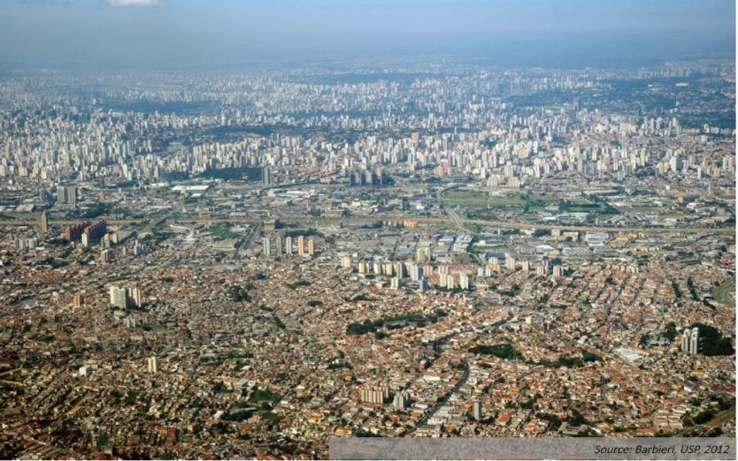
São Paulo …

Slide 7
Mexico City …

Slide 8
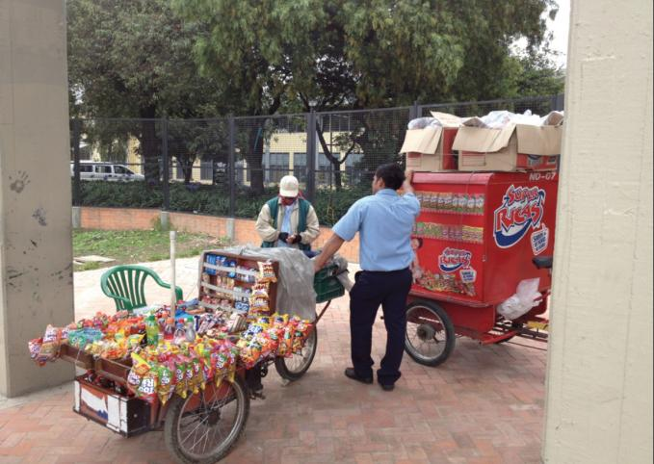
Megacity Logistics
Source: Megacity Logistics Lab
…and where do they do their shopping?

Slide 9
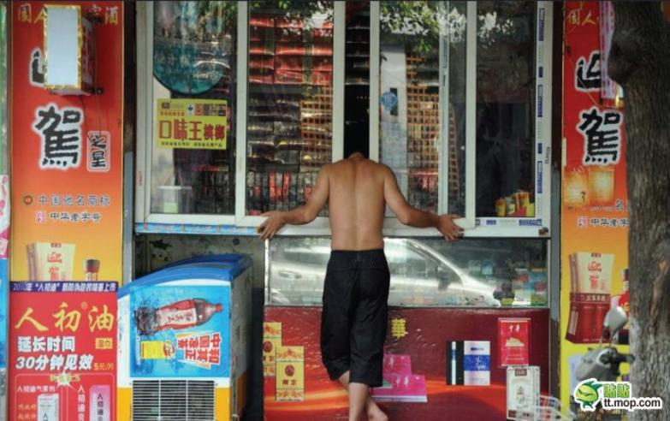
Here!
Source: Megacity Logistics Lab

Slide 10
Content
Mega Trends
The Food Waste Problem
The Save Food Initiative (SFI)
The Role of Packaging
Food Waste Reduction by Packaging Optimization
Commitment of EAFA and FPE to Contribute to Food Waste Reduction as Member of

Slide 11
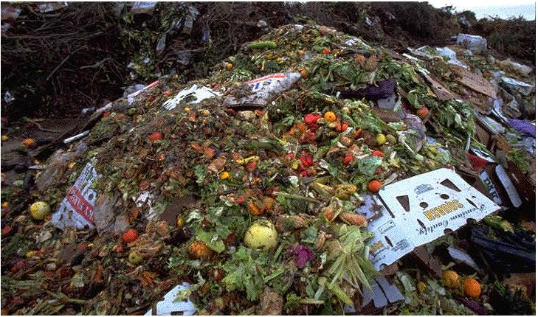
The Food Waste Problem
“Roughly one third of the food produced in the world for human consumption every year — approximately 1.3 billion tonnes — gets lost or wasted”
(UN FAO study (2011))

Slide 12
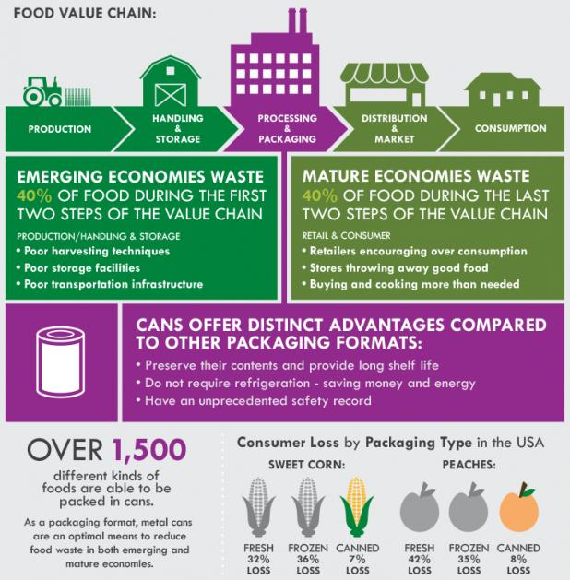
The Food Waste Problem

Slide 13
The Food Waste Problem (in numbers)
Scale
Edible food wastage = 1.3 billion tonnes (total = 1.6 Gt)
Land use: ~ 30% of the worlds agricultural land (1.4 billion hectares)
Carbon
Food Waste third biggest source of carbon emissions (after USA, China)
About 30 percent of the carbon footprint of an average European are linked to the production and distribution of food and to nutrition [EC 2006]
Economic impact
On a global scale, the cost (based on 2009 producer prices) of food wastage is 750 billion USD
This is equivalent to the GDP of Switzerland
Source: FAO Study 2013: Food wastage footprint. Impacts on natural resources

Slide 14
The Food Waste Problem
“The UN FAO has said food production will need to increase by 70% by 2050. 50% of this could come from reducing food waste.”
Janez Potocnik, EU Commissioner for the Environment

Slide 15
Content
Mega Trends
The Food Waste Problem
The Save Food Initiative (SFI)
The Role of Packaging
Food Waste Reduction by Packaging Optimization
Commitment of EAFA and FPE to Contribute to Food Waste Reduction as Member of

Slide 16
The Save Food Initiative
“Just imagine that global food loss and waste were a country. It would have a surface area larger than my own homeland, China. It’s fields and meadows would be producing food that nobody would eat. It would be the largest user of water for irrigation and the third largest generator of greenhouse gases.
This example shows how important it is – and indeed vital to our survival – to fight food waste and loss.”
Dr Ren Wang,
Assistant Director General Agriculture and Consumer Protection Department (AGD), Food and Agriculture Organisation of the United Nations

Slide 17
The Save Food Initiative
Save Food Leadership/ Co-ordination
Membership:
More than 130+ Save Food members (companies, associations…) from all parts of the food and packaging supply chain and 250 NGOs via FAO

Slide 18
Challenge
The Mango Project Challenge
Approximately 64% of all mangos in Kenya are lost every year.
64 %
Production of mangos by small scale farmer
(MT of mangos, 2014)
Source: Kenya Investment Authority (2012)
Source: XCOM Africa 2015

Slide 19
The Mango Project Challenge – Reasons for Loss
Almost 45% of all mango food loss can be tackled within the SAVE FOOD initiative.
45%
Source: Kenya Investment Authority (2012)
Source: XCOM Africa 2015

Slide 20
The Mango Project Partners along the Value Chain
The current supporters are widely spread along the value chain and committed themselves with financial and in-kind contributions.
Project component | Partner
Cultivation, Capacity Building and Logistics
Processing and Packaging
Sales and Marketing
Source: XCOM Africa 2015

Slide 21
Content
Mega Trends
The Food Waste Problem
The Save Food Initiative (SFI)
The Role of Packaging
Food Waste Reduction by Packaging Optimization
Commitment of EAFA and FPE to Contribute to Food Waste Reduction as Member of

Slide 22
Fresh or Packed ? – Impact on Food Waste
:
:
Source: US Department of Agriculture (www.packagingtoday.co.uk )

Slide 23
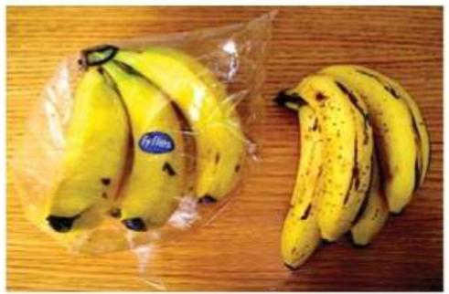
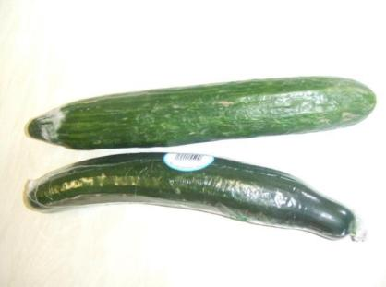
Fresh or Packed ? – Impact on Food Waste
Bananas
Identical bunches stored for 7 days
Cucumbers
Shelf life extended from 3 days to 14+ days
Packaging – Part of the solution to reducing Food Waste
Source: INCPEN
Notes:
Good morning.
I would like to thank Packbridge for the opportunity to address you today.
I work with EAFA in the role of Sustainability Director. Who is EAFA?

Slide 24
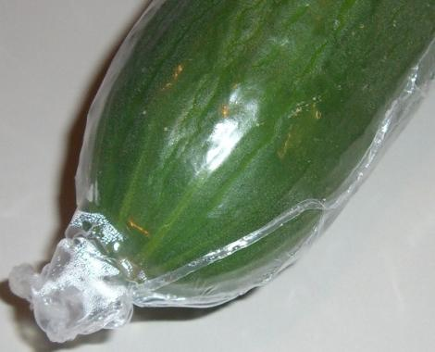
Example – cucumber
No packaging versus PE film (prolonged shelf life, less moisture loss) 4,6 % food waste instead of 9,4 % (at the retailer)
Foto: denkstatt
Source: Denkstatt/ARA 2014 Study: “How Packaging Contributes to Food Waste Prevention”
Notes:
Reduzierter Konsumentenabfall NICHT inkludiert!!
5a: previous situation
No packaging
Average weight of the cucumber: 480 g (own measurements, 11 products)
Food waste: 9.4 %
5b: cucumber with packaging (prolonged shelf life, less moisture loss)
Average weight of the film: 1.5 g (own measurements)
Average weight of the cucumber: 480 g (own measurements)
Food waste: 4.6 %
Data provided by MPREIS, OFI
Results Summary:
Additional emission of packaging: + 4.5 g CO₂e
Reduction of the food waste – 3.5 g CO₂e
The environmental benefits of food waste reduction surpass the environmental impact of the film packaging, if ONE of the following conditions is fulfilled:
The food waste is reduced by >6.3 percentage points (e.g. 3.7 % instead of 10 % food waste); in the example above the reduction is 4.8 % points (remark: the impact of food waste in households is not included in the calculation)
The thickness of the film is reduced by 22 % (films with different thicknesses are used today, the calculation is based on an average value)
The distance for transport is increased by 60 % (the calculation is based on local production)
The cucumber is grown in a greenhouse (calculation: open field)
2/3 of film packaging is collected separately (calculation: 1/3)

Slide 25
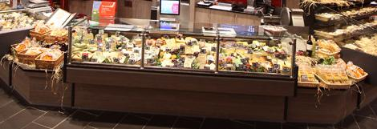
Fresh or Packed ? – Impact on Food Waste
Packaged portions of 150g of sliced cheese reduce food waste from 5% to 0.14%
….And an overall carbon footprint of 40g CO2 eq per portion
Gram CO2 per 150g of cheese
Net benefit of cheese sold packed vs sliced cheese sold at counter
Sliced cheese sold at counter
Sliced cheese sold packed
Packaging – Part of the solution to reducing Food Waste
Data source: Denkstatt 2014 Austrian Retailer Study

Slide 26
Fresh or Packed ? – Impact on Food Waste
“Over 30% of fresh food becomes waste while only 10% of packed food ends up as waste”
(Dr Nehring, Chairman of the German association of fruit, vegetable and potato producers (2013))
But!
Sealed Air 2014 research (US) shows that 89% of shoppers think packaging waste is more harmful to the environment than food waste

Slide 27
The Food Waste – Packaging Paradox
Consumer perception:
We do not want (more) packaging.
We need to reduce Climate Change impacts.
Wasting food is bad….but I don‘t waste that much!
30%
10%
CO_{2 eq}
Over 30% of an EU consumers annual carbon footprint is due to the production and consumption of food and drink* and 1/3 of that is wasted = 10%
* European commission 2006
Notes:
Solutions?
We need the consumers (w.r.t. their behaviour and perception of packaging‘s role).
Consumers are emotionally touched by Climate Change.
Opportunity to get consumers more involved when correlation of food waste, climate change reduction potential and ‚better‘ packaging would become more transparent?
This is why ‚Save Food Initiative‘ is so valuable!

Slide 28
The Food Waste – Packaging Paradox
Engaging consumers emotionally to change their habits:
Our packaging communication messages:
We need to reduce Climate Change impacts.
That their wasted food has a significant environmental impact.
Packaging is part of the solution to reducing food waste!
30%
10%
CO_{2 eq}
This is why SAVE FOOD is so valuable!
Notes:
Solutions?
We need the consumers (w.r.t. their behaviour and perception of packaging‘s role).
Consumers are emotionally touched by Climate Change.
Opportunity to get consumers more involved when correlation of food waste, climate change reduction potential and ‚better‘ packaging would become more transparent?
This is why ‚Save Food Initiative‘ is so valuable!

Slide 29
Packaging saves more resources than it consumes hereby PREVENTING waste
Carbon Footprint (GWP) - The Packaging as Percentage of Total
EAFA/FPE LCA’s
qualified as best
practice (Nov. 2013)
Packaging - Part of the Solution to Reducing Food Waste

Slide 30
Beating the Packaging Paradox
Increasing
Environmental
Impact
High
Risk
Region
Risk of product loss
Low Risk Region
Perfect
Fit
Minimum Environmental Impact
(Product & Pack)
Underpacking
Overpacking
Increasing Packaging Material
Weight or Volume
Optimum
Message: A small over-packaging (~10%) could have much less impact than “under-packaging” and causing 1% product loss!

Slide 31
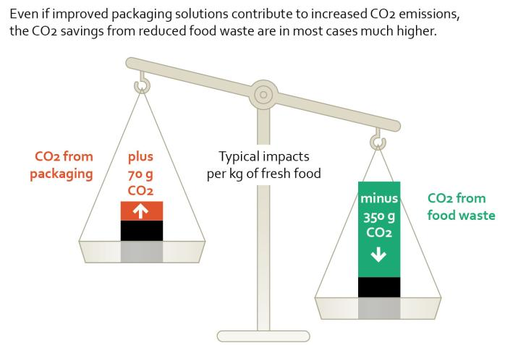
Carbon Footprint of Packaging and Food
Source: Denkstatt/ARA 2014 Study: “How Packaging Contributes to Food Waste Prevention”

Slide 32
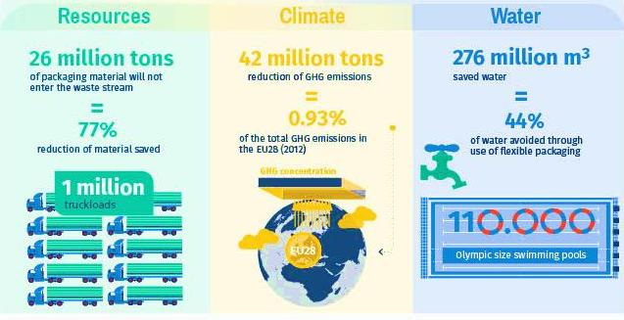
Prevention = Resource Efficiency Scale of the opportunity
Scientific Study (ifeu 2014): More usage of flexible packaging for food– due to its resource efficient use of materials (even with zero recycling) – may annually save up to:

Slide 33
Content
Mega Trends
The Food Waste Problem
The Save Food Initiative (SFI)
The Role of Packaging
Food Waste Reduction by Packaging Optimization
Commitment of EAFA and FPE to Contribute to Food Waste Reduction as Member of

Slide 34
Reducing Food Waste – Prevention
MILK
Just 1.5g of alufoil in a beverage carton (28g) enable 1 litre of milk to be transported and stored for several months without refrigeration
Packaging – Part of the solution to reducing Food Waste
Photo: International Aluminium Institute (IAI)

Slide 35
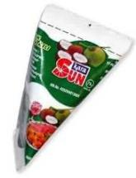
Right size and affordability
Country: Indonesia
Product: Coconut UHT cream
Size: 65ml and 200ml
Issue addressed:
Convenience and the right size for one-shot consumption
Provide quality coconut cream to consumers in cities.
Source: Tetra Pak

Slide 36
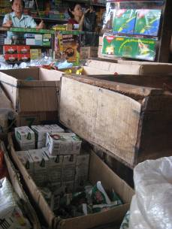
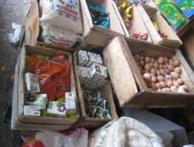
Distribution
Available where DiP* consumers shop
Mainly traditional outlets (wet market; shops)
Selected modern trade
* Deeper In the Pyramid
Source: Tetra Pak

Slide 37
Optimal Portioning/Dosing to Reduce Waste
Easy & Controlled pouring for olive oil and vinegars reduces overdosing and prevents “dripping & dribbling” after pouring.
Packaging – Part of the solution to reducing Food Waste
Pictures courtesy of Guala Closures

Slide 38
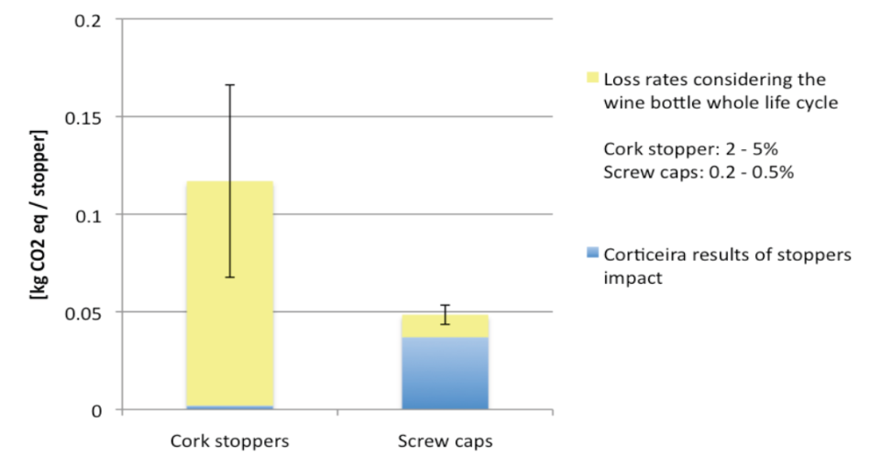
Reducing Food Waste - Prevention
Wine
Packaging – Part of the solution to reducing Food Waste

Slide 39
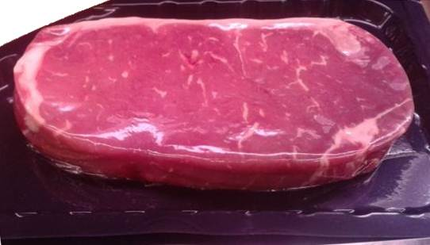
Example – Sirloin steak
Darfresh skin packaging extends the shelf life from 6 to 16 days;
enables steaks to be cut and aged in pack, eliminating separate packaging for aging; reduction of food waste by 16 percentage points
Total waste (product and packaging) reduced by 50 %
Photo: denkstatt
Source: Denkstatt/ARA 2014 Study: “How Packaging Contributes to Food Waste Prevention”
Notes:
1a: previous packaging
20 g PE/EVA+PE/PVdC/EVA+PE vacuum-bag (for 6 kg meat) = aging packaging
11 g EPS tray and 4 g EVOH/PE/PA film – final packaging (absorbent pad not considered)
358 g of packed food (scaled down to 330 g)
Food waste: 34 %
1b: improved packaging (shelf life of 16 days instead of 6 days; no separate aging packaging needed)
19 g PS/EVA/PE based “Darfresh” skin packaging (absorbent pad not considered); aging takes place in final packaging
300 g of packed food (scaled up to 330 g)
Food waste: 18 %
Data provided by REWE, Sealed Air, OFI, Köhrer
Summary Sirloin steak
Total waste (product and packaging) reduced by 50 %
The high environmental impact of top quality beef results in high environmental benefit of reduced food waste
The differences concerning production and recovery of packaging are comparably small
As a general rule: the more valuable / expensive the product, the more important is a robust protection of the product by high quality packaging

Slide 40
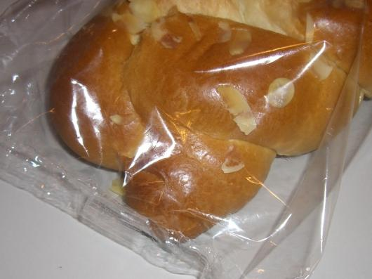
Example – plaited yeast bun
PP film bag instead of paper bag – less dehydration 0,8 % food waste instead of 11 %
Photo: denkstatt
Source: Denkstatt/ARA 2014 Study: “How Packaging Contributes to Food Waste Prevention”
Notes:
3a: previous packaging
11.5 g paper bag with PP viewing stripe
400 g plaited yeast bun
Food waste: 11 %
3b: improved packaging (less dehydration)
3.5 g OPP film
400 g plaited yeast bun
Food waste: 0,8 %
Date provided by MPREIS
Results Summary
Optimization of packaging: - 12 g CO₂e
Reduced food waste: - 136 g CO₂e
Significant reduction of both, the amount of packaging and the amount of food waste
Both effects reduce greenhouse gas emissions in total life-cycle
Substituting paper by plastic packaging has advantages in this example, even if (slightly) higher emissions occur within waste management

Slide 41
Example – garden cress
Additional breathable PP film (protection against being touched by customers, improving humidity and temperature for the cress) 3.4 % food waste instead of 42 %
Photo: denkstatt
Source: Denkstatt/ARA 2014 Study: “How Packaging Contributes to Food Waste Prevention”
Notes:
4a: previous packaging
75 g PS tray
100 g salad cress and hemp substratum (25 g cress harvested)
Food waste: 42 %
4b: improved packaging (protection against contact by the customer, optimum air moisture for the cress)
75 g PS tray, 10 g breathable PP film
100 g salad cress and hemp substratum (25 g cress harvested)
Food waste: 3,4 %
Data provided by EMO Eigenmarken GmbH / Pfeiffer-Handelsgruppe
Results summary:
Optimization of packaging: - 121 g CO₂e
Reduced food waste: - 65 g CO₂e
Less amount of packaging per unit of consumed food (although the amount of packaging per unit of packed food increases)
By applying an additional film packaging, food waste could be reduced by more than 90%
Both effects reduce greenhouse gas emissions in total life-cycle

Slide 42
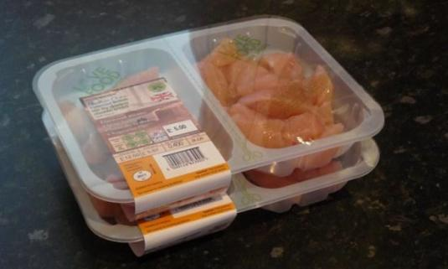
Example – chicken meat
On average 14 % of chicken meat is wasted by
consumers. A tray with two segregated cavities contributes to reducing food waste. Waste reduction by only 0.5 % percentage points is enough to compensate the impacts of additional packaging.
Picture from WRAP report 2011
Source: Denkstatt/ARA 2014 Study: “How Packaging Contributes to Food Waste Prevention”
Notes:
This example refers to benefits on the consumer level (example 1 to 5 focused on waste at retail level)
Unfortunately no quantitative data for the possible improvements are available
The initial value of 14% food waste has been estimated by DEFRA (UK) based on statistics about sales and waste amounts from consumers
Segregated cavities reduce the probability of wasted meat, if not all meat is immediately cooked and eaten when packaging is opened
6a: previous packaging
20.6 g PP tray and film
350 g chicken meta
Food waste: 14 %
6b: improved packaging (tray with two segregated cavities)
24 g PP tray and film
350 g chicken meat in 2 segregated cavities
Assumed food waste: 9 % (reduction by 5 percentage points)
Data source “Packaging design to reduce household meat waste” (WRAP, 2011)
Results Summary
Improved packaging: + 7.6 g CO₂e
Reduction of food waste - 108 g CO₂e
Impact benefit ratio = 1 : 14
Break-even point: reduction > 0.5 percentage points,
for example 13.5 % food waste instead of 14.0 %
The additional packaging amount (16 % due to segregation into 2 cavities) is already compensated if food waste is reduced by only 0,5 percentage points.
In case of the assumed reduction of food waste from 14 % to 9 % the resulting CO₂-benefit is 14 times higher than the CO₂-emissions caused by the packaging amount additionally used.
As a general rule: the more valuable / expensive the product, the more important is a robust protection of the product by high quality packaging

Slide 43
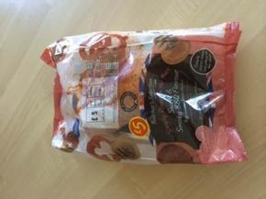
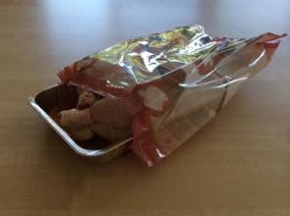
Leftovers - Solutions to Reduce Food
The whole chicken is in an aluminium tray and a printed roasting bag.
The consumer cuts the corner off the bag and places the whole item into the oven for cooking.
The printed ovenable bag, contains cooking instructions but most importantly a recipe for the consumers for the ‘left-overs,’
Advantages:
1) Ease of production handling
2) High visual appearance on shelf
3) Reduced on shelf contamination by using a bag as opposed to an overwrap (saves wastage and disposal of leaking overwrapped packs)
4) No washing of poultry by the household which is highly beneficial for germ/bacteria control and energy efficient
5) Ease of consumer use. Place whole product including the bag in the oven
6) Finally, recipe suggestions for using the ‘left-overs reducing the food waste further.
Source and pictures courtesy Contital/i2r

Slide 44
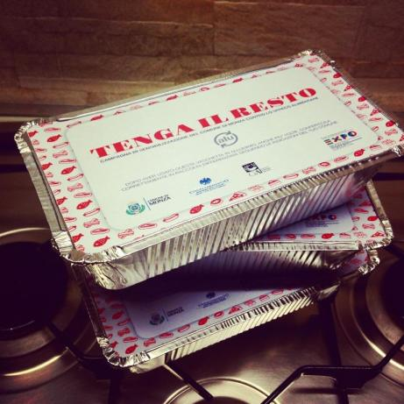
Leftovers - Solutions to Reduce Food
CiAl, the Italian Aluminium Association has developed a campaign “tenga il resto” (Keep the rest) to reduce the uneaten food waste from restaurants in the cities of Monza (Lombardie) and in Arezzo (Tuscany) https://www.google.it/?gws_rd=ssl#q=%22tenga+il+resto%22
“One hundred thousand aluminum containers distributed in 26 restaurants in the city (Monza), to bring home meals not completely consumed.”

Slide 45
Content
Mega Trends
The Food Waste Problem
The Save Food Initiative (SFI)
The Role of Packaging
Food Waste Reduction by Packaging Optimization
Commitment of EAFA and FPE to Contribute to Food Waste Reduction as Member of

Slide 46
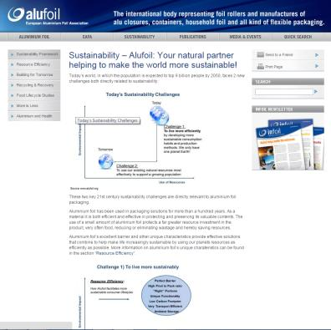
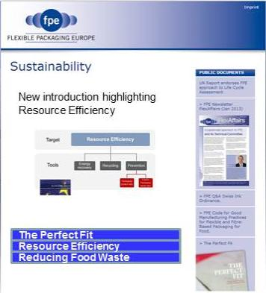
Reducing Food Waste – Our Studies
www.alufoil.org/sustainability
www.flexpack-europe.org

Slide 47
Reducing Food Waste – Our Videos
Alufoil - “More is Less”
http://www.alufoil.org/thought-leadership-paper-more-is-less.html
Flexible Packaging - “The Perfect Fit”
http://www.flexpack-europe.org/the-perfect-fit.html

Slide 48
Our Commitment
Save Food member
Active communicator globally on food waste reduction
The only association supporting the Save Food Mango Project
Thank you !
stefan.glimm@alufoil.org
glimm@flexpack-europe.org

