Slide 1


Bisphenole A (BPA) – a model substance to handle chemicals in FCM?
OFI - Austrian Research Institute for Chem. and Tech.
www.ofi.at
Notes:
Huge topic

Slide 2
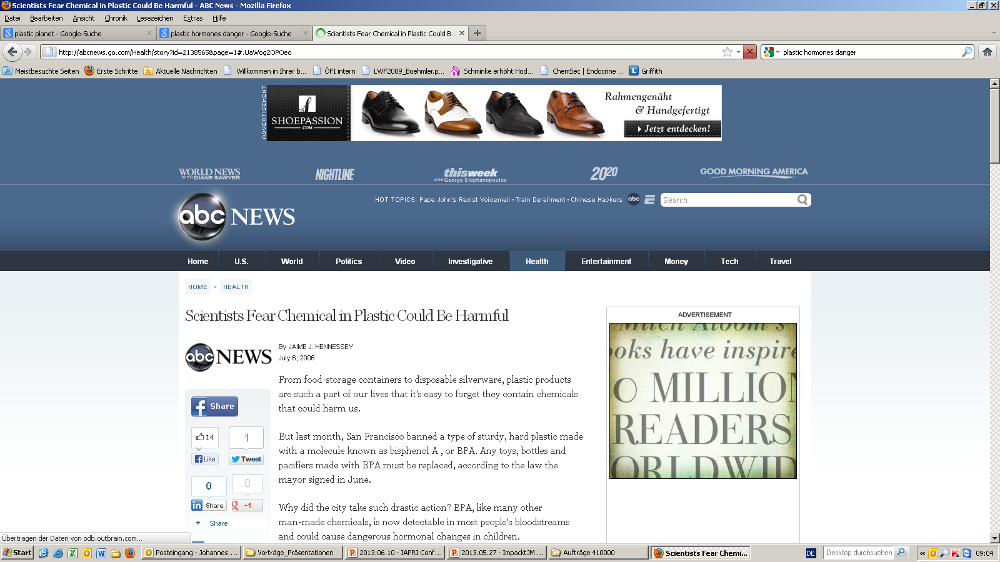

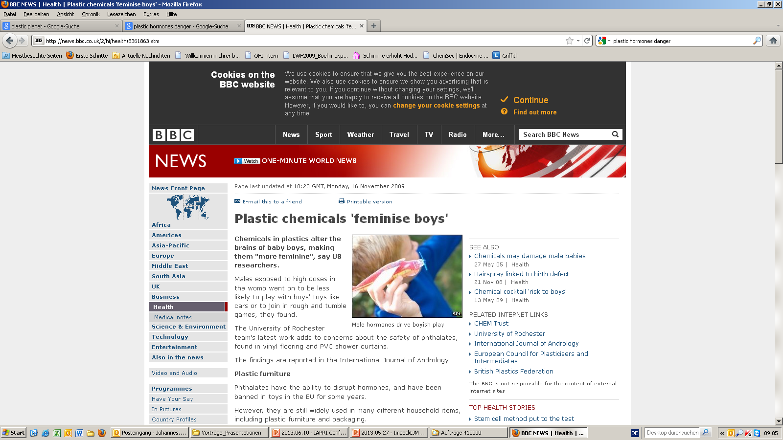
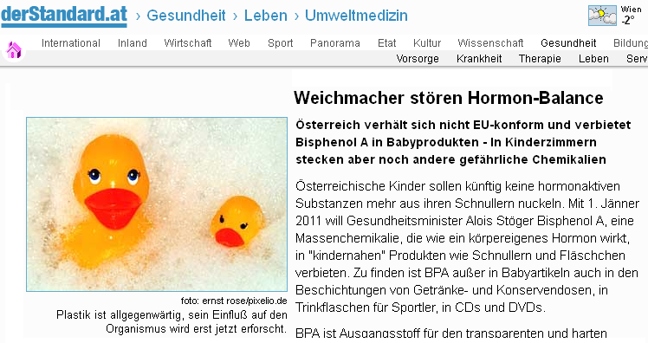
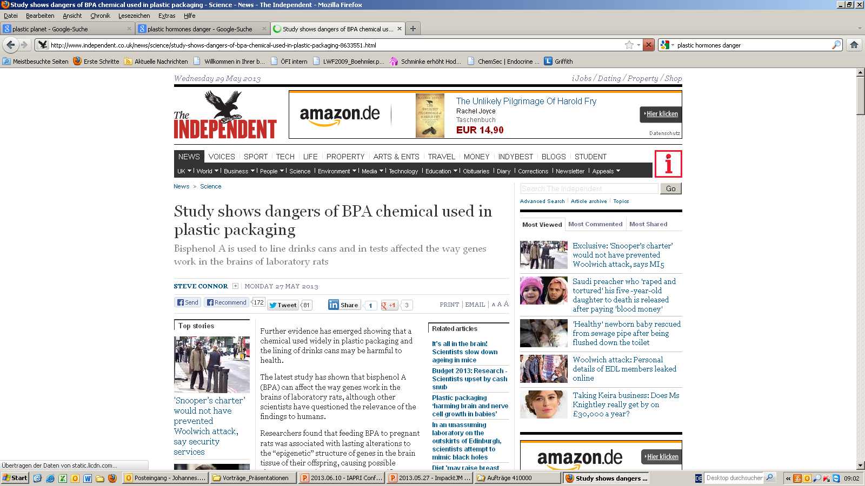
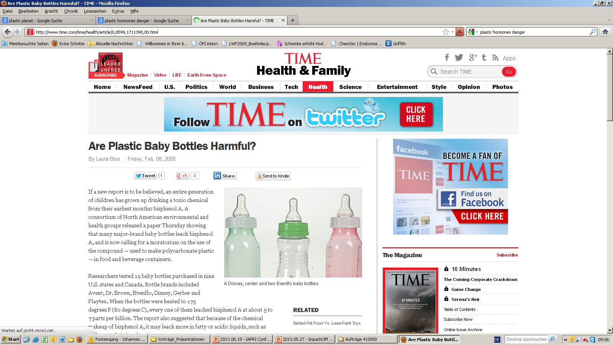
Media Headlines

Slide 3

Consumers are concerned…
3
/20

Slide 4
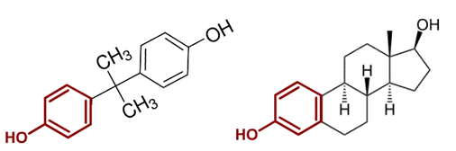
Structural Similarities
Bisphenol A
(Monomer of polycarbonate)
Estrogen (17β-Estradiol)
(Natural female sex hormone)
4
/20

Slide 5
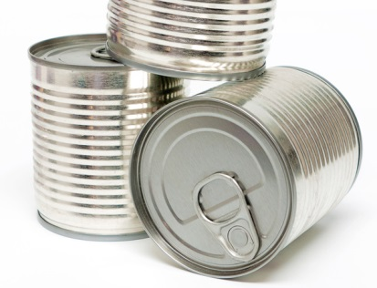
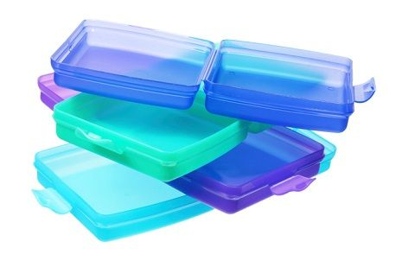
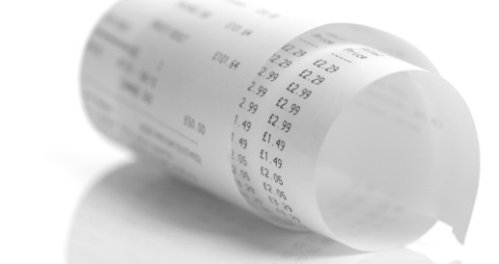
Fields of application of Bisphenol A
Food Contact Materials
Packaging material Polycarbonate PC
Inner coated in metal cans
Coated closures for jars
PVC: sometimes as additive in plasticisers; stabilisation of PVC
Other products
E.g. thermo-graphic paper (thermo-inks); widely use receipts at cash desks
5
/20

Slide 6
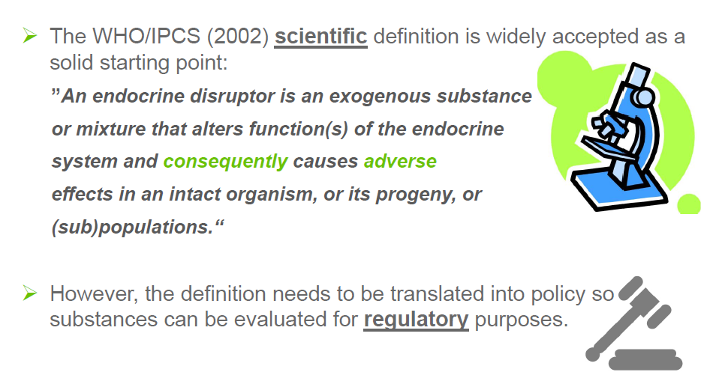
Endocrine Disruptor - Definition
6
/20

Slide 7

Regulations on European Level
Endocrine Disruptors
Use of ED is regulated in different guidelines:
  Biocidal products regulation (528/2012)
  Plant protection products regulation (1107/2009)
  REACH: SVHC (1907/2006)
  No specific regulation for FCM
7
/20

Slide 8

Outlook EU level
How Endocrine Disruptors are defined?
Up to now NO legal criteria in EU, if and when a chemical substance is categorized as endocrine disruptor!
All drafts up to now rejected at industry's urging
Argumentation:
  Impact-Assessment necessary:
    Are there sufficient replacements?
    Crop failures, contamination with aflatoxins,…
8
/20

Slide 9
New plan for fixing the criteria for ED
9
/20
„Public consultation“: until 16.01.2015
Evaluation of Inputs, Impact-Assessment
Set up of criteria by DG SANTE
(not earlier then end of 2016)

Slide 10

New plan for fixing the criteria for ED
SWEDEN:
Claim against European Commission launched, because of delaying the criteria for ED
Court of Justice of the European Union (CJEU) entitles Sweden to be right: EC should have fixed criteria for ED by end of 2013!
→ Maybe we will see a quicker decision!
10
/20

Slide 11
BPA – New limits for FCM?
01/2015: EFSA risk assessment of BPA
  Reduction of TDI by factor 12,5
    Old TDI: 50 µg/d/kg BW
    New TDI: 4 µg/d/kg BW
  But: SML (0,6 mg/kg food)
  until now unchanged
Temporarily
(as long as evaluation of hormonal effects is not closed completely)
It would be logic to reduce the limit to 0,24 mg/kg food
(because limit of 0,6 mg/kg was based upon a TDI of 10 µg/d/kg BW)
11
/20

Slide 12
BPA – Roadmap by DG SANTE
  „Public consultation“, 5 options:
    Option 1: no change
    Option 2: Adoption of SML
    Option 3: Adoption of SML and set up of guidelines for coatings in metal cans
    Option 4: Adoption of SML and set up of guidelines for FCM
    Option 5: total and complete ban of BPA for all food contact materials (FCM)
But this SML applies only to plastics!
New: Draft of EC!
Guideline for other Bisphenols under discussion, but no concrete plans so far
12
/20

Slide 13

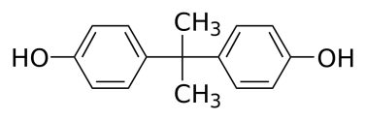
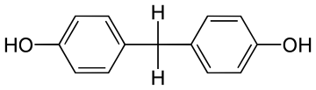
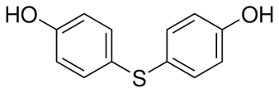
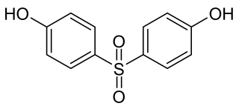
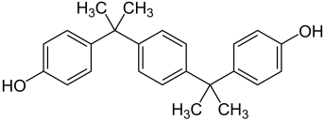
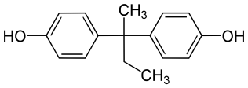
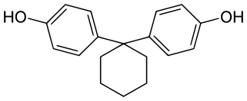
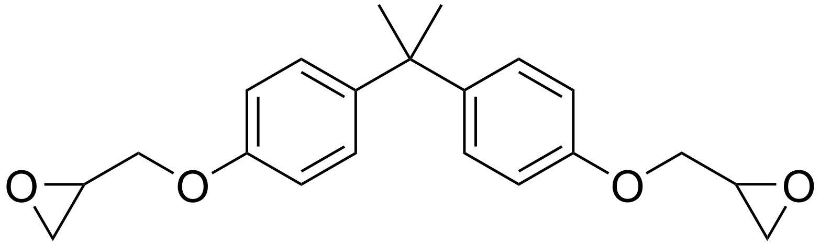
Bisphenol A replacement – estrogen activities in-vitro
13
/20

Slide 14
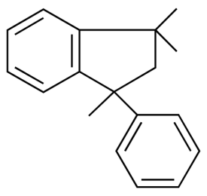
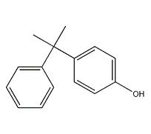
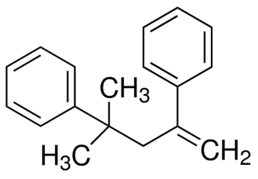
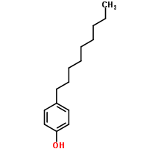
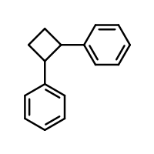
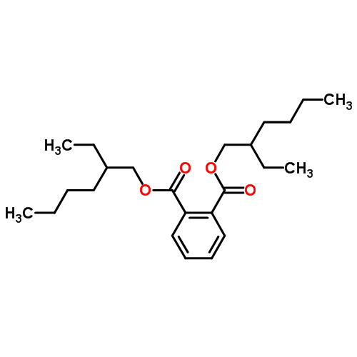
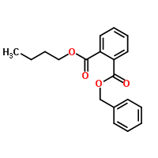
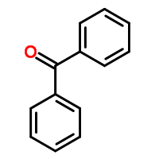
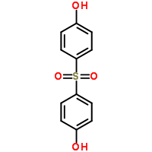
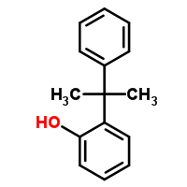
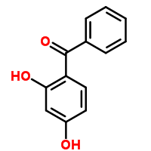
Hormone active substances in plastics
Other possible sources
Additives (e.g. plasticizers, UV-blockers)
By-Products of the polymerization process (e.g. styrene dimers)
Monomers (e.g. Bisphenol A, Bisphenol S,…)
Printing color components (e.g. photo initiators)
Contaminants
….
14
/20

Slide 15
Hormone active substances in plastics
Bisphenol F
Bisphenol A
Other possible sources
Additives (e.g. plasticizers, UV-blockers)
By-Products of the polymerization process (e.g. styrene dimers)
Monomers (e.g. Bisphenol A, Bisphenol S,…)
Printing color components (e.g. photo initiators)
Contaminants
….
Nonylphenol
Phthalate
Bisphenol S
15
/20

Slide 16
Hormone active substances in plastics
Other possible sources
Additives (e.g. plasticizers, UV-blockers)
By-Products of the polymerization process (e.g. styrene dimers)
Monomers (e.g. Bisphenol A, Bisphenol S,…)
Printing color components (e.g. photo initiators)
Contaminants
….
Some new estrogen active substances identified by OFI.
Probably many hormone active substances still unknown!
16
/20

Slide 17
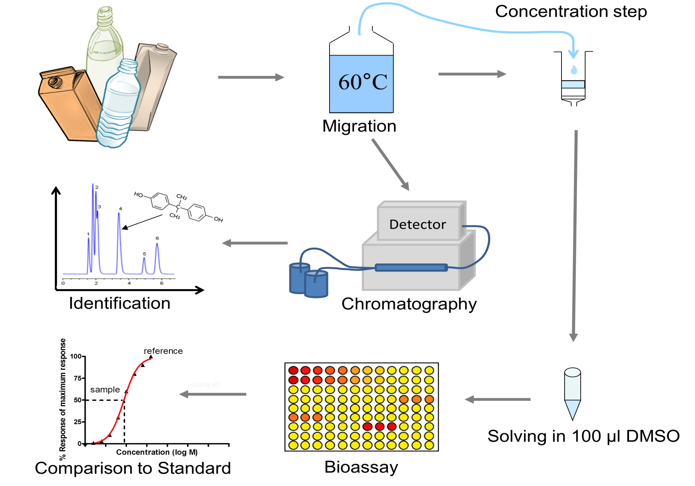
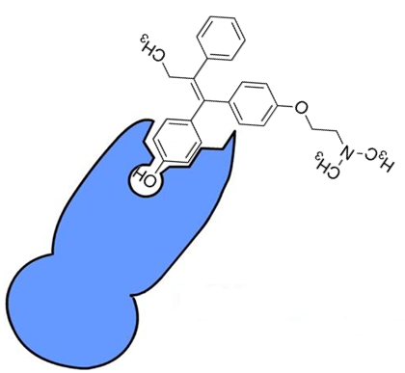
Scheme of analysis
In-vitro Test on hormone active substances: All substances that bind to the hormone receptors can be detected.
This includes unknown hormone active substances
17
/20
Notes:
Retailer. European regulations

Slide 18
Screening of samples
More than 300 different samples of food contact materials
(bottles, cups, microwave packaging, caps, granulates, films, food cartons,…)
  Samples included various materials:
    Composite films
    Polystyrene
    Polyolefins
    Polycarbonate
    Food cartons
    Paper board
    Coated metal cans
18
/20
Notes:
For more than 3 years we are working now in a project cooperation with industry, polymer, food retailers, packgage producers
No activity in PET samples
Big advantage, we can analyze directly empty packages, never been in contact with food before. We will later see many food products are hormone ac

Slide 19

Summary of our screening of food packaging
Majority of food packaging is not hormone active (> 80 %)
  About 15% of tested packaging materials:
    Estrogen active (activity like females sex hormone)
    But: Activity of most samples low compared to
    natural hormones/phyto-hormones in food
  BPA: not the main source of estrogen activity
    Estrogen activities in polycarbonate lower than in many other food contact materials
19
/20
Notes:
binding agent used to glue the components together
From our point of view

Slide 20
Contact: Johannes Bergmair
t: +43 1 7981601 976
johannes.bergmair@ofi.at
www.ofi.at
www.ofi.at

