Slide 1
Food Losses and Food Waste:
The role of packaging
Dr. Johannes Bergmair

Slide 2
Current Situation
Food Wastage Footprint (FAO)
https://www.youtube.com/watch?v=IoCVrkcaH6Q
https://www.youtube.com/watch?v=Md3ddmtja6s
http://www.fao.org/food-loss-and-food-waste/en/
http://www.iufost.org/iufostftp/FLW-%20FAO.pdf
Packaging
http://www.worldpackaging.org
Food Security & Food Safety
http://www.nature.com/scitable/knowledge/library/food-safety-and-food-security-68168348
http://www.who.int/foodsafety/areas_work/en/
Challenges
https://www.youtube.com/watch?v=raSHAqV8K9c
2
/29

Slide 3
Food Losses and Food Waste
1/3 of the food produced for human consumption is either lost or wasted globally along the food supply chain
Despite sufficient world production: One in seven people are starving!
Environmental impact: CO₂, water, land area, biodiversity
Economic loss and costs to society
Population growth: 2050 – 9 billion people (need to raise the food production by 60 %)
Get Active – Save Food!
Source: http://www.fao.org/food-loss-and-food-waste/en/
3
/29

Slide 4
Stop Food Wastage: Hierarchy
Source: http://www.iufost.org/iufostftp/FLW-%20FAO.pdf
4
/29

Slide 5
Food Wastage
Less developed countries
Food tends to be lost at pre-harvest, harvest and initial handling phase
With increasing development
Waste tends to move up the distribution chain to retail and consumption level
Here food is more likely thrown away when still edible
5
Source: http://www.chep.com/resources/case_studies/how_packaging_can_reduce_food_waste/
/29

Slide 6
Causes: Packaging
Harvest and initial handling phase
Inappropriate choice of containers and packaging materials
Sanitation and hygienic standards of the containers used to pack and transport the products
Processing
Lack of packaging
Distribution and Transport
Rough handling during packaging and (un) loading of transport vehicles
Inappropriate packaging containers or packages
Retail
Inadequate packaging and damage of packages
Large pack sizes which force consumers to purchase more than needed
Marketing strategies, product promotions and bulk discounts
Source: http://www.iufost.org/iufostftp/FLW-%20FAO.pdf

Slide 7
Solutions: Packaging
Solutions at micro-, meso-, and macro-level
Enable the change
Technical solutions:
Appropriate packaging
Appropriate materials
Modern packaging such as active and intelligent packaging
Portion sized packaging
Re-closable packaging
Convenient packaging
Hygienic processing and packaging
Source: http://www.iufost.org/iufostftp/FLW-%20FAO.pdf

Slide 8
Solutions: Packaging
Life Cycle Analysis
Trade-offs between food waste and packaging
“As little as possible, as much as necessary”
Less food waste
More packaging
Source: http://www.chep.com/resources/case_studies/how_packaging_can_reduce_food_waste/

Slide 9
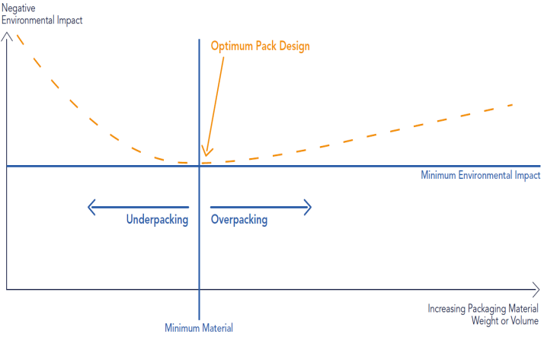
Underpacking as a Danger
= Waste of Food
= Waste of Packaging Material
Notes:
Lars Waste of food and packaging

Slide 10
Save Food
Packaging contains, protects, preserves, promotes, carries information – and reduces costs
“An unwrapped cucumber loses moisture and becomes dull and unsaleable within 3 days. Just 1.5 grams of wrapping keeps it fresh for 14 days.
Selling grapes in trays or bags has reduced in-store waste of grapes by 20%.
In-store wastage of new potatoes reduced from 3% when sold loose to less than 1% after specially designed bags were introduced.“

Slide 11
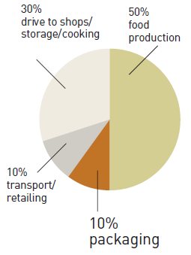
Source: www.incpen.org
“Of the total energy used in the food chain,
50% is used in food production,
10% on transport to the shops and retailing,
10% to make the packaging and the remaining 30% is used by shoppers to drive to the shops and store and cook food.“

Slide 14
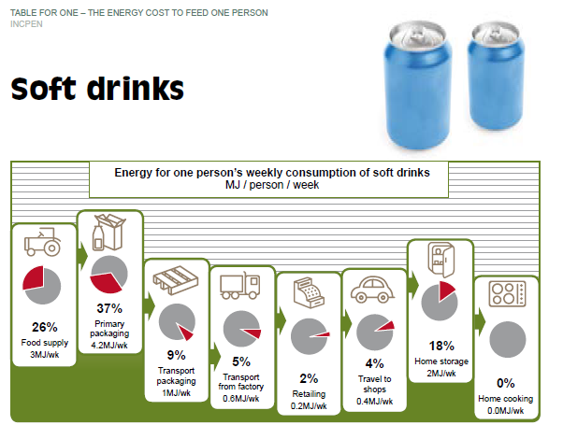

Slide 15
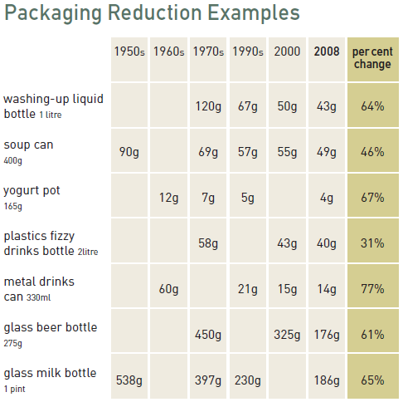
Source: www.incpen.org

Slide 16
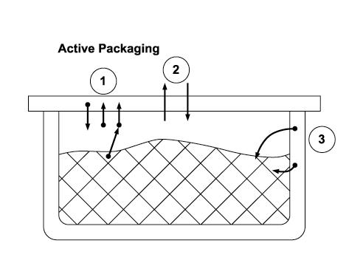
What is active packaging?
1: Active controlling of the composition of the head space atmosphere
2: Active controlling of the packaging permeability
3: Active depositing of qualitykeeping substances and filling

Slide 17
What does active packaging cause?

Slide 18
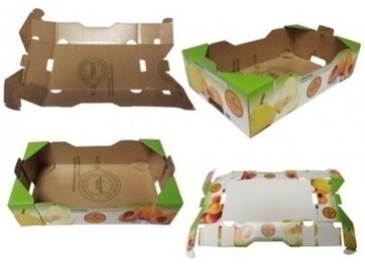
BANDEJA PITUFO
FLEXOGRAFICA DEL MEDITERRANEO, S.L., Spain
Active packaging with antibacterial properties and ethylene absorber delays the ripening of the tomato and results in 30% less product in poor condition in 20 days.

Slide 19
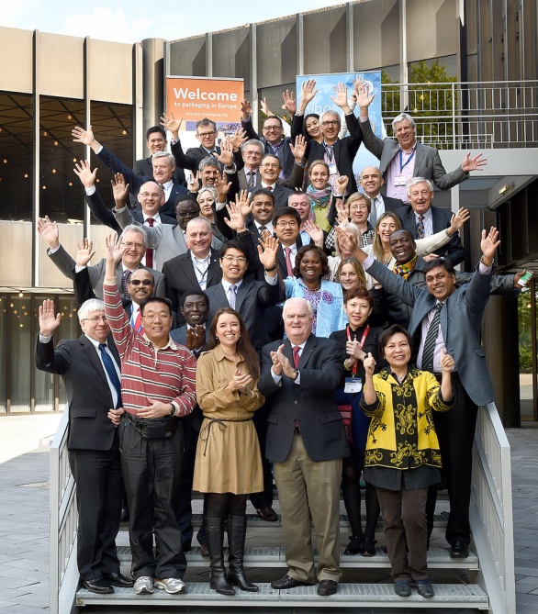
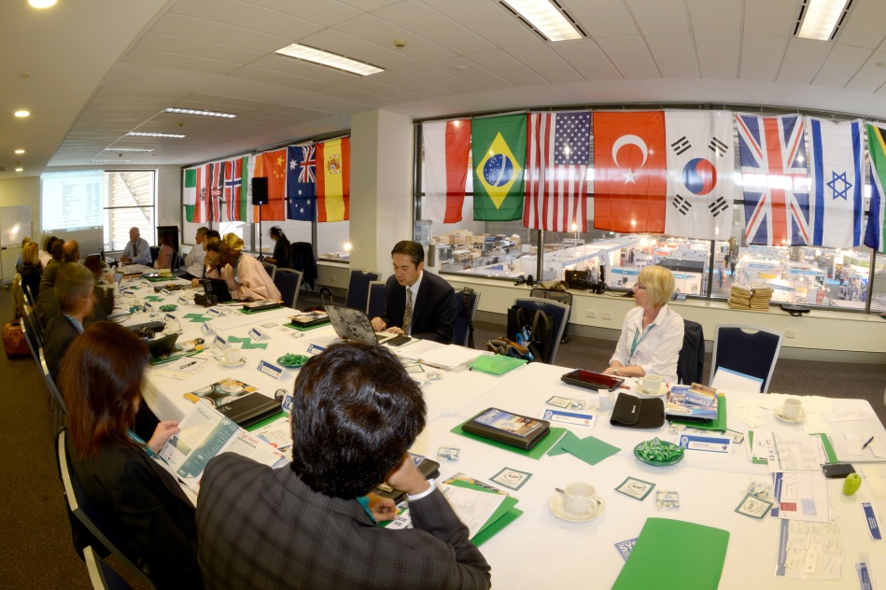
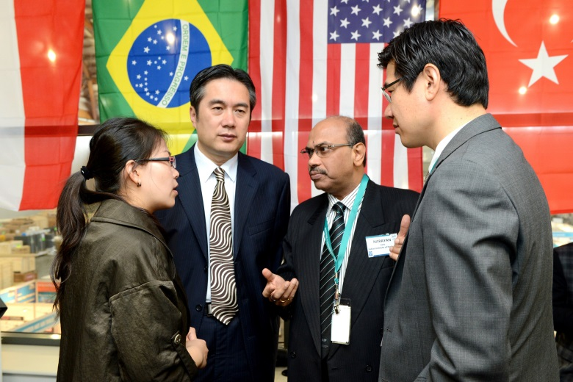
WPO WORLD PACKAGING ORGANISATION
WPO Vision
Better Quality Of Life
Through Better Packaging
For More People

Slide 20
Sustainability
It continues to be true that a significant percentage of food never meets its purpose, that of nourishing the hungry. This is especially true in developing nations, but not exclusive to them. Food wastage is common to all cultures. Better packaging plays a huge role in reducing spoilage and retaining nutrition for those who need it most.
WPO is committed to educating people about the value that packaging adds to Society, not only for food but for beverages, pharmaceuticals, and virtually every product used by consumers and industry alike.

Slide 21
Position Paper
Prevention and Reduction of Food Losses and Food Waste via Appropriate Packaging!
Position Paper available
To be published: handout
Idea: video (2-3 min; like FAO; packaging)

Slide 22
Interpack 2017
Using the appropriate packaging (material) is regarded to be a key element of a set of tech-nologies to reduce food losses and food waste.
Interpack 2017: 2017-05-04 to 2017-05-10
Save Food Pavilion

Slide 23
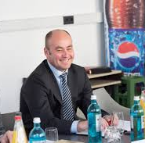
Actions of WPO @ Interpack 2017
Exhibition of national award winners and WorldStar winners, related to “Save Food”
first and exclusive worldwide exhibitions of “packaging that saves food” on Interpack 2017
Bernd Jablonowski Messe Düsseldorf

Slide 25
WorldStar Student Awards

Slide 26
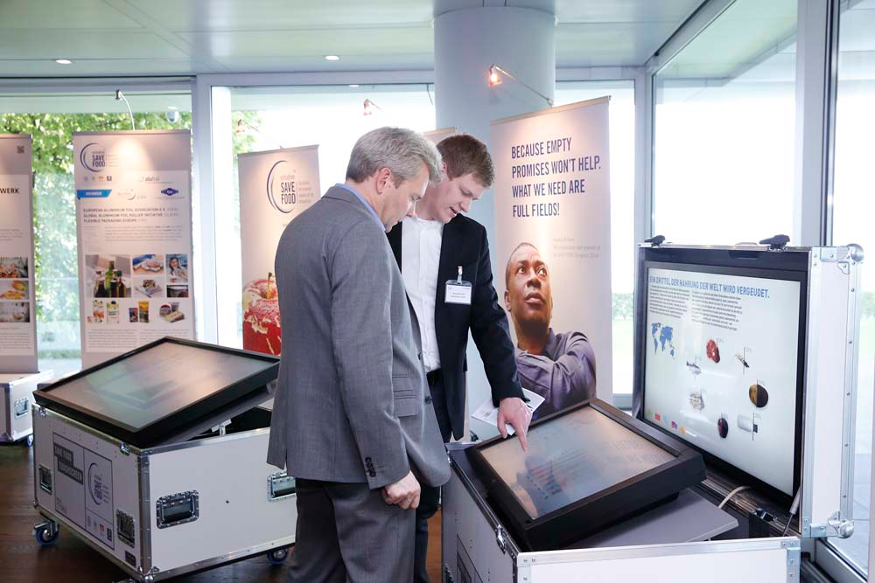

Slide 27
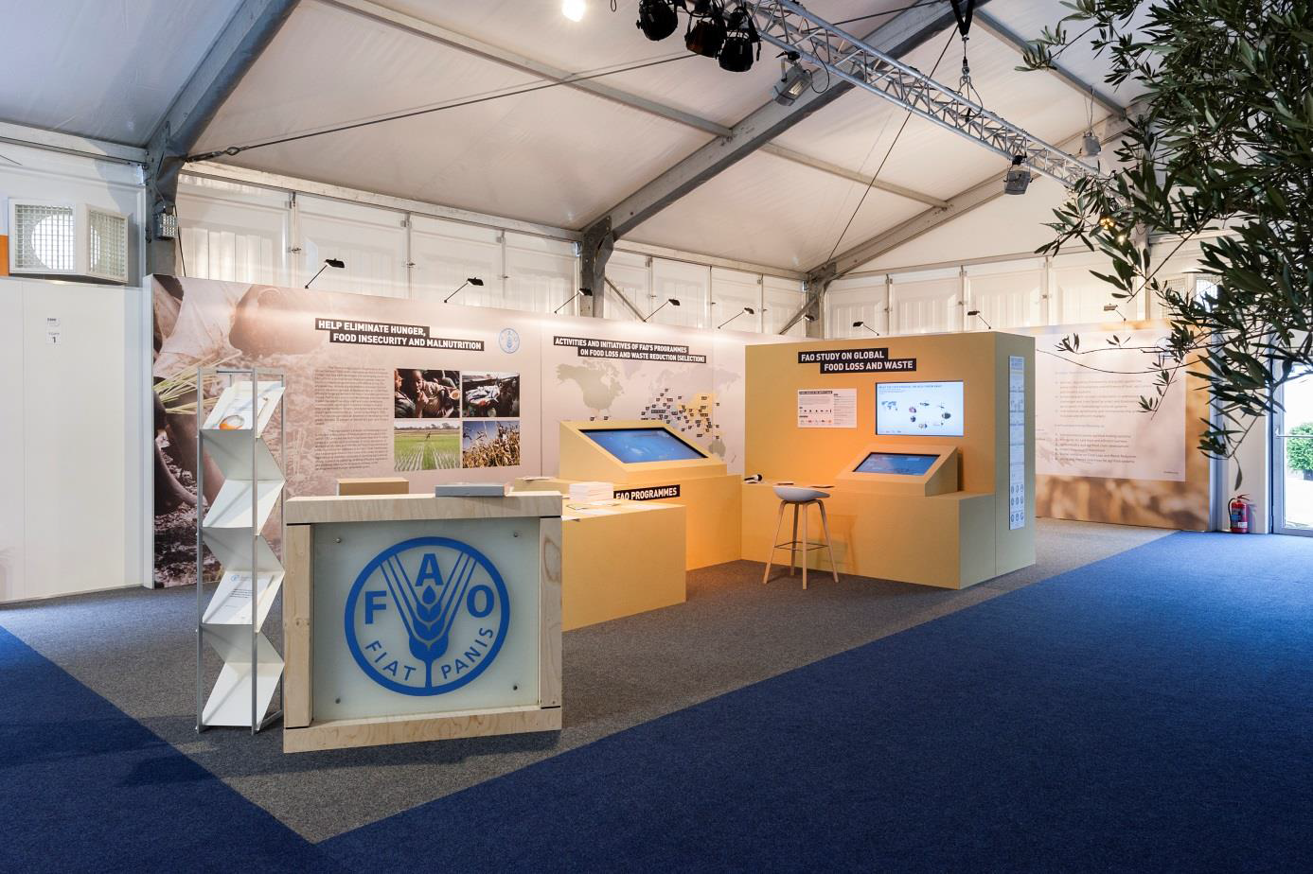
Pavillon 2014

Slide 28
Attending WPO Members
World | WPO
Africa | APO
Argentina | IAE
Australia | AIP
Austria | OFI
Brazil | ABRE
China | CPF
Czech Republic | SYBA
Croatia | Tectus
Germany | dvi
Hungary | CSAOSZ
India? | IIP
Indonesia | APF
Iran
Lebanon + Region | LibanPack
South Africa | IPSA
Spain | Graphispack
The Netherlands? | NVC
UK | IOM 3
USA | IoPP

Slide 29
THANK YOU!
Johannes Bergmair
E-Mail: johannes.bergmair@ofi.at
OFI
Brehmstraße 14a
A-1110 Wien
+43-(0)664 5214778
+43-(0)1-798 16 01 - 480

