Slide 1
Shelf Life of Packaging Materials
Dr. Johannes Bergmair

Slide 2
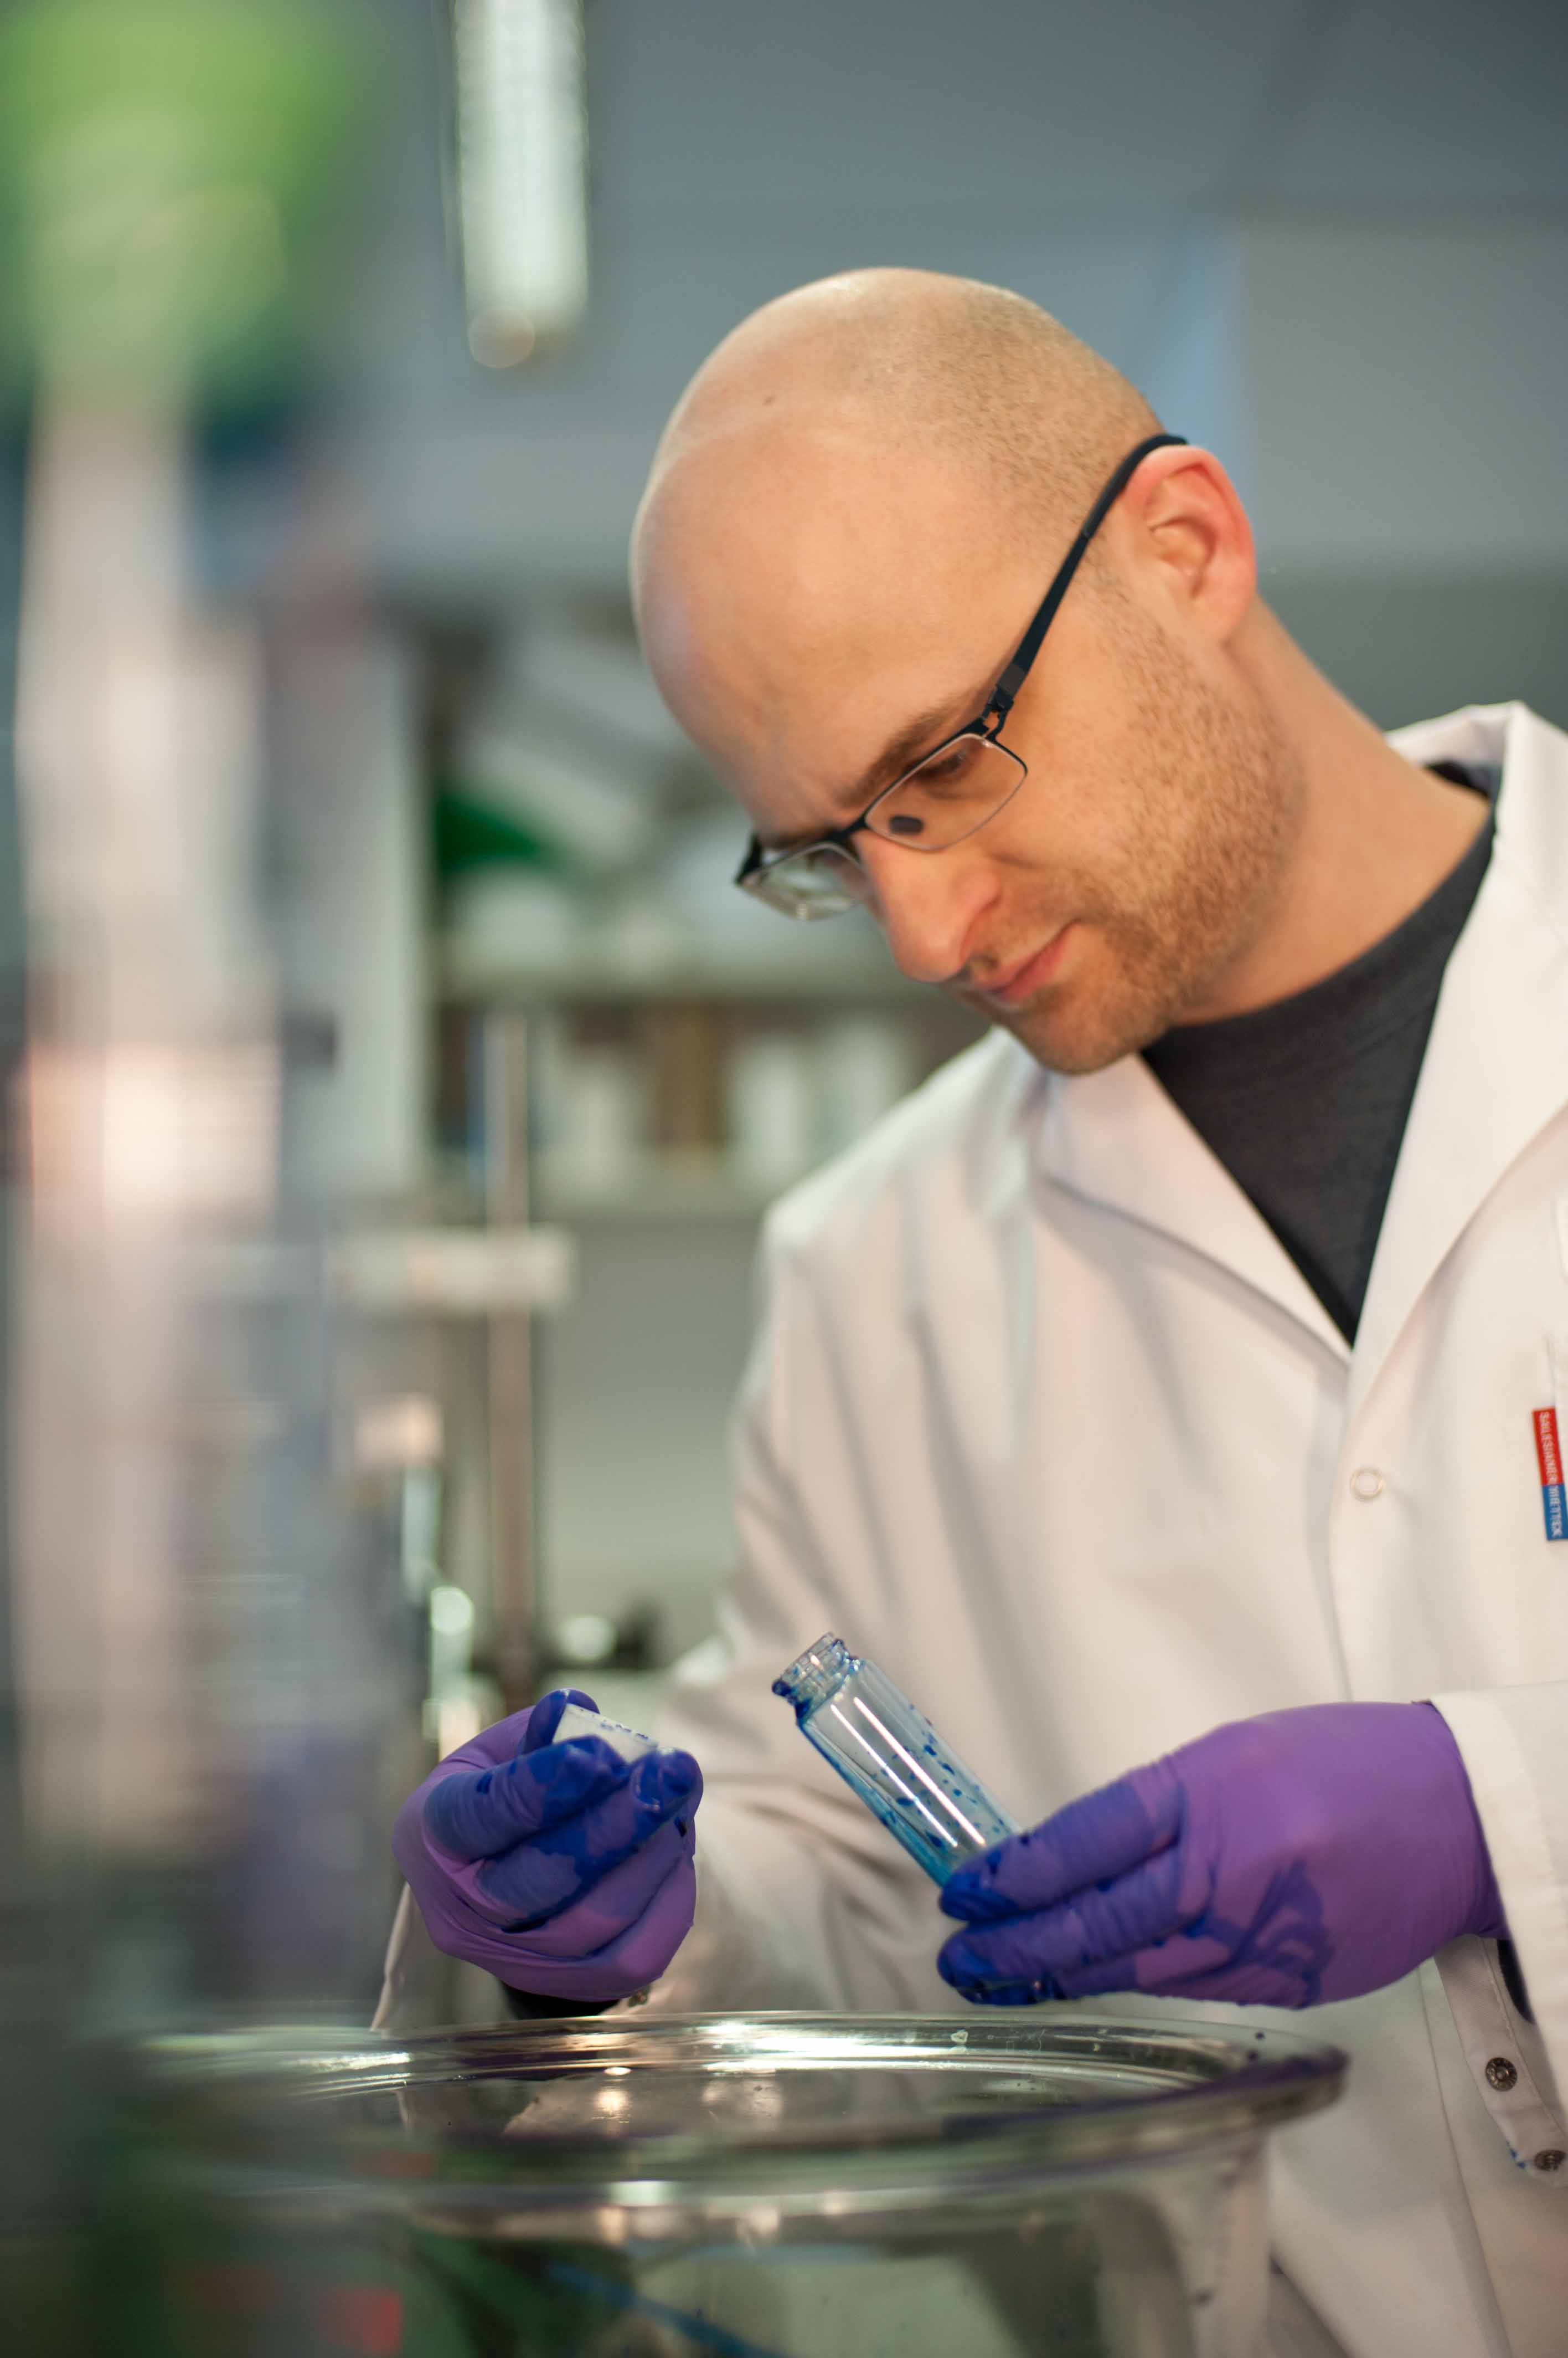
Who we are
OFI – progress in good hands
We are the experts for material applications and building renovation.
We check and confirm the reliability of your materials – whether for use in vehicle construction, in packaging or in the building industry. To make sure your products are fit for the market.
We examine buildings and plan renovation projects. To make sure houses, bridges, roads and memorials are safe and can be used on a lasting basis.
Page 2/23

Slide 3
Basic functions of packaging 1
Containment: depends on the product’s physical form and nature. For example, a hygroscopic free-flowing powder or a viscous and acidic tomato concentrate
Protection: prevention of mechanical damage due to the hazards of distribution
Preservation: prevention or inhibition of chemical changes, biochemical changes and microbiological spoilage
Convenience: for the pack handlers and user(s) throughout the packaging chain
Information about the product: legal requirements, product ingredients, use etc.
Presentation: material type, shape, size, color, merchandising display units etc.
Page 3/23

Slide 4
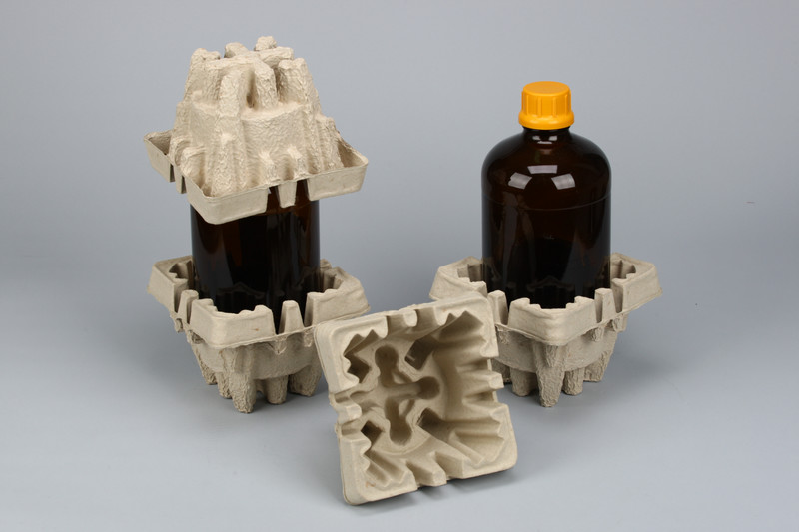
Basic functions of packaging 2
Brand communication: e.g. pack persona by the use of typography, symbols, illustrations, advertising and colour, thereby creating visual impact
Promotion (Selling): free extra product, new product, money off etc.
Economy: for example, efficiency in distribution, production and storage
Environmental responsibility: in manufacture, use, reuse, or recycling and final disposal
Page 4/23

Slide 5
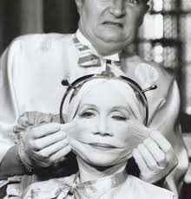
…but also a package has a shelf life
Aging of a material
Is an interaction with the environment
Reasons for aging of packages
Temperature
Light
natural environment (air, humidity, ..)
Chemical environment (oil, surfactants, pollutants)
Biological environment
Page 5/23

Slide 6
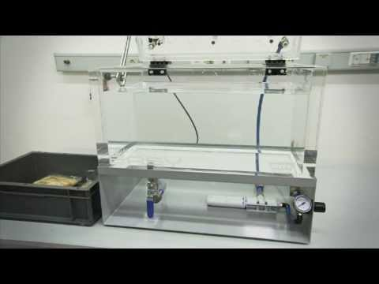
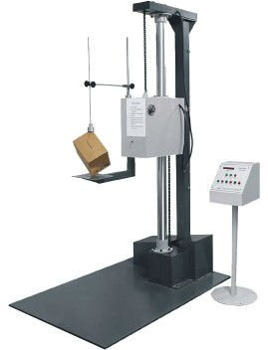
The classical approach in Packaging design
basic needs of the product
Estimation of requirements
Temperature
Mechanical properties
Resistance to media influences
Selection of the right materials
specifications
Experience (similar applications)
Selection based on tests
Page 6/23

Slide 7
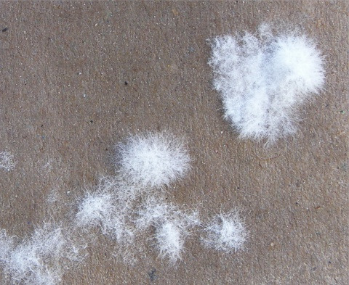
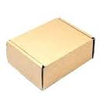
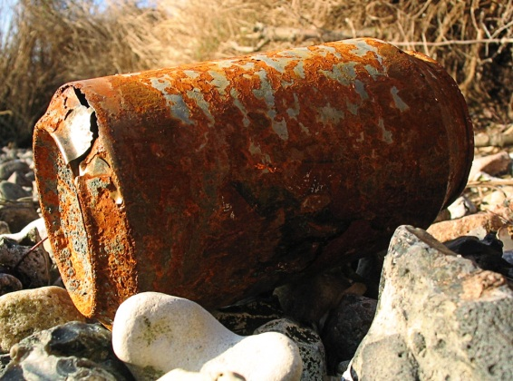
Examples for aging of packages
Paper and cardboard
Spoil (depending on moisture)
Can get damp
Paper can yellow (Determination of hue of near white specimens DIN 55980)
Metals
Can oxidize
Glas
Can get scratches
Loose its sparkle
Page 7/23

Slide 8
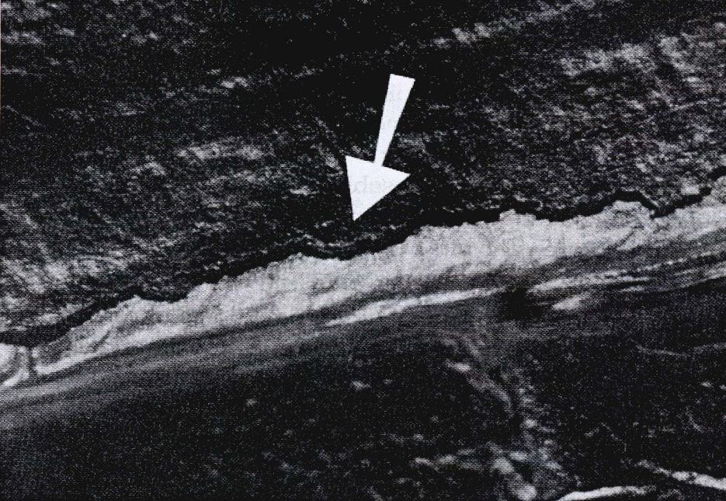
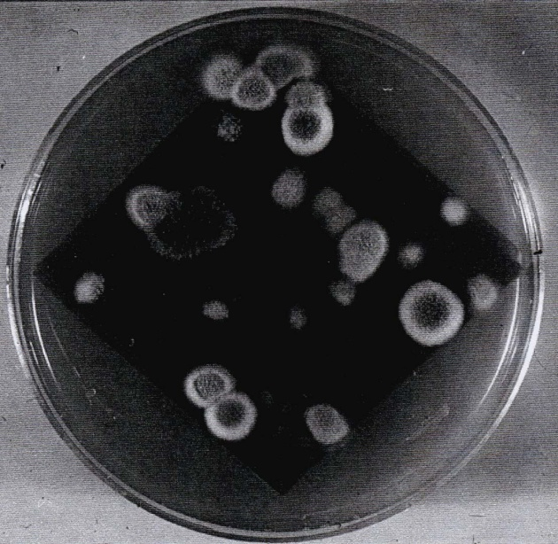
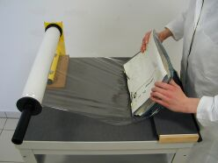
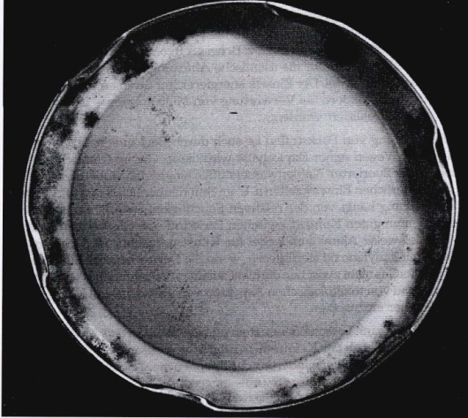
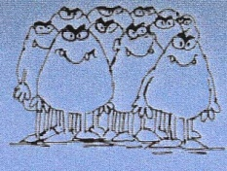
Microbial contamination of packaging materials
Compounds:
Metal closures:
Page 8/23

Slide 9
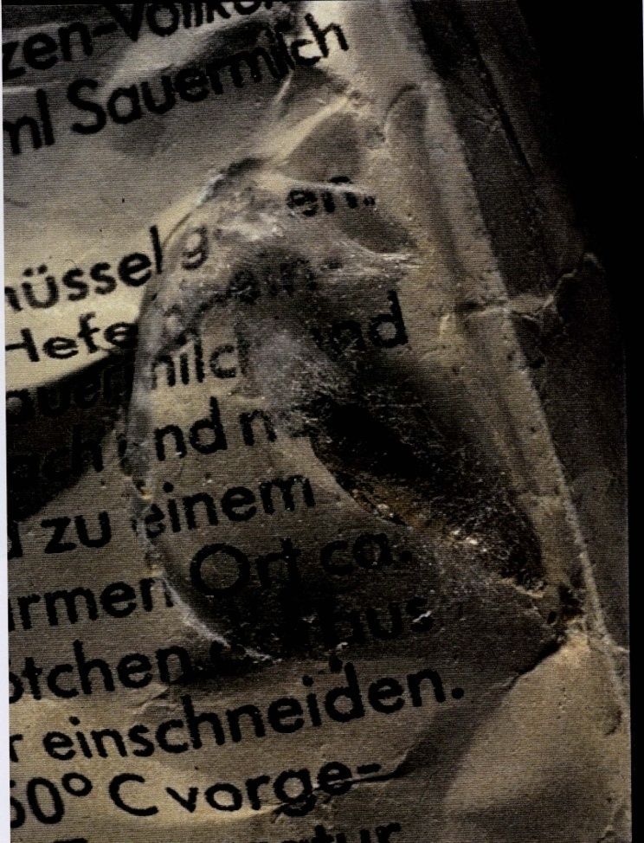
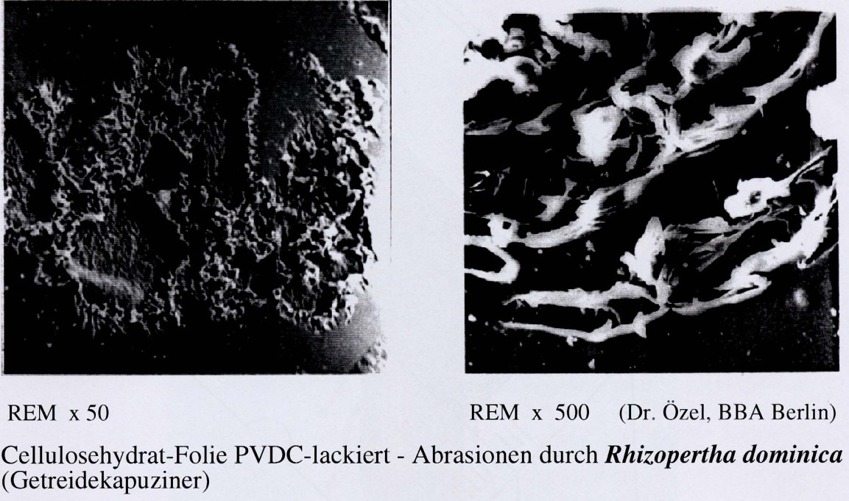
Microbial contamination of packaging materials
Contamination by insects
Page 9/23

Slide 10
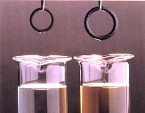
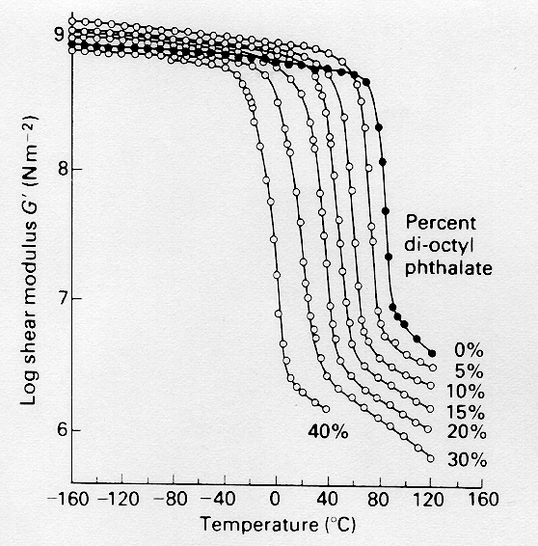
Aging process in polymers
Physical aging process
Swelling
Dissolution
Leaching / extraction /Migration of plasticizers
lead to
embrittlement
volume shrinkage
Page 10/23

Slide 11
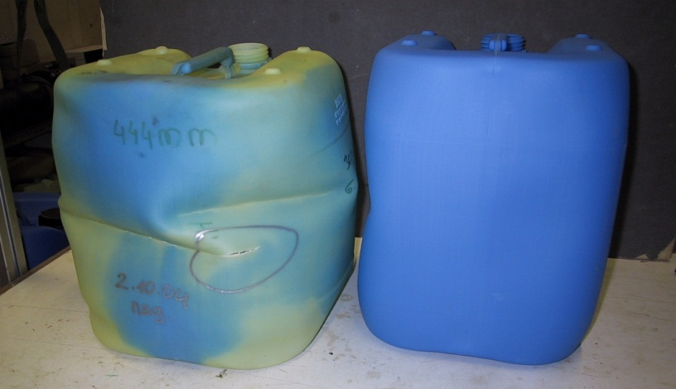
Aging process in polymers
Chemical reaction with the polymer
Irreversible change in properties (Molecular degradation)
Examples:
Hydrolytic degradation of polyesters, polyamides, polyurethanes, POM etc. (acid / base catalysed)
oxidizing of PP by acids
Air oxidation of diene elastomers
Page 11/23

Slide 12
Chemical Resistance: stress corrosion cracking
Cracking under tensile stress
- far below the yield stress of the polymer
occurrence of cracks by Crazes
Crazes = microcavities that are bridged with highly stretched polymer fibrils
Some chemicals promote this Cracks
Page 12/23

Slide 13
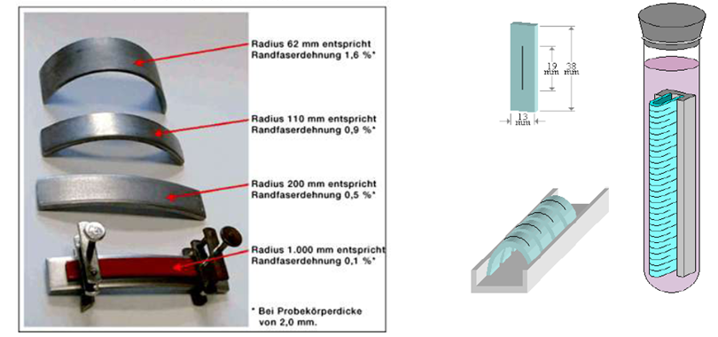
Tests for stress corrosion cracking
ISO 22088-3:2006
Plastics -- Determination of resistance to environmental stress cracking (ESC) -- Part 3: Bent strip method
ASTM D1693 - 13
Standard Test Method for Environmental Stress-Cracking of Ethylene Plastics
Page 13/23

Slide 14
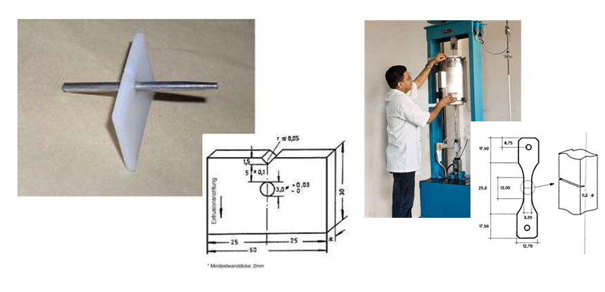
Tests for stress corrosion cracking
ISO 22088-4:2006
Plastics -- Determination of resistance to environmental stress cracking (ESC) -- Part 4: Ball or pin impression method
ASTM D5397 - 07(2012)
Standard Test Method for Evaluation of Stress Crack Resistance of Polyolefin using Notched Constant Tensile Load Test
Page 14/23

Slide 15
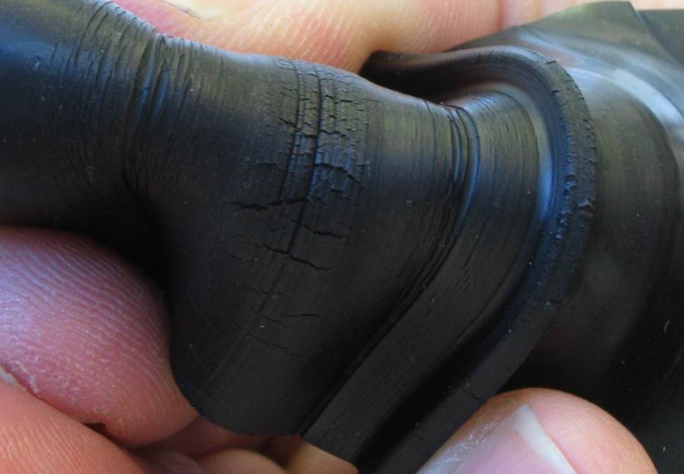
Ozone cracking in diene elastomers
mechanism
Chemical attack of the double bond in the polymer chain
Already in natural ozone concentrations → very low(0.02-0.05 ppm)
Forming an 'ozonised' surface layer which inhibits further penetration of ozone
With simultaneous mechanical stress :
Ozone cracking perpendicular to the direction of the acting force
Prevention:
so called 'Antiozonants' (for example, n. p-phenylenediamine)
Page 15/23

Slide 16
Autoxidation of hydrocarbons (by Bolland & Gee)
initiation:
(for example, by heat / energy input)
RH → R*
secondary reactions:
R* + O₂ → ROO* (extremely fast)
ROO* + RH → ROOH + R*
Page 16/23

Slide 17
Autoxidation of hydrocarbons (by Bolland & Gee)
hydroperoxide:
(catalyzed by metal ions)
ROOH → RO* + *OH 2 ROOH → RO* + ROO* + H₂O
Chain termination reactions:
2 ROO* → Inactive reaction products+ O₂ R* + ROO* → ROOR 2 R* → R-R
Page 17/23

Slide 18
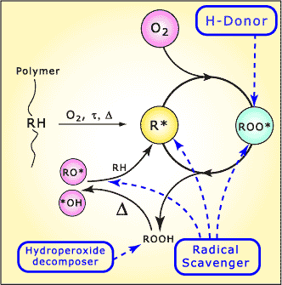
Autoxidation of hydrocarbons (by Bolland & Gee)
Prevention by the use of
Antioxidants
primary AO
(H-donors)
secondary AO
(Hydroperoxide decomposers)
radical scavengers
Page 18/23

Slide 19
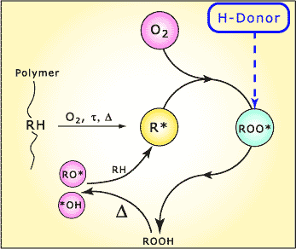
Autoxidation of hydrocarbons (by Bolland & Gee)
Inactivation of peroxyradicals
→ Prevention of another attack to the polymeric chain
Page 19/23

Slide 20
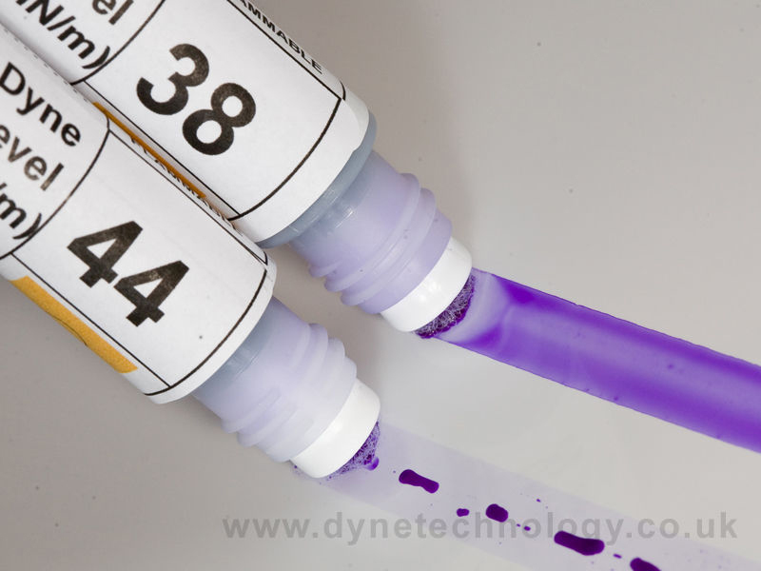
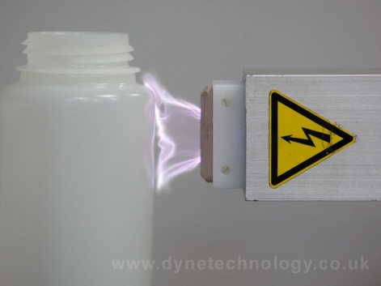
Pretreated surfaces – corona treatment
Corona treatment
is a surface modification technique that uses a low temperature corona discharge plasma to impart changes in the properties of a surface.
Polyethylene, polypropylene, nylon, vinyl, PVC, PET, metalized surfaces, foils, paper, and paperboard stocks are commonly treated by this method.
Shelf life
Treated films have a reduced shelf life
Treatment can be tested (Wetting)
Page 20/23

Slide 21
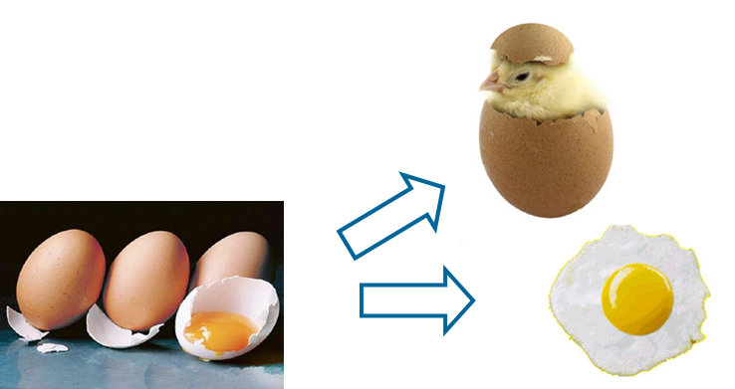
Accelerated storage
shelf life of typical polymer films used in packaging industry: 6 to 12 month
Q10 (temperature coefficient)
Every 10°C → double reaction speed – But:
Page 21/23

Slide 22
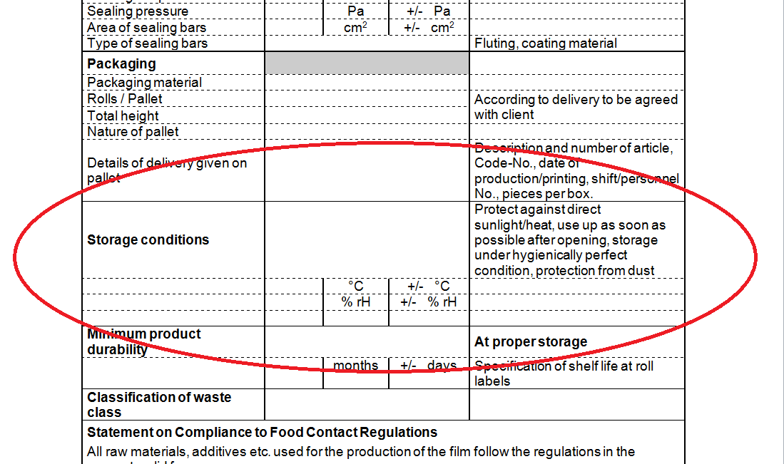
Specifications
Page 22/23

Slide 23
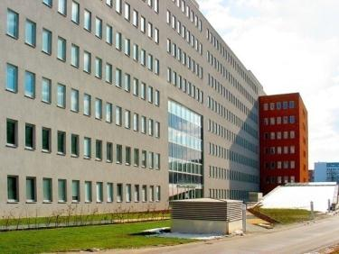
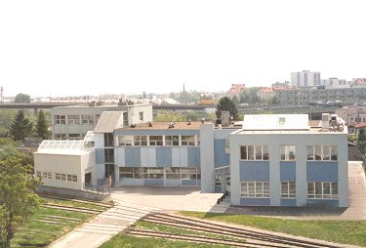
THANK YOU!
Johannes Bergmair
E-Mail: johannes.bergmair@ofi.at
OFI
Brehmstraße 14a
A-1110 Wien
+43-(0)1-798 16 01 - 976
+43-(0)1-798 16 01 - 480
Page 23/23

