Slide 1
Exploring the Standard
BRC Global Standard for Packaging and Packaging Materials

Slide 2
Agenda
The Packaging Standard
Questions and close
About BRC Global Standards
Consistency and compliance
Continuous improvement

Slide 3
About the BRC Global Standards

Slide 4
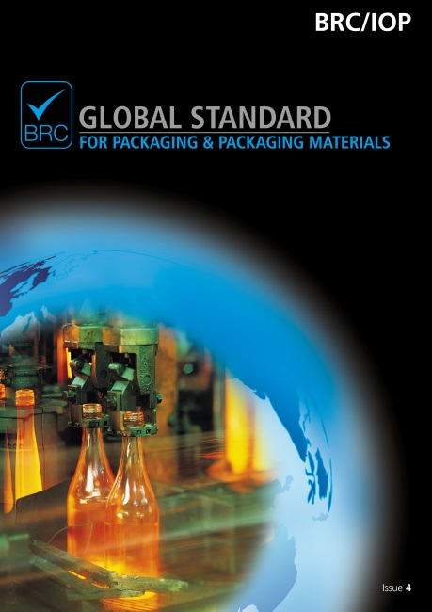
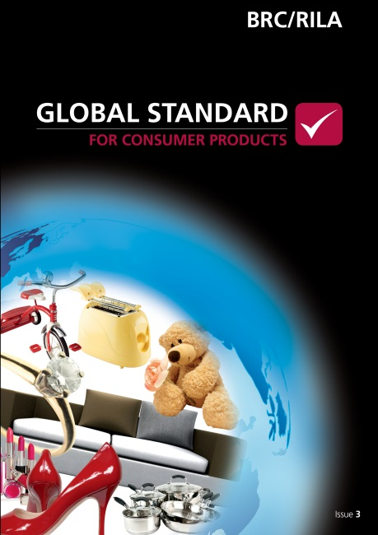
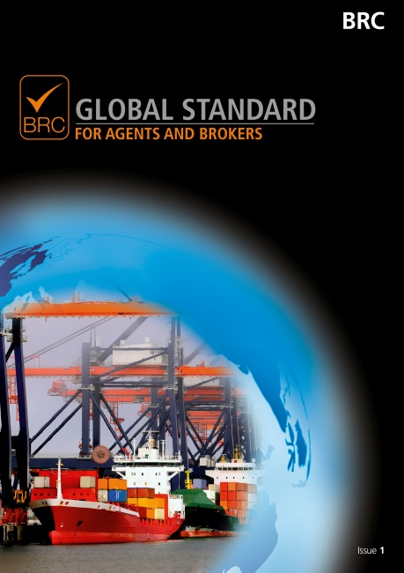
BRC Global Standards

Slide 5
Certificates
22,637 certificated sites
In 129 countries
Submitted by 77 Certification Bodies

Slide 6
Packaging Standard

Slide 7
BRC Packaging – Core principles
Improve product safety and quality
Enable manufacturers to meet the demands of their customers – reducing multiple audits
Facilitate improvements and efficiencies in the manufacture of products
Provide part of the due diligence defence for both customers and the certificated site

Slide 8
Scope
Food contact packaging
Non-food contact packaging
Consumer products packaging
Secondary and tertiary packaging for all uses

Slide 9
Contents
Introduction
Requirements
Senior management commitment and continuous improvement
Hazard and risk management system
Product safety and quality management system
Site standards
Product and process control
Personnel
Protocol

Slide 10
Fundamental Requirements
Objective
Senior management commitment
Highlight requirements that are crucial to establishment and operation of effective product safety and quality management systems
Fundamental clauses
Hazard and risk analysis
Internal audits
Specifications
Traceability
Housekeeping and cleaning
Process control
Training and competence

Slide 11
Packaging Certificates
Top 12 Countries | Total Sites | % of total
United Kingdom | 640 | 21.6
Germany | 217 | 7.3
Italy | 196 | 6.6
Netherlands | 161 | 5.4
China | 159 | 5.4
Spain | 147 | 5.0
Turkey | 133 | 4.5
Poland | 123 | 4.2
France | 120 | 4.1
India | 120 | 4.1
United States | 115 | 3.9
Belgium | 76 | 2.6
Top 12 growth countries (Europe) | Total Sites
Lithuania | 6
Belarus | 5
Croatia | 4
Ukraine | 4
Russian Federation | 59
Serbia And Montenegro | 9
Bulgaria | 5
Spain | 147
Armenia | 2
Hungary | 22
Turkey | 133
Romania | 15
Notes:
2290 certificates in Europe in total (April 2015).

Slide 12
Living in a Material World

Slide 13
Issue 5 Rewrite

Slide 14
Issue 5 Rewrite Objectives
Consideration of packaging users needs throughout supply chain
Packaging industry led, practical application
A move from ‘good practice’ to ‘best practice’
Enhanced quality management systems for printed packaging
Transparency and traceability in the supply chain

Slide 15
Rewrite Working Groups
User Feedback
Consultation on draft standard
Trial audits
Conferences
Global Standards Team
Working Group
Retailers and Food service
Manufacturer Trade associations
Certification Bodies
Independent experts
UKAS

Slide 16
New elements for Issue 5
Traceability test
Meet concerns regarding supply chain traceability
Visibility where agents and brokers are used
Voluntary Modules
Traded Goods
Environmental Awareness Module
Unannounced audits
Full or part unannounced audits available

Slide 17
Timelines for Issue 5
Activity | Time
Publication activity and typesetting | January – June 2015
Preparation of training materials | February – May 2015
Publish Issue 5 | July 2015
Auditor training and public training courses | July to December 2015
Issue 5 goes live for audits | 1st January 2016
English
German
Spanish
French
Italian

Slide 18
Training for Issue 5
Understanding Requirements
Conversion (for auditors/ATPs)
Conversion (for manufacturers)
Introduction to the Standard
Auditor Skills

Slide 19
Environmental Awareness Module

Slide 20
EAM: key features
Site focused environmental management
Encourages sites to focus on their environmental pressures
Resources available through training
Auditor competency

Slide 21
More information

Slide 22
New publication model
New model for accessing the Standards to make information easily available to improve the value and ensure consistency
FREE to download and print the BRC Global Standards
Subscription service for the price of a Standard (£95 per year) providing access to all documents
Ensure that BRC Global Standards continues to be industry leading

Slide 23
Global Standards Directory
Contains all audits conducted against a BRC Global Standard
Administrated by Certification Bodies
Used by suppliers, buyers & retailers to share audits
Validate the authenticity of audit documents

Slide 24
Compliance Programme
Contract with Certification Bodies
Requirements for Auditors
Compliance Visits
BRC Directory
Measuring auditor and CB performance – KPIs and the star rating
Sanctions
Stakeholder feedback

Slide 25
Hvala lijepo Thank you
Joanna Griffiths
Packaging Technical Manager – BRC Global Standards
joanna.griffiths@brcglobalstandards.com

