Slide 1
WPO
On the Way to Save Food
Dr. Johannes Bergmair

Slide 2
Europe
Page 2/25

Slide 3
http://ec.europa.eu/food/food/chemicalsafety/foodcontact/docs/ReferencesEurNatLeg_20091026.pdf
Page 3/25

Slide 4
USA
Page 4/25

Slide 5
FDA US Food and Drug Administration
Code of Federal Regulations (CFR)
for FCS (food contact substances)
Chemical Asessment
Migration: single-use-applications vs. repeat-use-applicationsand
Packaging info: consumption factors (CF) and food-type distribution factors (fT)
Toxicological Assesment
Environmental Asessment
21 CFR 25.40 or exclusion of environmental assessment (EA)
DC = CF(M) = CF Ʃ (MFSL)(fT)
DC: dietary concentration
M: Meanvalue related to fT –value
MFSL: Migrationlimit
EDI = DC x 3 kg food per person per day
EDI: estimated daily intake; (1.5 kg liquid und 1.5 kg solid food)
Page 5/25
Notes:
http://www.cfsan.fda.gov/~dms/opa-docs.html
Center for Food Safety and Applied Nutrition (CFSAN, Zentrum für Lebensmittelsicherheit und angewandte Ernährung)
Center for Drug Evaluation and Research (CDER, Zentrum für Arzneimittelbewertung und Forschung)
Center for Biologics Evaluation and Research (CBER, Zentrum für biologische Bewertung und Forschung)
Center for Devices and Radiological Health (CDRH, Zentrum für radiologische Geräte und Gesundheit)
Center for Veterinary Medicine (CVM, Zentrum für Veterinärmedizin)
National Center for Toxicological Research (NCTR, Nationales Zentrum für toxikologische Forschung)
Office of Regulatory Affairs (ORA, Büro für Überwachungsaufgaben)
Office of the Commissioner (OC, Büro des Beauftragten)

Slide 6
China
Page 6/25

Slide 7
China
GB 9685-2008
Hygienic standards for uses of additives in food containers and packaging materials
http://www.codeofchina.com
Issued by the Ministery of Health (MOH)
containers and packaging materials and other equipment or utensils in contact with food
paper, bamboo, wood, metals, porcelain, ceramics, plastics, rubber, fibre, glass …
Regulates food packaging 959 additives (positive list, migration limitis)
Official under revision since 25 Jan 2013
Page 7/25

Slide 8
Working Plan
1) Set up a list with overview of existing regulatory
collect and evaluate what is available across the world
2) Set up a network of contact persons for FCM
directory on WPO-website (contacts, players, …)
Sources:
Presentations PIRA conference
Wiley : “Global Legislation for Food Packaging Materials”
2 EU Documents
AUS and NZ review papers
Page 8/25

Slide 9
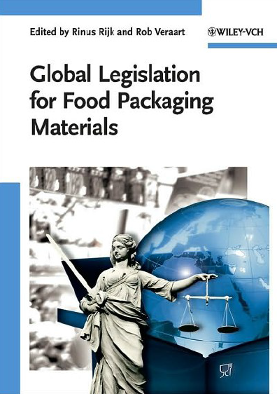
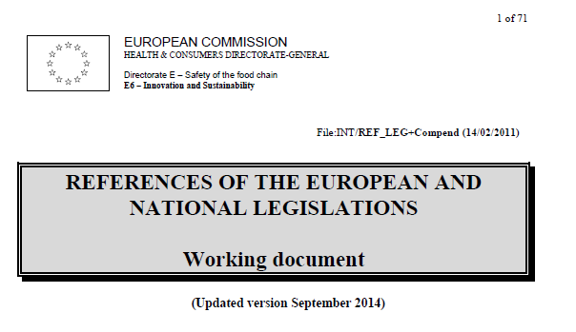
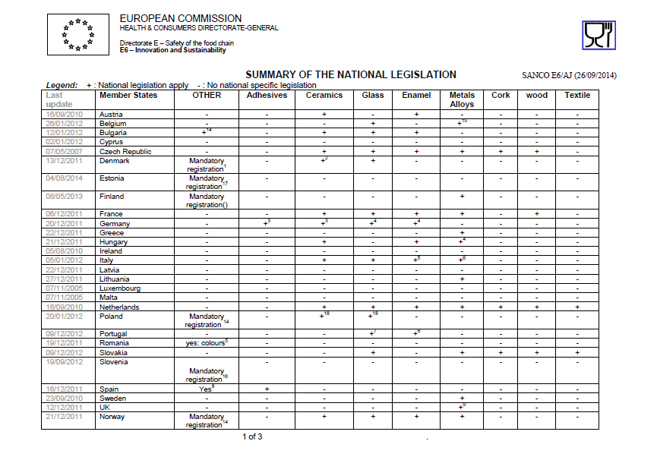
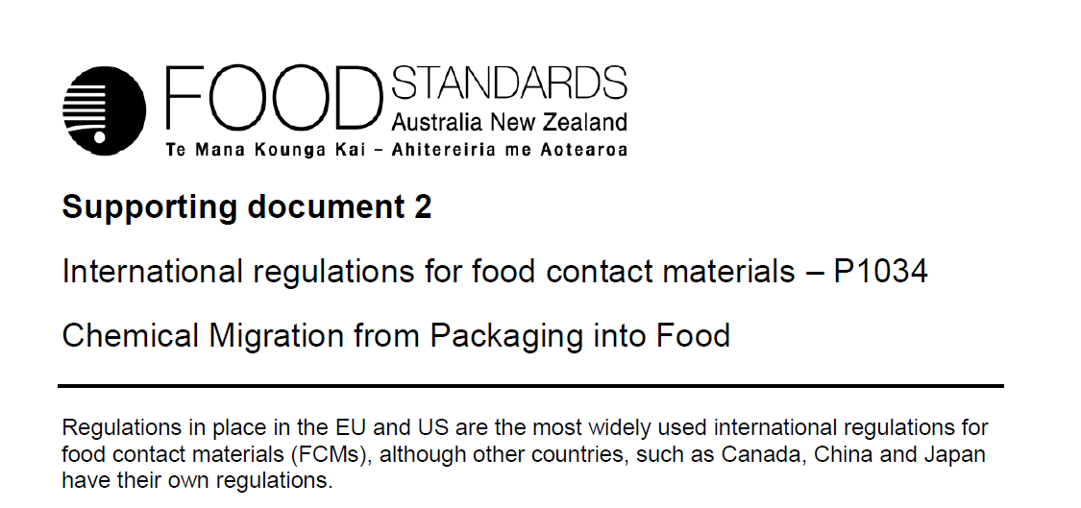
Page 9/25

Slide 10
ACTION!!!
1) WG members check for their country/region:
Presentations PIRA conference
Wiley : “Global Legislation for Food Packaging Materials”
What to check:
Actual?
Any further information for countries in the reports?
Any further info for other countries?
Coordinated by Johannes Bergmair
2) Contact Person – List coordinated by Johannes Bergmair (mail to johannes.bergmair@ofi.at)
Must be NO expert – but able to connect to experts for FCM
Better non-governmental
Name/ Organisation / Address / Phone / Email
Page 10/25

Slide 11
We have a committee!!!
Kishan Singh – South Africa
Kofi Essuman – international
Rodelio Espinosa – Philippines
Kofo Ajelabi – Nigeria
Adnan Akbaş – Turkey
N.N. – Brazil (via Lilliam)
N.N. – USA (via Tom/Pat)
Prof. Dr. Saha – India
Joseph Nyongesa – Kenya
Pierre Pienaar - AUS
Johannes Bergmair – Austria (EU)
Anybody missing??
China?? Japan??
Page 11/25

Slide 12
What it‘s all about…
Page 12/25

Slide 13
Current Situation
Food Wastage Footprint (FAO)
https://www.youtube.com/watch?v=IoCVrkcaH6Q
https://www.youtube.com/watch?v=Md3ddmtja6s
http://www.fao.org/food-loss-and-food-waste/en/
http://www.iufost.org/iufostftp/FLW-%20FAO.pdf
Packaging
http://www.worldpackaging.org
Food Security & Food Safety
http://www.nature.com/scitable/knowledge/library/food-safety-and-food-security-68168348
http://www.who.int/foodsafety/areas_work/en/
Challenges
https://www.youtube.com/watch?v=raSHAqV8K9c
Page 13/25

Slide 14
Food Losses and Food Waste
1/3 of the food produced for human consumption is either lost or wasted globally along the food supply chain
Despite sufficient world production: One in seven people are starving!
Environmental impact: CO₂, water, land area, biodiversity
Economic loss and costs to society
Population growth: 2050 – 9 billion people (need to raise the food production by 60 %)
Get Active – Save Food!
Source: http://www.fao.org/food-loss-and-food-waste/en/
Page 14/25

Slide 15
Stop Food Wastage: Hierarchy
Source: http://www.iufost.org/iufostftp/FLW-%20FAO.pdf
Page 15/25

Slide 16
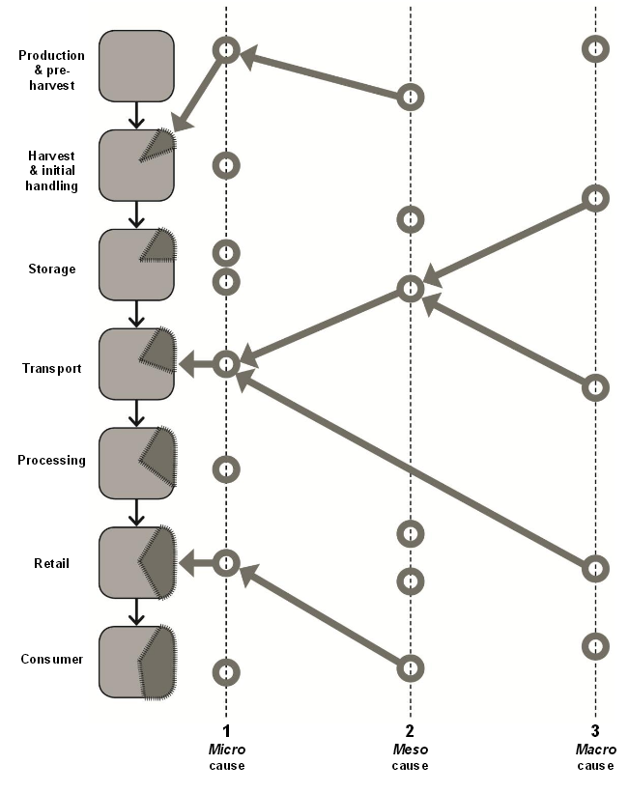
Causes and Solutions
Causes and solutions: integrated perspective
Micro-, meso-, and macro-level causes and solutions
“The food chain is represented here in the left of the figure in a schematic way: depending on produce, location, etc. the real order and succession of the different steps can vary and can form very complex chains. Food losses and waste at each step of the food chain can result from micro-, meso- and macro-causes. Here a micro cause of food loss at the stage of transport is represented. One meso, and one macro-cause also happen to influence the micro cause. The meso-cause is in turn also influenced by two separate macro causes. For instance, in the case of transport, one example of micro-cause is the rough handling of raw produce. Related meso-causes could be for example the absence of properly trained loaders, and/or of proper packaging or logistic solutions. Related macro-causes for example could be found in the economic environment leading to low-paid, untrained loaders, and poor infrastructure.“
Source: http://www.iufost.org/iufostftp/FLW-%20FAO.pdf
Page 16/25

Slide 17
Food Wastage
Less developed countries
Food tends to be lost at pre-harvest, harvest and initial handling phase
With increasing development
Waste tends to move up the distribution chain to retail and consumption level
Here food is more likely thrown away when still edible
Source: http://www.chep.com/resources/case_studies/how_packaging_can_reduce_food_waste/
Page 17/25

Slide 18
The Role of Packaging
Primary Function
Contain
Preserve
Protect
Secondary Function
Information
Convenience
Presentation
Brand communication
Promotion
Economy and environmental responsibility
Source: Coles, R., McDowell, D., und Kirwan, M. (2003). Food Packaging Technology. Blackwell Publishing Ltd, Oxford.
Page 18/25

Slide 19
Causes: Packaging
Harvest and initial handling phase
Inappropriate choice of containers and packaging materials
Sanitation and hygienic standards of the containers used to pack and transport the products
Processing
Lack of packaging
Distribution and Transport
Rough handling during packaging and (un) loading of transport vehicles
Inappropriate packaging containers or packages
Retail
Inadequate packaging and damage of packages
Large pack sizes which force consumers to purchase more than needed
Marketing strategies, product promotions and bulk discounts
Source: http://www.iufost.org/iufostftp/FLW-%20FAO.pdf
Page 19/25

Slide 20
Solutions: Packaging
Life Cycle Analysis
Trade-offs between food waste and packaging
“As little as possible, as much as necessary”
Less food waste
More packaging
Source: http://www.chep.com/resources/case_studies/how_packaging_can_reduce_food_waste/
Page 20/25

Slide 21
Solutions: Packaging
Solutions at micro-, meso-, and macro-level
Enable the change
Technical solutions:
Appropriate packaging
Appropriate materials
Modern packaging such as active and intelligent packaging
Portion sized packaging
Re-closable packaging
Convenient packaging
Hygienic processing and packaging
Source: http://www.iufost.org/iufostftp/FLW-%20FAO.pdf
Page 21/25

Slide 22
Example: Extended Shelf Life
Polymer films
Source: http://www.plasticseurope.org/documents/document/20140219143921-plastic_packaging_-_born_to_protect_brochure_190214.pdf
Page 22/25

Slide 23
FAO Save food initiative
Sustainability + Food Safety = Save Food
First issued at Interpack 2011
FAO Save food focuses on third world countries
WPO has subscribed to the program, but practical details were pinpointed in 2014
Workshop in December in Rome 2013, reported in Düsseldorf
Announced next meeting in Switzerland 11th/12th May 2015
Page 23/25

Slide 24
FAO Save food initiative latest development
The CoP (community of practice) on food loss reduction started an online discussion on “losses occurring along the maize supply chains: levels, causes and solutions promoted”
Committee on World Food Security (CFS) established
AUC (African Union Commission)/FAO High-level Consultation on Post-Harvest Losses
Food Processing and Packaging Exposium (FPPE) 2014 this week in Nairobi
UNIDO (Vienna, Mr. Schebesta) wants to start a platform
Questions:
- how can WPO contribute?
- can WPO training be made part of the program?
Page 24/25

Slide 25
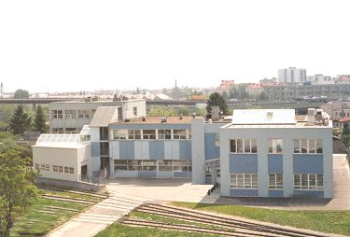
THANK YOU!
Johannes Bergmair
E-Mail: johannes.bergmair@ofi.at
OFI
Brehmstraße 14a
A-1110 Wien
+43-(0)1-798 16 01 - 976
+43-(0)1-798 16 01 - 480

