Slide 1
Eko forum
Paper Bag Advantages

Slide 2
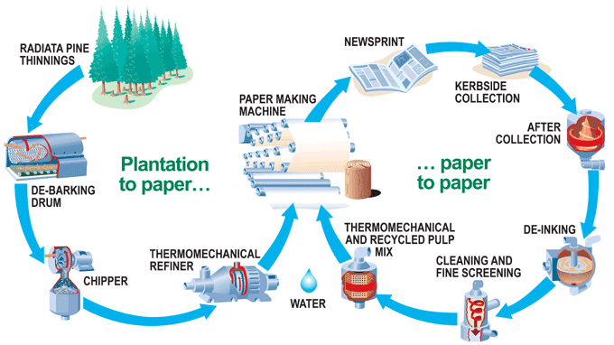
Made From Renewable Natural Resource
Many people still believe that paper-making is responsible for the destruction of the rain forests. This is simply not true.
Rainforest wood is unsuitable for paper manufacture, even if the industry was inclined to use it as a raw material.
The wood used in paper-making is grown as a “crop” in fully managed and sustainable forests. Sustainable forestry is both a commercial necessity for the industry, as well as an environmentally friendly operation.

Slide 3
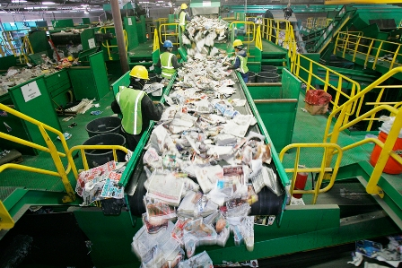
Highly Recycled
72% of all paper and paperboard packaging was recovered for recycling
paper bag and sacks shows a recovery rate of 50%
this rate is five times higher than plastic

Slide 4
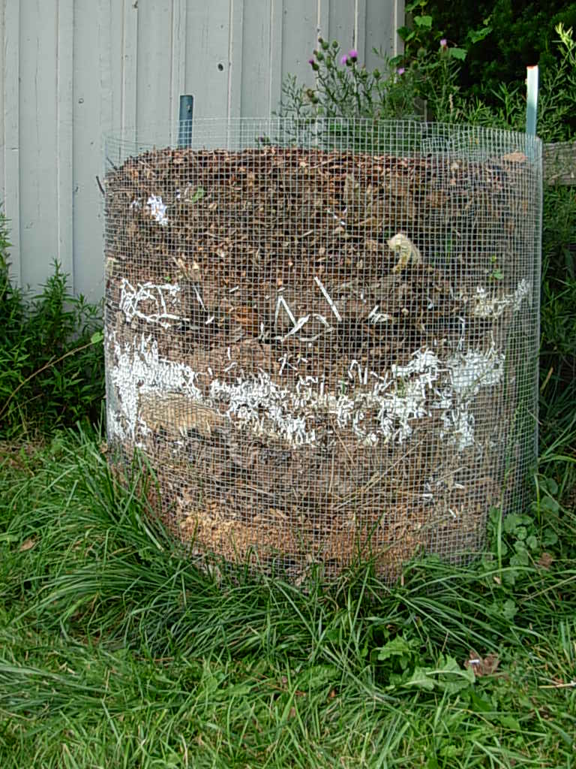
Biodegradable
paper bags are 100% biodegradable
take approximately one month to decompose
can be used as fertilizer when put in a compost pit
safe for wildlife
plastic bags take as many as 100 years to decompose

Slide 5
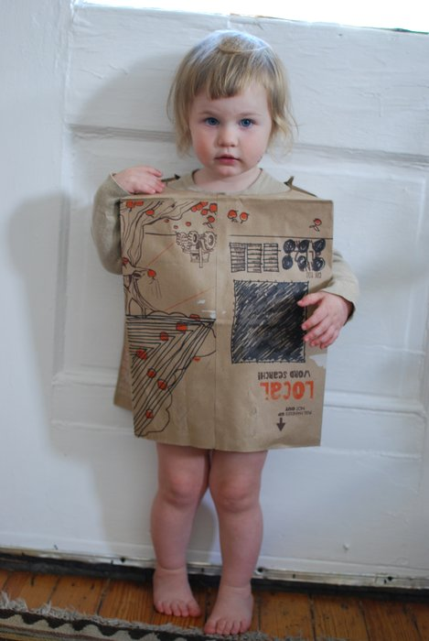
Practical advantages
Easy to open
Paper bag is freestanding and easy to fill
Easier to carry than plastic bags
Holds more items than plastic bags = fewer bags to handle
Suitable for collecting organic waste
Safe for small children to play with

Slide 6
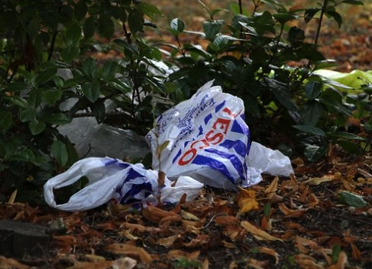
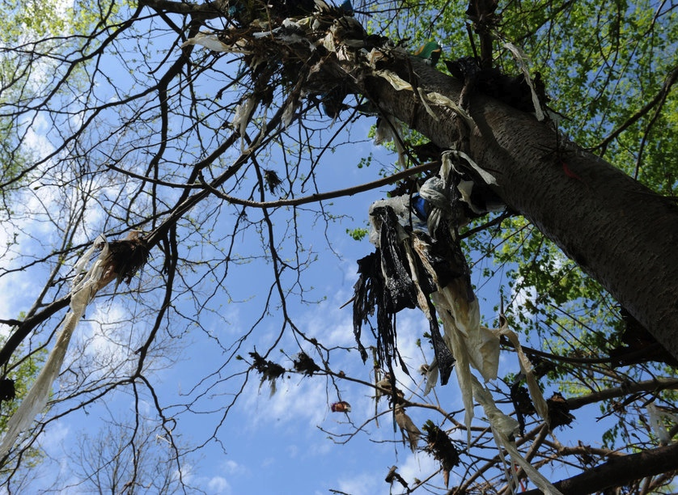
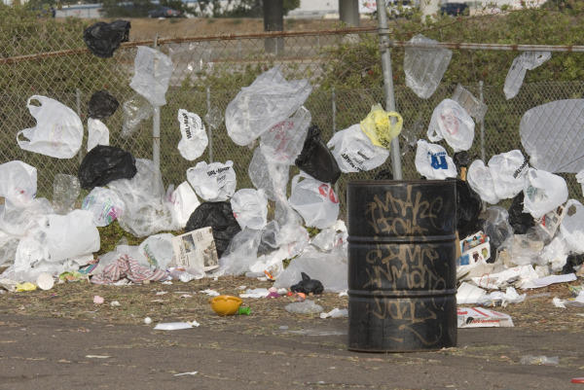
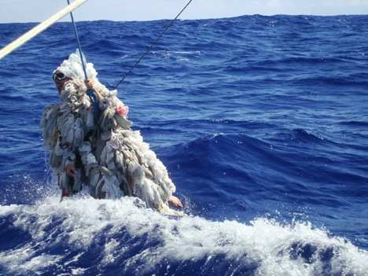
Facts

Slide 7
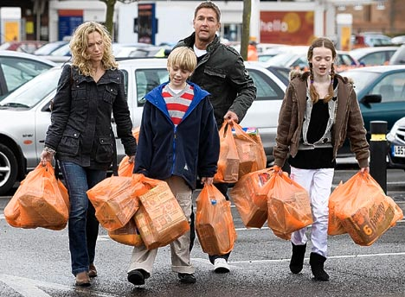
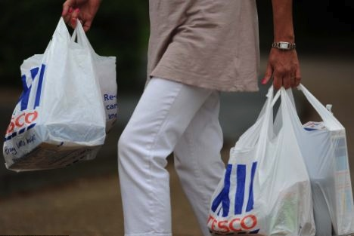
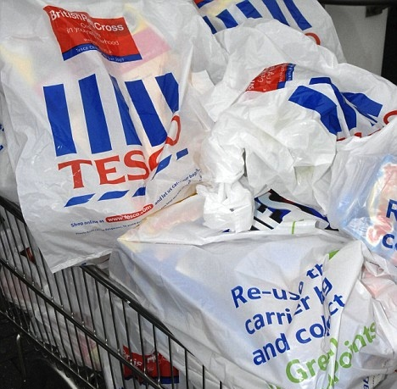
Everyday use of plastic bags

Slide 8
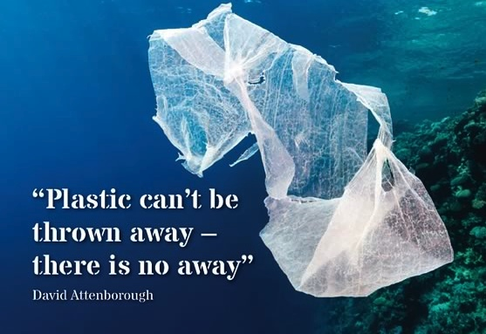
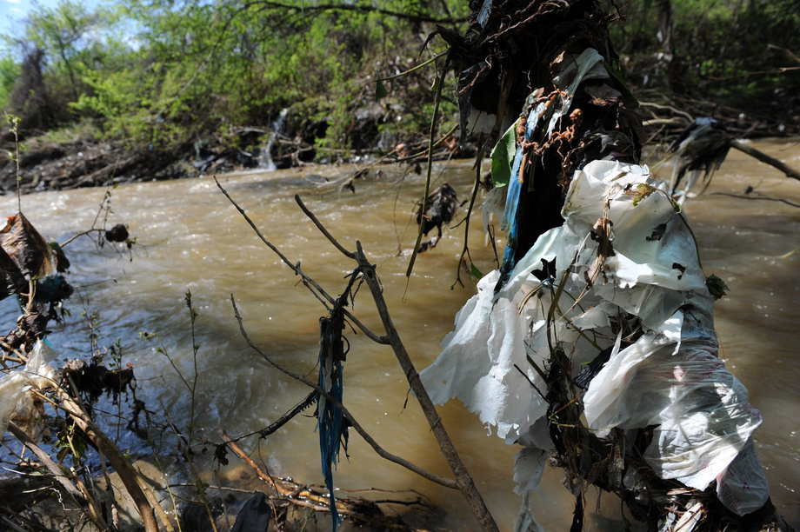
Photodegradation
Plastic bags are photodegradable, or broken up by UV light from the sun.
Plastic does not degrade in the usual sense. Instead of the material being lost as it converts into something else, it merely breaks into smaller pieces--i.e. bite-size pieces of decreasing sizes. This is significant because pieces can block the gastrointestinal tract of an animal, preventing digestion of other food.

Slide 9
Thank you

