Slide 1
Vetropack Straža – prva i zadnja karika u kružnom toku staklene ambalaže
Vetropack Straža – first and last link in the cyclical life of the glass packaging
Nikola Drašković, Vetropack Straža

Slide 2
Table of Contents
Vetropack Straža – brief introduction
Container glass fits into principles of circular economy
Why is important to recycle glass?
Glass recycling ratios
Recycling plant
Conclusion

Slide 3
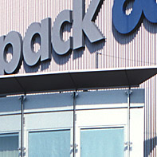
Vetropack Straža – major container glass producer within the region
Established in 1860; since 1996 member of the Vetropack Group
3 furnaces and 11 production lines
Nominal production capacity: 248.000 tones
Revenues (2013, HRK): 745.6 million
Sales (2013, pieces): 924.8 million
Employees: 609

Slide 4
Vetropack Group – mid-sized European container glass producer

Slide 5
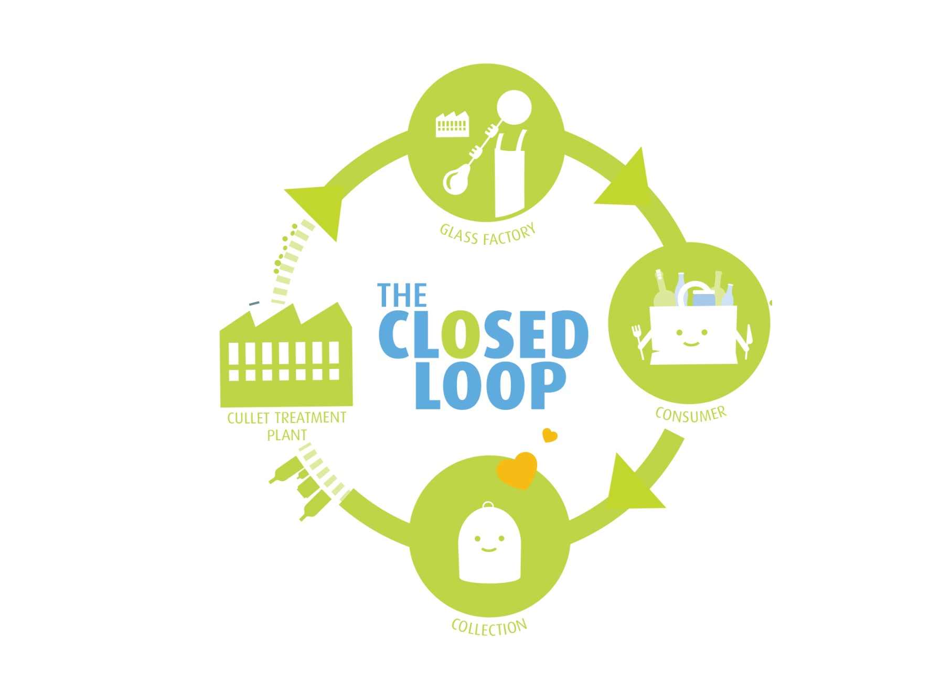
Container glass fits into principles of circular economy

Slide 6
Container glass fits into principles of circular economy
Container glass is made of natural raw materials
Glass is 100% recyclable
From 1 kg of cullet (recycled glass) we could produce 1 kg of new bottles and jars, and all over again, indefinitely

Slide 7
Why is important to recycle glass?
Reduction in energy consumption (if we recycle one glass bottle, we could save energy sufficient to power a TV or a computer for 20 minutes)
Raw materials preservation
Lower water consumption
Lower emissions (lower CO2 footprint)
Landfill reduction

Slide 8
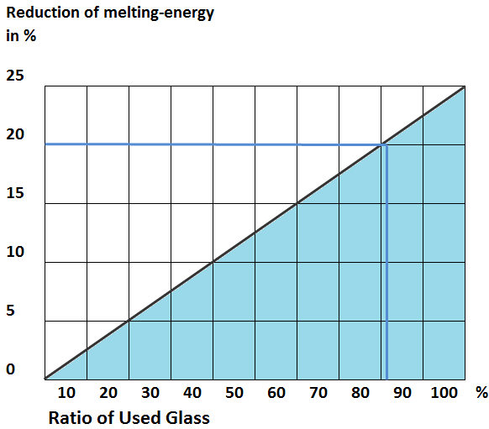
Cullet reduces energy consumption during melting
Energy consumption reduction, %
Cullet ratio, %

Slide 9
Glass recycling in Europe

Slide 10
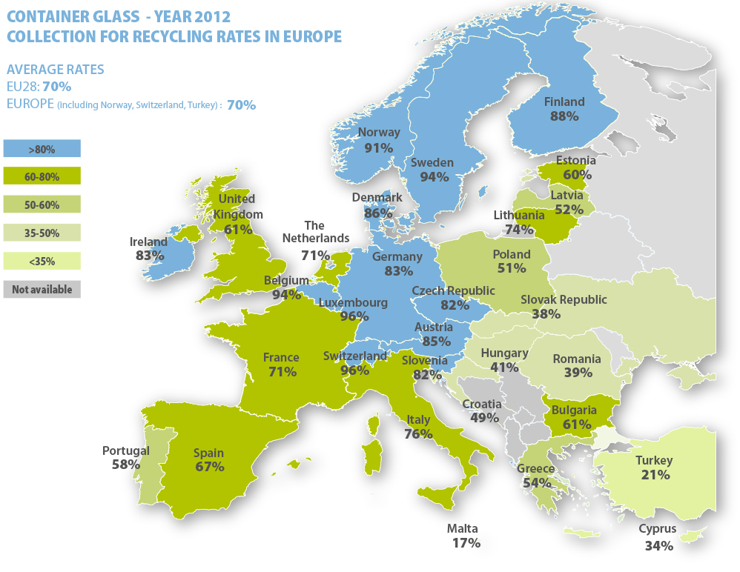

Slide 11
Glass recycling in Switzerland – a long climb

Slide 12
Glass recycling in Croatia – initial success followed by stagnation

Slide 13
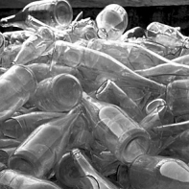
Recycling plant in Vetropack Straža
The recycling plant was built in 1999
Initial investment: 10 million HRK
Capacity: 10 - 12 t/h → annual capacity: 105.000 t
20 workers (2 – 4 shifts)

Slide 14
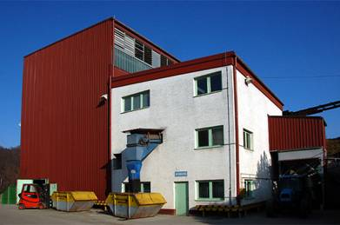
Recycling plant in Vetropack Straža

Slide 19
Cullet ratio in production in Vetropack Straža (in % of batch)

Slide 20
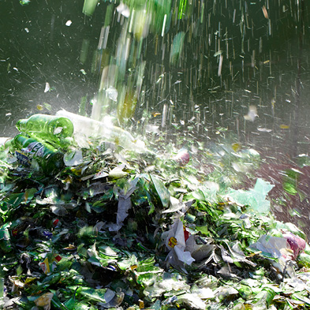
Conclusion
Vetropack Straža is the major container glass producer within the region
Container glass fits into principles of circular economy
Glass recycling has many positive implications
Glass recycling in Croatia lags behind the European average
Vetropack Straža offers its experience in expertise for the improvement of glass recycling system in Croatia

