Slide 1
Upravljanje ambalažnim otpadom u Srbiji
Waste Management in Serbia
Ekostar Pak
Vaš ekološki partner

Slide 2
Osnivanje Establishment
28. 09. 2010. – Osnovana kompanija Ekostar Pak
Ekostar Pak was founded
25.10.2010. - Dobijena je dozvola od strane nadležnog Ministarstva Republike Srbije, čime je Ekostar Pak stekao svojstvo Operatera sistema za upravljanje ambalažnim otpadom
Obtained licence which was authorised by Ministry of environmental protection and which gave a Ekostar Pak a permit of National Waste Management Operater

Slide 3
Osnivači Founders
2010. god – Osnivači (Founders):
Umka
Avala Ada
Fabrika Hartije Beograd
2012. god - Proširenje osnivačkog članstva :
New founders:
Jaffa
Brzan Plast
Beohemija

Slide 4
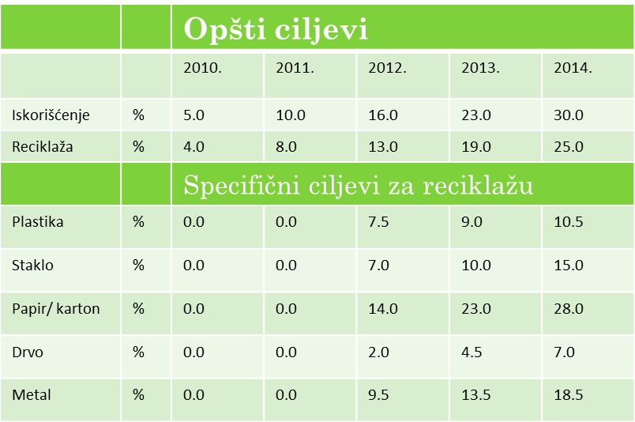
Obaveza upravljanja ambalažnim otpadom Waste managment obligation
Zakon o ambalaži i ambalažnom otpadu, uz prateće podzakonske akte, definisao je obaveze svih Obveznika ovog Zakona koji na tržište Republike Srbije plasiraju više od 1000 kg nepovratne ambalaže.
Packaging and packaging waste law define obligation for all companies which put on market more than 1000 kg of packaging per year

Slide 5
Ukupan broj firmi u sistemu upravljanja ambalažnim otpadom/broj klijenata Ekostar Pak-a Total number of firms involved in packaging waste management / number of Ekostar Pak clients

Slide 6
Ukupne količine ambalažnog otpada plasirane na tržište Srbije koje su u sistemu upravljanja ambalažnim otpadom/količine predate na upravljanje Ekostar Pak-u The total amount of packaging waste placed on the Serbian market involved in the packaging waste management / amount submitted to Ekostar Pak

Slide 7
Ukupno prikupljeno i reciklirano ambalažnog otpada/ količine koje je Ekostar Pak prikupio i reciklirao Quantity of collected and recycled packaging waste/quantitiy which Ekostar Pak collected and recycled

Slide 8
Ispunjenje Nacionalnog cilja National goal fulfilment

Slide 9
Ispunjenje Nacionalnog cilja National goal fulfilment

Slide 10
Ulaganje u sistem Investment in system

Slide 11
Prednosti uvođenja sistema Advantages of the system
Rast prikupljenih i recikliranih količina ambalažnog otpada/Growth in the amount of collected and recycled packaging waste
Značajno veće ulaganja u sistem sakupljanja i opremu u odnosu na period pre primene Zakona/ Significantly greater investment in the collecting system and equipment than it was before the Law
Ekostar Pak je uložio oko 3,25 mil. Eur/ Ekostar Pak has invested around 3.25 million €
Povećao se broj sakupljača ambalažnog otpada i pojavili su se novi u mestima gde ih do sada nije bilo/ Number of collectors have increased and new collectors appeared in places where they haven’t been
Povećao se i broj reciklera /Number of recyclers increased

Slide 12
Nedostaci: Issues:
Nedovoljno angažovanje inspekcije/ Insufficient engagement of inspection
Pojava nelojalne konkurencije/Appearance of unfair competition
Nekontrolisano izdavanje dozvola novim operaterima/ Uncontrolled licensing new operators

Slide 13
Hvala na pažnji! Thank you for your attention!
Sve dodatne informacije, relevantne Zakone, Uredbe i ostale podzakonske akte koje se odnose na upravljanje ambalažom i ambalažnim otpadom možete pronaći na našoj internet stranici
Any additional information relevant laws, regulations and other laws relating to the packaging and packaging waste management can be found on our website
www.ekostarpak.rs
ekostarpak@ekostarpak.rs

