Slide 1
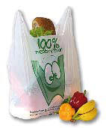
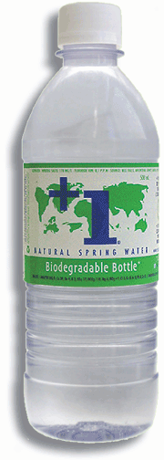

OFI
DI Dr. tech. Johannes Bergmair
Croatia, 29. May 2014
Food safety in packaging technology:
News from European Legislation and a global approach
Notes:
Produktbeispiele: PLA / Maisstärke
+1 Bottle PLA: http://plusonewater.ca/en/index.php

Slide 2
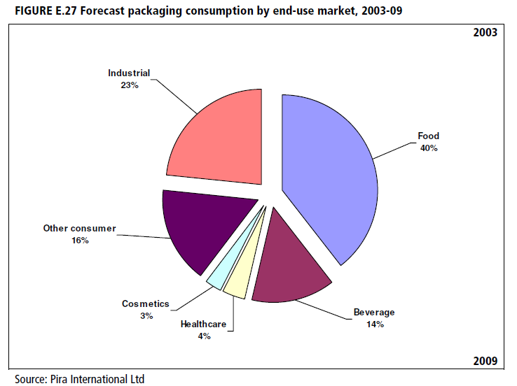
Is food packaging relevant?
statistics say:
Yes!
(Market Statistics and Future Trends in Global Packaging 2008; www.worldpackaging.org)

Slide 3
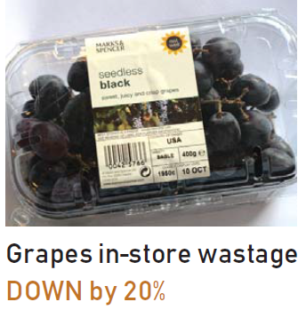
Packaging’s contribution to society
Urbanization: Food and other goods are made at some distance from where they are consumed.
No liquids, gels or powders would be available.
Fruit and vegetables would not be available out of season.
The environmental damage from broken goods and spoiled food would be enormous.
Food waste has at least ten times the environmental impact of packaging
waste.
Source: www.incpen.org

Slide 4

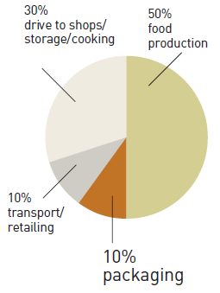
Source: www.incpen.org
Of the total energy used in the food chain,
50% is used in food production,
10% on transport to the shops and retailing,
10% to make the packaging and the remaining 30% is used by shoppers to drive to the shops and store and cook food.

Slide 5


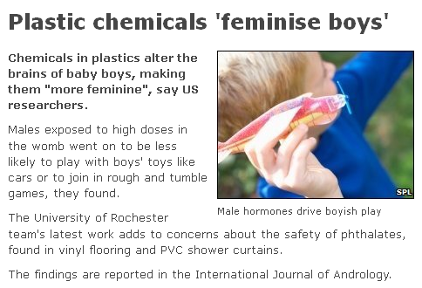
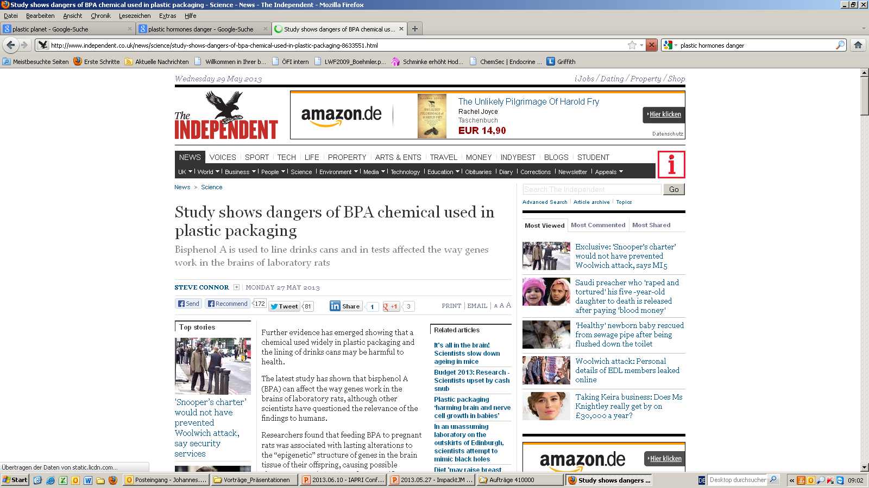
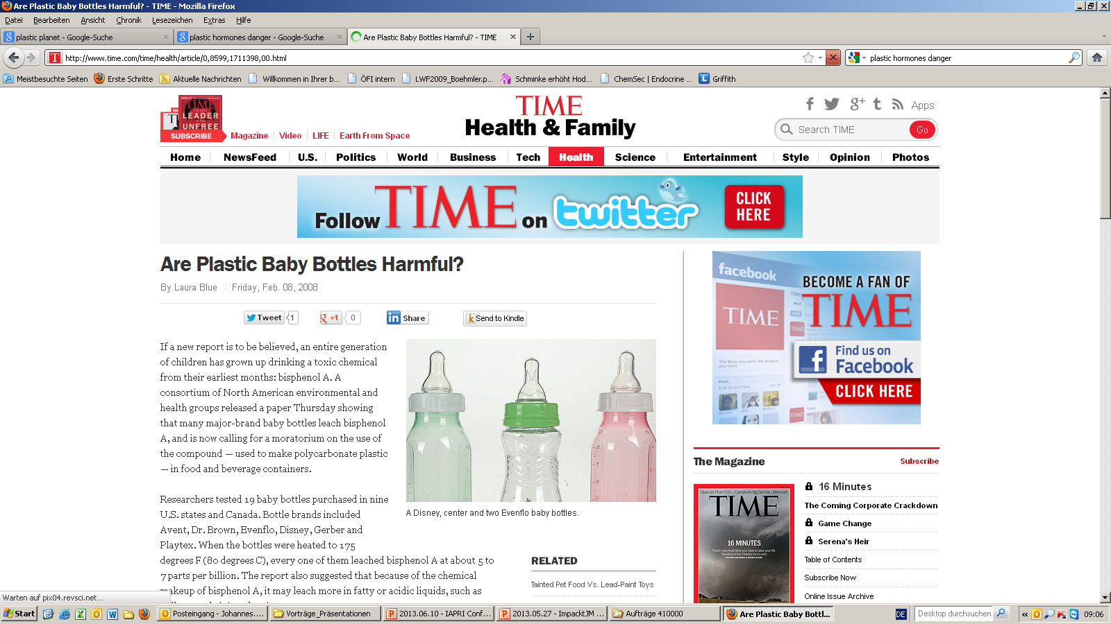
Media Headlines I
Endocrine activity
Notes:
Avoid drinking from PET bottles to avoid BPA, drink from SIGG bottles, coated with BPA

Slide 6
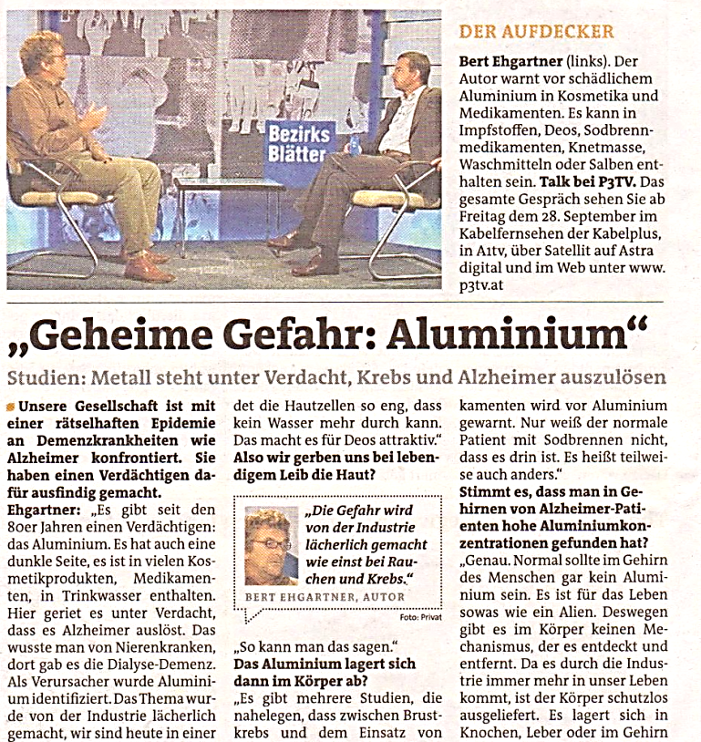

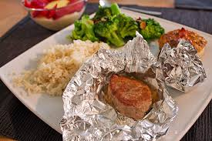
Media Headlines II
Aluminium causing Alzheimer & cancer ?

Slide 7
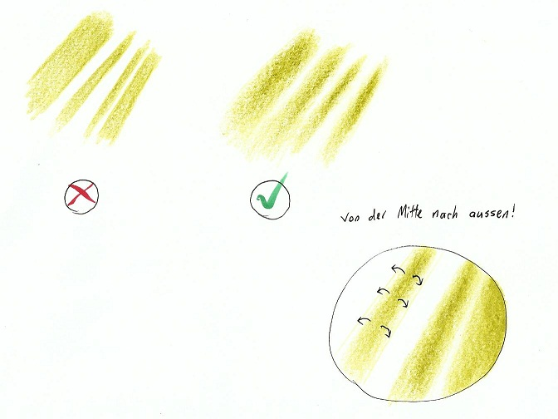
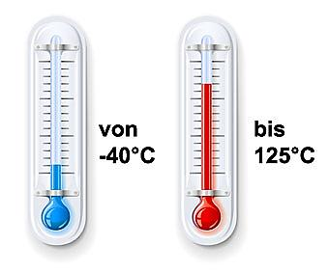

Interaction between foodstuff and packaging
migration
diffusion
mechanical stress
light
Food
corrosion
heat
cold
permeation
emission
microorganisms
Notes:
Fact is, there is always interaction between foodstuff and packaging going on.
For example corrosion,…
Migration is one of the most important external factors.

Slide 8
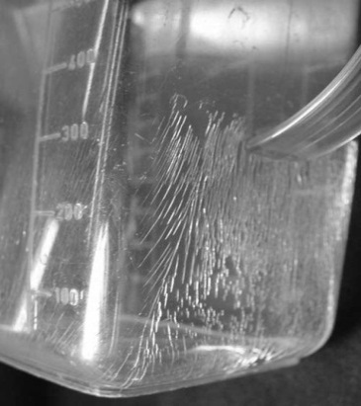


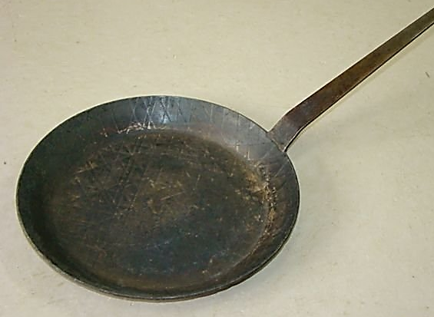
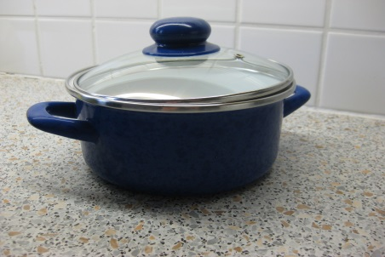
Interaction not only with packaging
changing of surface:
results from heat, mechanical stress, corrosion…
Notes:
We use this articles daily in the kitchen and we notice changes of surface…

Slide 9



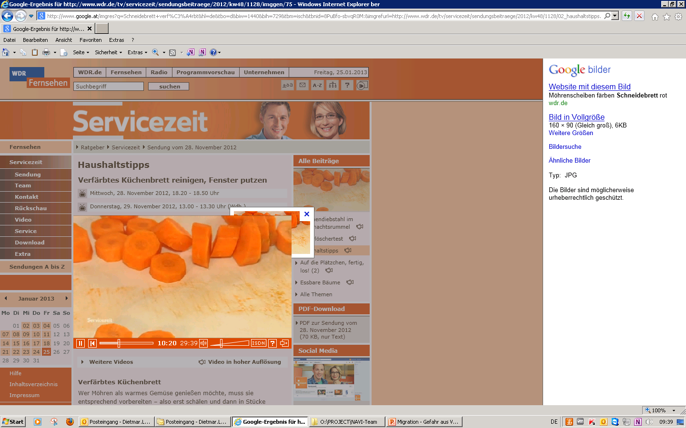

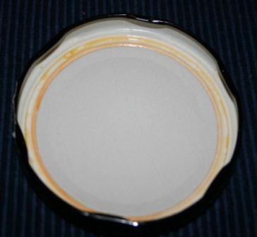
We all knew
All products interact with the environment:
The question is not if, but how quickly
2020:
EUR 20 million turnover
20% more
staff
Colour change due to reaction with natural colorants
Notes:
For example cutting fruit or vegetables..

Slide 10
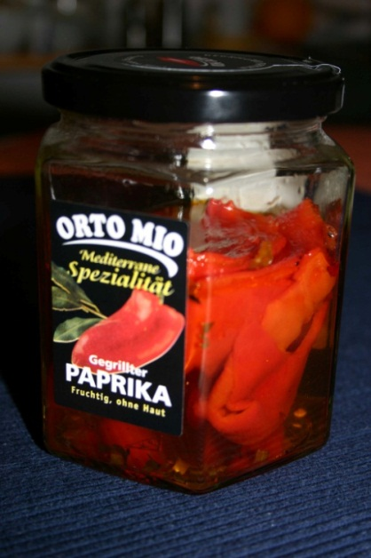
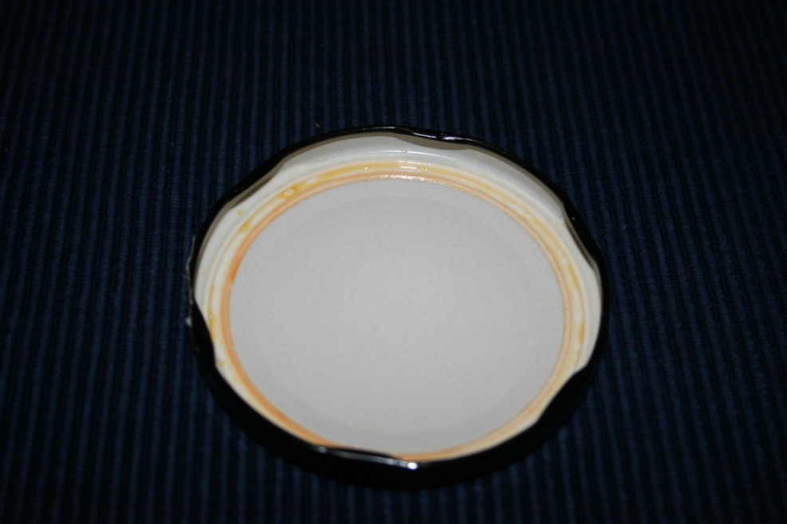

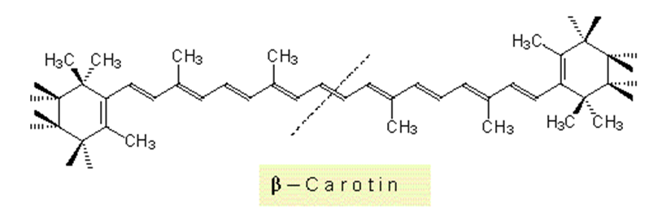
Chemical Interaction

Slide 11
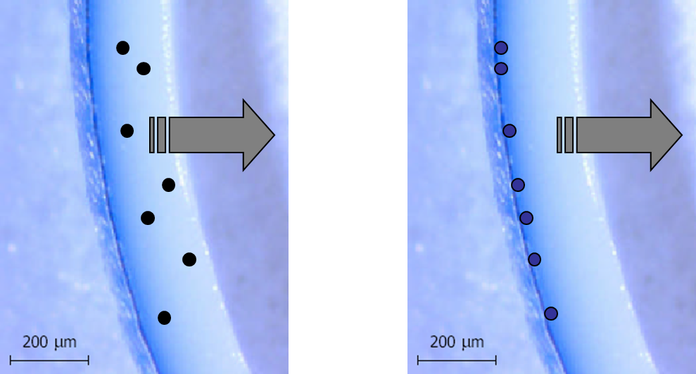
Chemical Interaction
U - Environment
P - Packaging
F – Filling Good

Slide 12
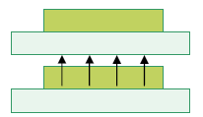

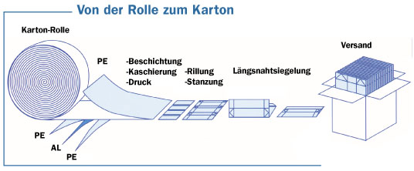
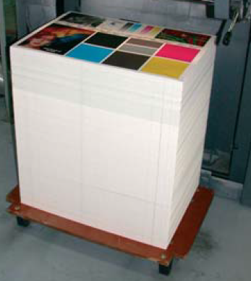
Forms of migration
Invisible „set off“ by reel/stack
Printing inks
film/foil
* Fachverband Kartonverpackungen für flüssige Nahrungsmittel e.V. (FKN)
Notes:
Ink can come into contact with the contents as a result of set-off, which may occur if the unprinted inner surface of the packaging comes into contact with the printed outer surface during print production.
Migration & invisible set off are identified as a main source of risk.
Migration and invisible set-off must be prevented by arranging for suitable processing conditions and selecting a substrate or primary packaging with adequate barrier properties.

Slide 13
What is migration actually?
Migration = transfer of small amounts of substance
from packaging into food
Depend on:
Material
Time
Temperature
Solubility
etc.
Differentiation:
OML “overall migration limit “ means the maximum permit­ted amount of non-volatile substances released from a mate­rial or article into food simulants.
SML “specific migration limit” means the maximum permit­ted amount of a given substance released from a material or article into food or food simulants
Notes:
Migration is usually the transfer of small amounts of substance from packaging into food.
Generally we differentiate between:
OVERALL & Specific
Migration limits for plastic materials:
Overall Migration Limit - 10mg of substances/dm² (square) of the food contact surface for all substances that can migrate from food contact materials to foods
Specific Migration Limit (SML) for individual authorized substances fixed on the basis of a toxicological evaluation.

Slide 14

Framework Regulation (EG) No. 1935/2004
Food contact materials must not transfer their components
into the foods in unacceptable quantities.
Art. 3: materials and articles ...
... shall be manufactured in compliance with good manufacturing practice
... do not transfer their constituents to food in quantities which could:
endanger human health
(b) bring about an unacceptable change
in the composition of the food
(c) bring about a deterioration
in the organoleptic characteristics thereof
specific migration
overall migration
sensoric
Notes:
We have already heard of the framework regulation.
However I would like to mention that specific migration is used when there is danger to human health.
Overall migration is used in case there is an unacceptable change in the composition of food and Sensoric tests are used when there is a deterioration in the organoleptic characteristics of food.
As we have already heart, FWR regulates…
Materials and articles must be manufactured in compliance with good manufacturing practice so that, under their normal or foreseeable conditions of use, they do not transfer their constituents to foodstuffs in quantities which
could:
— endanger human health,
— bring about an unacceptable change in the composition of the foodstuffs or a deterioration in the organoleptic characteristics thereof.

Slide 15
Potential migrants
Glass
  Silicates
  Heavy metals (e.g. Lead, Chromium, Cadmium)
Plastics
  Plasticizers (e.g. Phthalates)
  Antistatic agents (Stearate)
  Lubricants and release agents (Stearate)
  Monomers (e.g. Styrene, vinyl chloride)
  Antioxidants (sterically hindered phenols, very small amounts)
Paper
  Additives and fillers (chalk, etc.)
Metal (Aluminium, tinplate)
  Electrochemical reactions lead to the transition of metals (especially acidic contents)
Notes:
Let’s move on to potential migrants
“Migration” of Aluminium tin in combination with low pH filling goods

Slide 16
http://ec.europa.eu/food/food/chemicalsafety/foodcontact/docs/ReferencesEurNatLeg_20091026.pdf

Slide 17
News for FCM in EU
Guidelines for Plastic Directive 10/2011 finally published
Germany plans national directive for printing inks
Germany plans national directive for mineral oils
Hormon active substances still under discussion

Slide 18

Europe

Slide 19

USA

Slide 20

FDA
US Food and Drug Administration
Code of Federal Regulations (CFR)
for FCS (food contact substances)
  Chemical Asessment
  Migration: single-use-applications vs. repeat-use-applicationsand
  Packaging info: consumption factors (CF) and food-type distribution factors (fT)
  Toxicological Assesment
  Environmental Asessment
  21 CFR 25.40 or exclusion of environmental assessment (EA)
  DC = CF(M) = CF Ʃ (MFSL)(fT)
  DC: dietary concentration
  M: Meanvalue related to fT –value
  MFSL: Migrationlimit
  EDI = DC x 3 kg food per person per day
  EDI: estimated daily intake; (1.5 kg liquid und 1.5 kg solid food)
Notes:
http://www.cfsan.fda.gov/~dms/opa-docs.html
Center for Food Safety and Applied Nutrition (CFSAN, Zentrum für Lebensmittelsicherheit und angewandte Ernährung)
Center for Drug Evaluation and Research (CDER, Zentrum für Arzneimittelbewertung und Forschung)
Center for Biologics Evaluation and Research (CBER, Zentrum für biologische Bewertung und Forschung)
Center for Devices and Radiological Health (CDRH, Zentrum für radiologische Geräte und Gesundheit)
Center for Veterinary Medicine (CVM, Zentrum für Veterinärmedizin)
National Center for Toxicological Research (NCTR, Nationales Zentrum für toxikologische Forschung)
Office of Regulatory Affairs (ORA, Büro für Überwachungsaufgaben)
Office of the Commissioner (OC, Büro des Beauftragten)

Slide 21

China

Slide 22
China
GB 9685-2008
Hygienic standards for uses of additives in food containers and packaging materials
  http://www.codeofchina.com
  Issued by the Ministery of Health (MOH)
  containers and packaging materials and other equipment or utensils in contact with food
  paper, bamboo, wood, metals, porcelain, ceramics, plastics, rubber, fibre, glass …
  Regulates food packaging 959 additives (positive list, migration limitis)
  Official under revision since 25 Jan 2013

Slide 23


Australia / New Zealand

Slide 24
Australia / New Zealand
www.foodstandards.gov.au

Slide 25

Brazil

Slide 26
Brazil
ANVISA Agência Nacional de Vigilância Sanitária
National Health Surveillance Agency
  www.anvisa.gov.br
  GMC Resolution on general criteria and material classification, published as Resolution RDC N. 91 (2001)
  Packaging and food companies must comply with the published technical regulations
  Sanitary Inspection is required (Operation License)
  HACCP must be implemented
  Companies must inform the beginning of the manufacture of the product(s) to the Sanitary Authority
  MERCOSUR GMC resolutions on food contact material

Slide 27

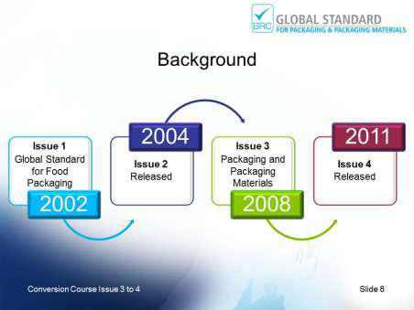
BRC Packaging
The BRC/IOP Global Standard for Packaging and Packaging Materials – Issue 4
published in February 2011; audits will commence against Issue 4 from Aug. 2011
Certification to the Standard verifies:
  technical and functional performance
  aids manufacturers’ fulfillment of legal obligations
  helps provide protection to the consumer

Slide 28

WPO

Slide 29

Long time vision/mission
WPO Food Safety Working Group
There is a harmonised legislation worldwide for (transport-)packaging for dangerous goods (ADR, RID, IATA, …).
We should have worldwide harmonised rules for food safety for packaging materials.
(Tom Schneider, President WPO)

Slide 30
tasks / targets
Knowledge
Discussion / Exchange of views
Information on current claims
engage bodies with analytical knowledge, to discuss severity of problem – risk assessment
collect most important food safety factor in each country
guide for GMP
investigate nano-tech opportunities vs. dangers
Network
build networks in order to influence
directory on WPO-website (contacts, players, …)

Slide 31
Possible tasks / targets
Contacts outside WPO
IAPRI, ISO, UN, EFSA, FDA, …
Overview of existing regulatory
collect and evaluate what is available across the world
Foresight of regulatory trends
survey of existing regulations
big picture: what is in place, what is coming
record actions in countries
food grade packaging should be implemented by law enforcement and public advocacy
screening advocacy rules

Slide 32

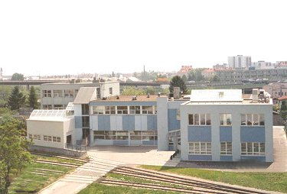
THANK YOU!
Johannes Bergmair
E-Mail: johannes.bergmair@ofi.at
OFI
Brehmstraße 14a
A-1110 Wien
+43-(0)1-798 16 01 - 976
+43-(0)1-798 16 01 - 480

