Slide 1
CROATIAN CHAMBER OF ECONOMY
Industry Sector
Packaging Industry Association
PRODUCTION OF PACKAGING IN THE REPUBLIC OF CROATIA
For the year 2013

Slide 2
CONTENT:
bruto domaći proizvod, indeksirano na 2006.
Macroeconomic Environment in the Republic of Croatia 2
Production of Packaging in Croatia – Statistical Data 5
Trends for 2014 and onward … 11
1

Slide 3
Macroeconomic Environment in the Republic of Croatia
THE CROATIAN ECONOMY STAGNATES, ECONOMIC RECOVERY IS UNCERTAIN.
CRISIS DEEPENING AND EXTENSION IS CERTAIN.
Gross Domestic Product, % growth rate
2

Slide 4
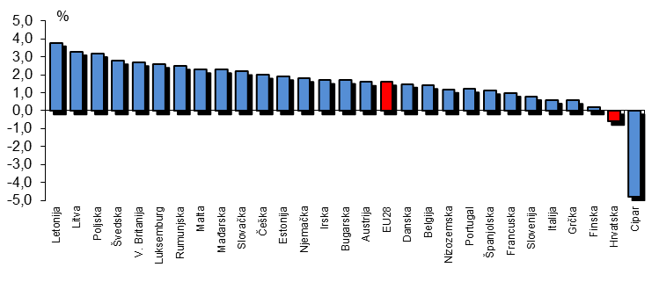
Macroeconomic Environment in the Republic of Croatia
ESTIMATED ANNUAL GDP GROWTH RATE (%) IN EU MEMBER STATES FOR THE YEAR 2014.
Gross Domestic Product, % growth rate
3

Slide 5
Macroeconomic Environment in the Republic of Croatia
THE HIGHEST UNEMPLOYMENT RATE IN CROATIA SINCE 2003
Unemployment rate in the Republic of Croatia, %
4

Slide 6
CONTENT:
bruto domaći proizvod, indeksirano na 2006.
Macroeconomic Environment in the Republic of Croatia 2
Production of Packaging in Croatia – Statistical Data 5
Trends for 2014 and onward … 11
*Podaci su izraženi u (000) tona
*Prikaz razdoblja 2006. – 2013 godine
*Izvor: podaci Državnog zavod za statistiku (proizvodnja) HGK
5

Slide 7
Production of Packaging in Croatia – Statistical Data
WOODEN PACKAGING PRODUCTS – PRODUCTION IN THE REPUBLIC OF CROATIA
Produced quantities in the period 2007 - 2013,
(in thousands of m3)
in thousands of m3
CAGR %
-0,8%
2007
2008
2009
2010
2011
2012
2013
6
*Source: Croatian Bureau of Statistics

Slide 8
Production of Packaging in Croatia – Statistical Data
CORRUGATED CARDBOARD PACKAGING, SACKS AND BAGS- PRODUCTION IN THE REPUBLIC OF CROATIA
Produced quantities in the period 2006 – 2013 ,
(in thousands of tons)
In thousands of tons
CAGR %
+1,6%
2006
2007
2008
2009
2010
2011
2012
2013
7
*Source: Croatian Bureau of Statistics

Slide 9
Production of Packaging in Croatia – Statistical Data
PLASTIC PACKAGING - PRODUCTION IN THE REPUBLIC OF CROATIA
Produced quantities in the period 2006 – 2013 ,
(in thousands of tons)
In thousands of tons
CAGR %
+2,0%
2006
2007
2008
2009
2010
2011
2012
2013
8
*Source: Croatian Bureau of Statistics

Slide 10
Production of Packaging in Croatia – Statistical Data
GLASS PACKAGING PRODUCTS- PRODUCTION IN THE REPUBLIC OF CROATIA
Produced quantities in the period 2006 – 2013 ,
(in thousands of tons)
In thousands of tons
CAGR %
+2,4%
2006
2007
2008
2009
2010
2011
2012
2013
9
*Source: Croatian Bureau of Statistics

Slide 11
Production of Packaging in Croatia – Statistical Data
METAL PACKAGING PRODUCTS- PRODUCTION IN THE REPUBLIC OF CROATIA
Produced quantities in the period 2006 – 2013 ,
(in thousands of tons)
In thousands of tons
CAGR %
-1,4%
2006
2007
2008
2009
2010
2011
2012
2013
10
*Source: Croatian Bureau of Statistics

Slide 12
CONTENT:
bruto domaći proizvod, indeksirano na 2006.
Macroeconomic Environment in the Republic of Croatia 2
Production of Packaging in Croatia – Statistical Data 5
Trends for 2014 and onward … 11
11

Slide 13
Trends for 2014 and onward …
MAIN CHALLENGES AND EXPECTATIONS IN THE FUTURE
Most common business issues encountered by packaging manufacturers:
- low liquidity, indebtedness
- smaller, fragmented orders
- increase in general costs
-innovation: active and intelllgent packaging (Rfid, nano technology,…) …nobody invest as price competition still goes on
Will consumers attenton shift from buying at the lowest price to a revaluation of quality?
- 2013: shifts to quality is slowly coming up, as a result of food scandals
12

Slide 14
Trends for 2014 and onward …
MAIN CHALLENGES AND EXPECTATIONS IN THE FUTURE
Price war made branding less attractive?
Unilever reduces brands from 1500 to 500 - Will this cost-driven trends continue? (Podravka, …)
EU?
Most frequently used measures:
- process and organizational restructuring
- optimization of costs
- export
13

