Slide 1
Xerox Automated Packaging Solutions
A New Way of Thinking
John Cable
HEC & Business Development Manager - DMO
e john.cable@xerox.com

Slide 2
Packaging is a key component of any brand

Slide 3
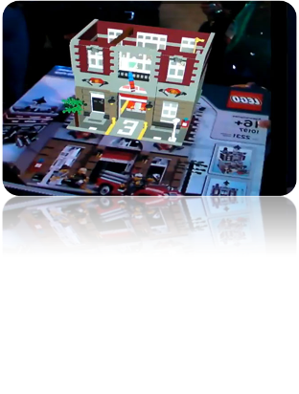
Brand Owners are always looking for new ways of working
Supply chain support
Reduce Costs
Reduce Obsolete inventory
Low waste production
Green packaging
Tracking and tracing
Counterfeit deterrent
Brand management and consumer marketing
Promotions
Loyalty programs
Information resource
Coupon generator
QR Codes
Augmented reality

Slide 4
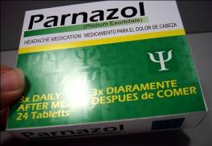
Many of the new Brand Requirements are more suitable to digital printing
Shorter-runs
Test products
Regional
Seasonal
Language Specific
Time specific
Demographics
Regulations
Security
Specific route to market (online, retail etc..)

Slide 5
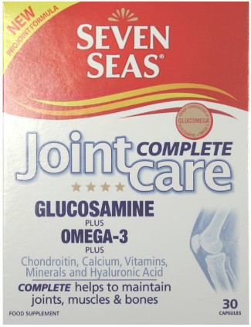
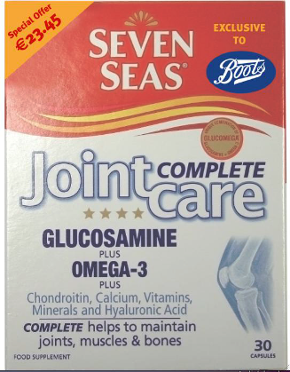
The ability to Version & Personalise is opening up new options

Slide 6
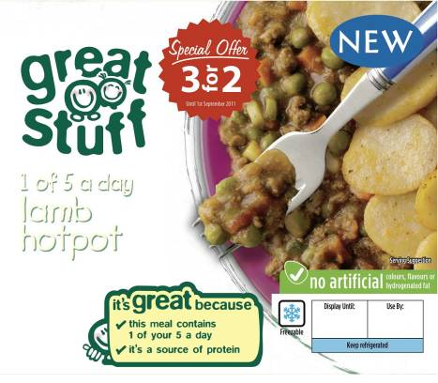
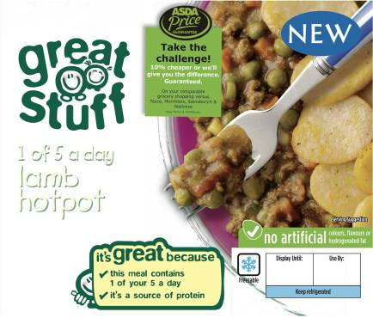
Brand Owners are expecting more flexibility and options

Slide 7
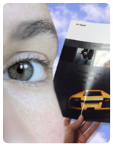
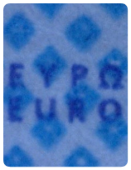
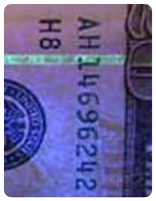
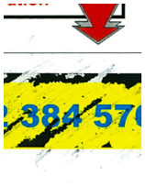
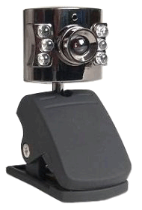
Individualized Security Printing
Standard Machines
Standard Materials
Standard Papers
Multi-layered personalised security printing
Gloss
Microtext
Fluorescence
Scratch-Off
InfraRed

Slide 8
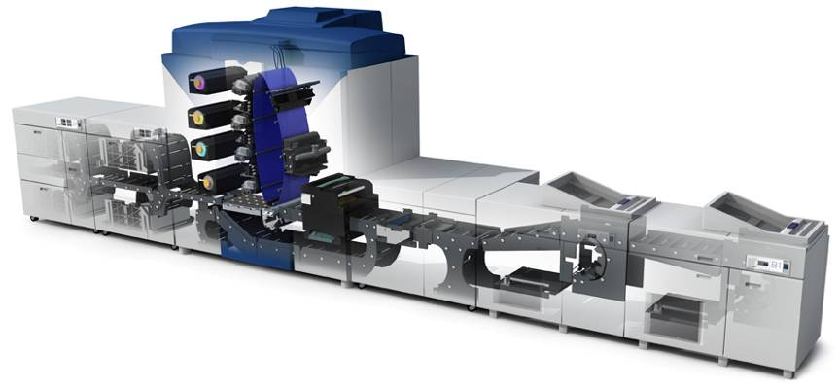
Flexibility to meet all your customer demands
More jobs to meet challenging demands
Packaging
Shelf labels
Point of Sale
Promotional Materials
Advertising
Brochures
Sell Sheets etc…
Automated Processes
High uptime and reliability
Large media range
Benchmark image quality and colour management
Most customers use their existing packaging finishing equipment

Slide 9
Fully Automated click to box solution

Slide 10
Xerox Automated Packaging Solution Powered by Stora Enso Gallop

Slide 11
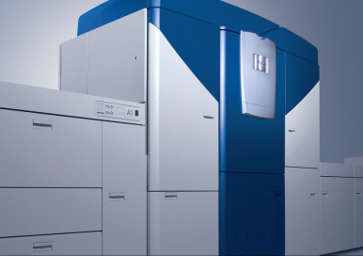
Xerox Automated Packaging Solution Powered by Stora Enso Gallop
Xerox iGen4 Digital Press
Full Colour Production digital printing at 110 A4 impressions ppm
Recommended average monthly volume
200,000 - 3,750,000 pages per month
Media Types
Substrate range up to 350 gsm/18 point paper board
Sheet size up to 26" x 14.33"
Coated: gloss, matte, dull, silk, Uncoated, textured, specialty stocks
Recycled, perforated, tabs, transparencies, a wide variety of labels, synthetics, DocuCard™, NeverTear, DuraPaper™
Mixed-stock jobs supported at rated speed
Automated colour management system with built controls and Inline spectrophotometer

Slide 12
Xerox Automated Packaging Solution Powered by Stora Enso Gallop

Slide 13
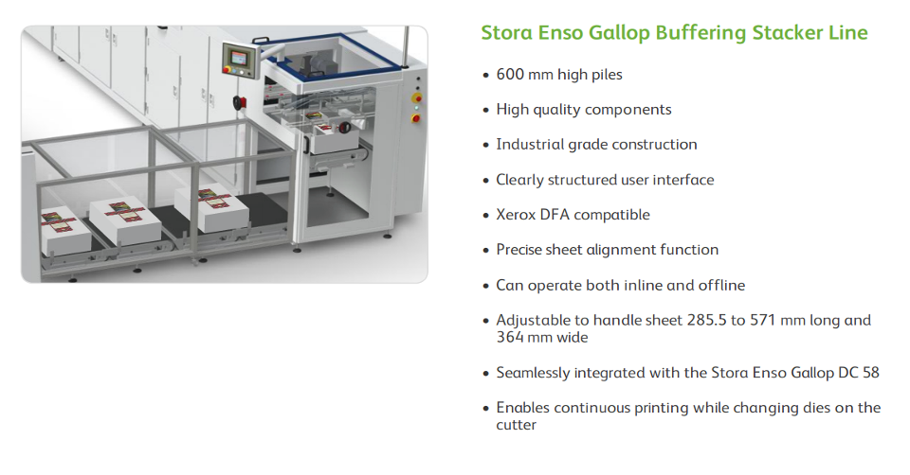
Xerox Automated Packaging Solution Powered by Stora Enso Gallop

Slide 14
Xerox Automated Packaging Solution Powered by Stora Enso Gallop

Slide 15
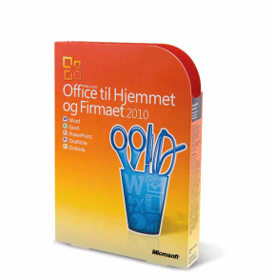
Mediaware Digital Limited Microsoft Packaging
The challenge
Microsoft® was in the process of launching their new Windows 7 operating system and was
looking for a way to:
Speed up distribution, cut costs, lower minimum orders and reduce obsolescence,
all while adding anti-counterfeiting security measures to every package.
The Results
Before Mediaware’s highly automated solution, Microsoft’s lead time to produce packages
was 20 days. With the help of the Xerox digital printing solution, packaging can now be
turned around within 72 hours, including the in-depth customization needed for each unique
geographic market.
Microsoft was thrilled with both the cost and time savings, and they have virtually eliminated
obsolescence by producing packaging on demand after the initial launch of a product.
For Mediaware, their contract has expanded significantly over the last 18 months. More
important, their success has brought in a number of new customers in the pharmaceutical
and gaming markets and driven their year-over-year growth rate to an impressive 42 percent.

Slide 16
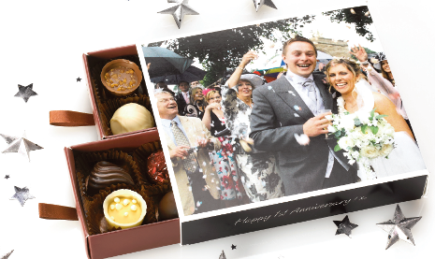
Irongate and Thornton's Chocolates
The ‘create your own chocolate box’ gift allows the consumer to create a truly personalised chocolate gift online. They are able to choose the size the colour of the box and the type of chocolates that go inside. They then pick from a range of generic box designs or choose to make the box truly personal by uploading their own photo. The photo image is printed on the lid, their chosen colour is printed on the sides and underneath of the box and their own personal greeting message is printed on the side of the box.
Consumers can create a chocolate box for any occasion - birthday, anniversary, Christmas gift or just a special surprise.
Results:
- Daily increase 200%
- Seasonal daily increase of over 500% 3500 boxes in 2
weeks leading up to Xmas 1000 in the week leading
to Valentine's Day
- Personalised option now represents 95% of consumer
orders for those lines
- Produce 30,000 personalised gift cards per annum
representing £90,000 worth of extra revenue for
Thornton's Online

Slide 17
Summary
The needs of the Brand Owner is changing as their markets and competition changes.
This is not a threat to the Industry.
Its an opportunity to work closer with your customer.

