Slide 1
Symphony Environmental Technologies
Copyright Symphony Environmental Ltd

Slide 2
Symphony
Symphony is a British public company, listed on the London Stock Exchange
Invested $30 million in R&D
Represented in 92 countries worldwide
Chairman is a Member of the European Parliament.

Slide 3
Symphony
is a Committee member of:
ASTM (American Standards)
BSI (British Standards Institute)
CEN (European Standards)
ISO (International Standards)
EUROPEN
Oxo-biodegradable Plastics Association
3
Notes:
3

Slide 4
Symphony’s Technologies
d2w Controlled-life Plastic
d2p Anti-microbial plastic and anti-fungal plastic
Unique tracers in plastic products
d2Detector -Anti-counterfeiting
Advanced electronic tagging

Slide 5
WHAT IS CONTROLLED-LIFE PLASTIC FOR?

Slide 6
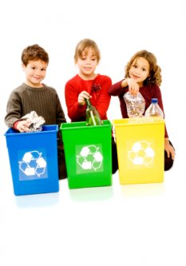
Plastic:
Lightweight
Flexible
Strong/Durable
Economical
Heat sealable
Impervious to moisture
Printable
Recyclable

Slide 7
BUT
PLASTIC CAN LAST FOR MANY DECADES IN THE ENVIRONMENT
7
Notes:
7

Slide 8
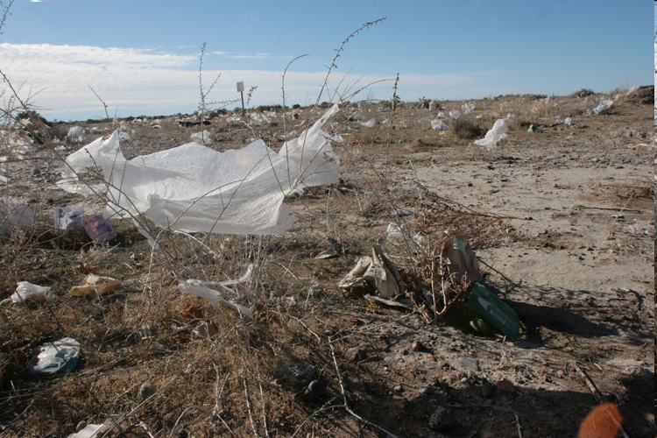
THE PROBLEM
Notes:
MSs
Numerous bacterial cells and fungal spores colonising the cracked area and the whole depth of the film through the crack is showing areas of microbial attack.

Slide 9
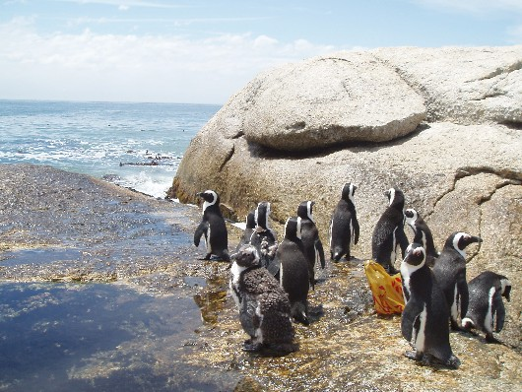
Notes:
MNL

Slide 10
Dr. Caroline Jackson MEP
18th July 2008
Former Chairman of European Parliament’s Environment Committee
“ we will never succeed in collecting all the waste and some may remain to disfigure the landscape. This is particularly the case with plastic waste. Where this goes uncollected it can accumulate in the environment, polluting the land and the oceans for many decades, and perhaps for hundreds of years.
However, technologies have now become available which can produce plastic products which will harmlessly degrade at the end of their useful life.”
10
Notes:
10

Slide 11
The fundamental point about d2w technology is that the additive included at manufacture turns ordinary plastic at the end of its useful life in the presence of oxygen into a material with a different molecular structure.
At that stage it is no longer a plastic and has become a material which is inherently biodegradable in the open environment in the same way as a leaf.

Slide 12
WELL-ESTABLISHED SCIENCE
Ample peer-reviewed science. Latest is 2011 paper in “Polymer Degradation & Stability” showing 91% biodegradation in 24 months
Intertek LCA 2012 puts environmental credentials of oxo-bio way ahead of conventional and bio-based plastics

Slide 13
LEGISLATION IN THE MIDDLE EAST
The UAE has created its own standard for degradable plastic (UAE5009:2009), and has legislated to require all short-life plastic to be oxo-biodegradable.
Extensive due-diligence
WHY?

Slide 14
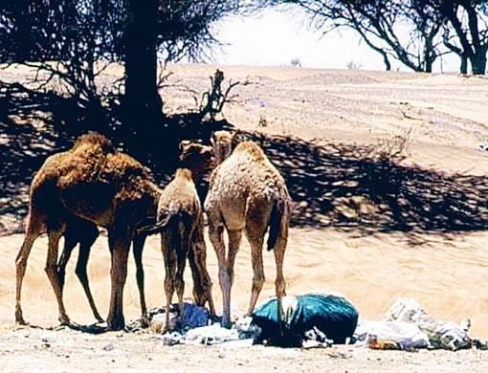

Slide 15
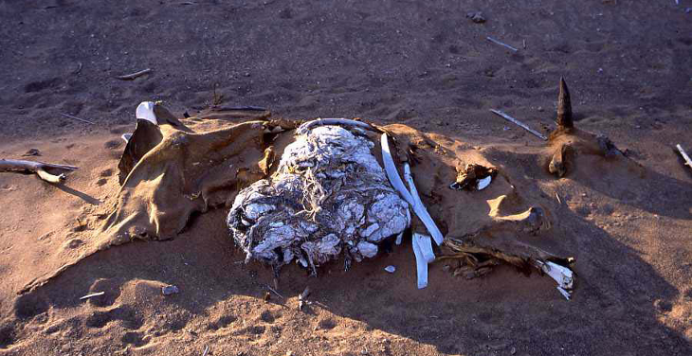
Notes:
MSs
Numerous bacterial cells and fungal spores colonising the cracked area and the whole depth of the film through the crack is showing areas of microbial attack.

Slide 16
NOT a disposal option
Nobody is suggesting that biodegradable plastics should simply be thrown away
BUT – North Pacific garbage patch
16

Slide 17
HOW DOES IT WORK?
FOUR STAGES
SHELF-LIFE
SERVICE-LIFE
OXIDATION PHASE - requires only oxygen
BIODEGRADATION PHASE
See http://www.biodeg.org/files/uploaded/biodeg/Timescale_for_Degradation.pdf
Stage 3 is the relevant phase for litter

Slide 18
LITTER
There is no evidence that degradable plastic of any kind encourages littering

Slide 19
WHAT IS IT NOT FOR?
LANDFILL
Already disposed of
Degradation deep in landfill is not desirable - methane

Slide 20
COMPOSTING?
EN13432 requires 90% of the plastic to convert to CO2 gas within 180 days – contributes to climate change but does not improve the soil.
Controlled-life plastic retains the carbon for much longer, and is better for the soil – but does not emit CO2 fast enough for EN13432
Composters don't want post-consumer plastic

Slide 21
WHAT DOES IT COST?
99% made with the same raw-materials as ordinary plastic. It does not use vegetable materials.
Little or no on-cost

Slide 22
HOW SAFE IS IT?
Controlled-life plastics pass the eco-toxicity tests in EN 13432, ASTM D6954 and BS8472 to confirm that they are not toxic
They also satisfy the requirements of EN13432 to confirm the absence of heavy metals and other toxic and hazardous substances
They also conform to EU and US requirements for direct contact with food

Slide 23
HOW IS IT USED?
It can be manufactured with existing machinery
No change of supplier or loss of jobs
Suitable for PE, PP, or PS

Slide 24
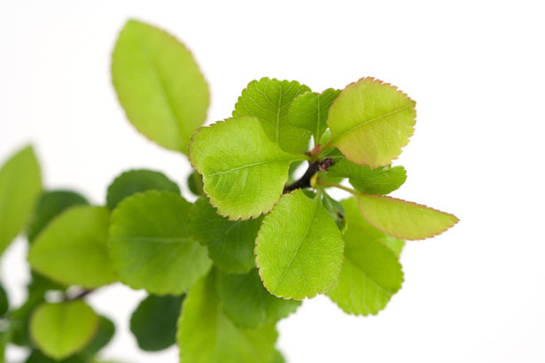
What can you do with Oxo-bio Plastic ?
RECYCLING
D2w Controlled-life plastic can be recycled during its service-life, with normal oil-based plastics
http://www.biodeg.org/position-papers/recycling/?domain=biodeg.org

Slide 25
IN WHICH APPLICATIONS?
Rigid products such as bottles and cups
Food packaging
Carrier bags or “shopper-bags” which consumers use to take away their purchases from the shop
Refuse sacks, which consumers buy in rolls at the shop, and use for disposal of their ordinary household waste.
Aprons, for the protection of garments, in the home, hospitals, restaurants, workshops etc.
Bags to contain dog faeces collected in parks, gardens, et
Bin liners, Gloves, Bread bags, Frozen food bags
Wrappers for cigarette packets
Shrink-wrap, pallet-wrap and “Bubble-wrap”

Slide 26
D2w PLASTIC IS NOT SUITABLE FOR
Long-life applications
PVC
PET

Slide 27
Controlled-life v Bio-based
CL is intended to degrade in the open environment – BB in industrial composting
CL costs less than 5% more – BB costs up to 400% more.
CL made from by-product of oil or gas – BB from crops
BBnot really “renewable”
CL stronger and more versatile
CL retains carbon, Bio-based hydro emits to atmosphere as CO2
CL can be recycled – BB CANNOT

Slide 28
RELEVANT STANDARDS
Controlled-life plastic can be tested according to ASTM D6954-04 – “Standard Guide for Plastics that Degrade in the Environment by a Combination of Oxidation and Biodegradation”
Also UAE Standard 5009:2009
British Standard 8472
Swedish Standard SPCR 141
French Accord T51-808 N 015

Slide 29
Standards - oxo
These Standards measure:
Tier 1 – Degradability
Tier 2 - Biodegradability
Tier 3 - Eco-toxicity
They are not Specifications.
It is not possible to provide a specific timescale in a general standard for oxo-biodegradable plastic, (as distinct from a standard for composting) because the conditions found in industrial composting are specific and the conditions found in the open environment are variable.
Also, the time taken for oxo-biodegradable plastic to commence and complete the processes of degradation and biodegradation can be deliberately varied.

Slide 30
IRRELEVANT STANDARDS (except for the eco-toxicity test)
EN 13432
ASTM D6400
AUSTRALIAN 4736
ISO 14855 and 17088
These are all standards for composting - requiring short timescales and rapid CO2 emissions

Slide 31
D2t Anti-counterfeiting
Unique tracer in plastic
Electronic tagging
Adding Value

Slide 33
D2p Adding Value
By protecting health
Adding d₂p to your product or packaging provides it with antimicrobial performance and anti-fungal performance
This means that any harmful bacteria that come into contact with your product or packaging will not be passed on through human contact
The bacteria and fungi will be killed off within a short time period
So not only is your product good for its original purpose but it also has the added value of helping to protect human health and to preserve food
This is your opportunity to be an innovator and use d₂p to your advantage
Adding Value

Slide 34
THE FUTURE
R&D continues
– New applications. (Last year Symphony developed an additive for metallised BOPP)
New timescales
More testing
New legislation
New standards
New environmental technologies

