Slide 1

Student Creative Workshop CROPAK 2012

Slide 2
STUDENT CREATIVE WORKSHOP
CROPAK 2012
Idea and Concept by:
Drena Milijević, managing director
Tectus d.o.o., Croatia
Organizers:
Tectus d.o.o., Croatia
Institute of Packaging and Graphic Arts – IAT Croatia
Trade Journal Ambalaža/REGprint
Patrons:
University of Rijeka
University of Split
University of Zagreb

Slide 3
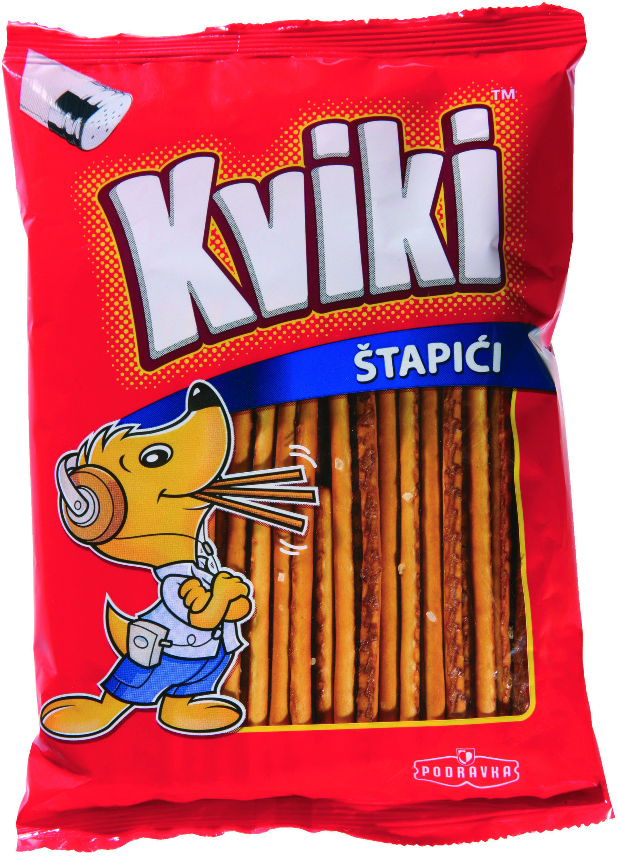
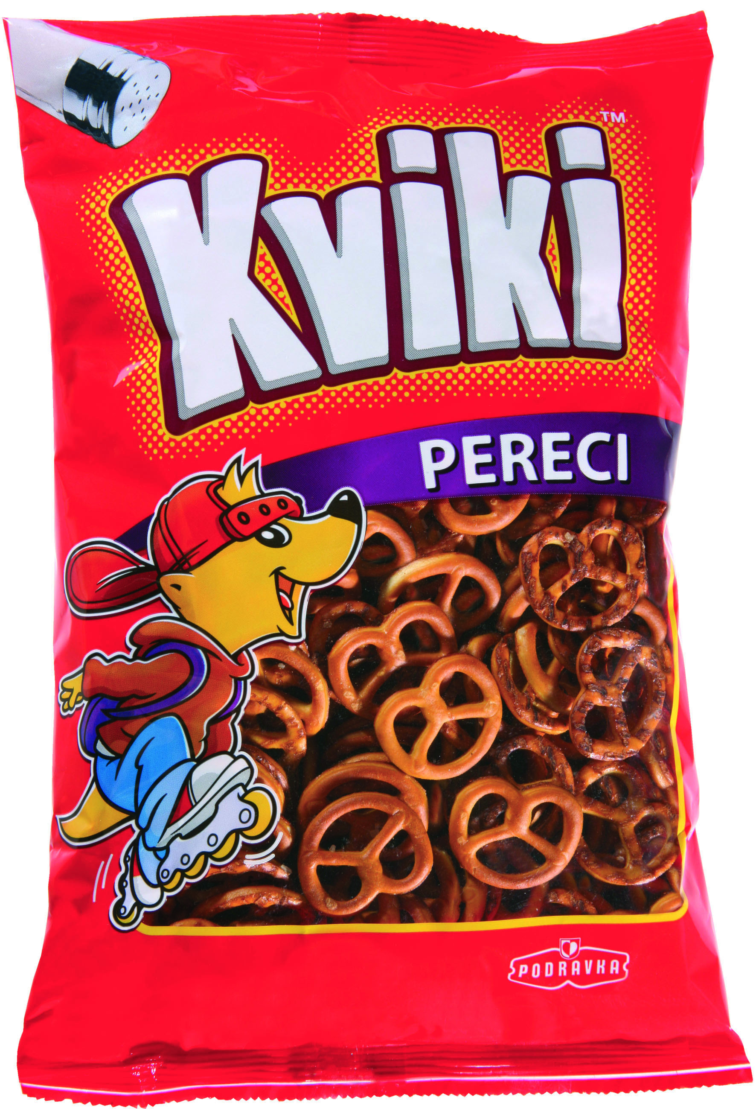
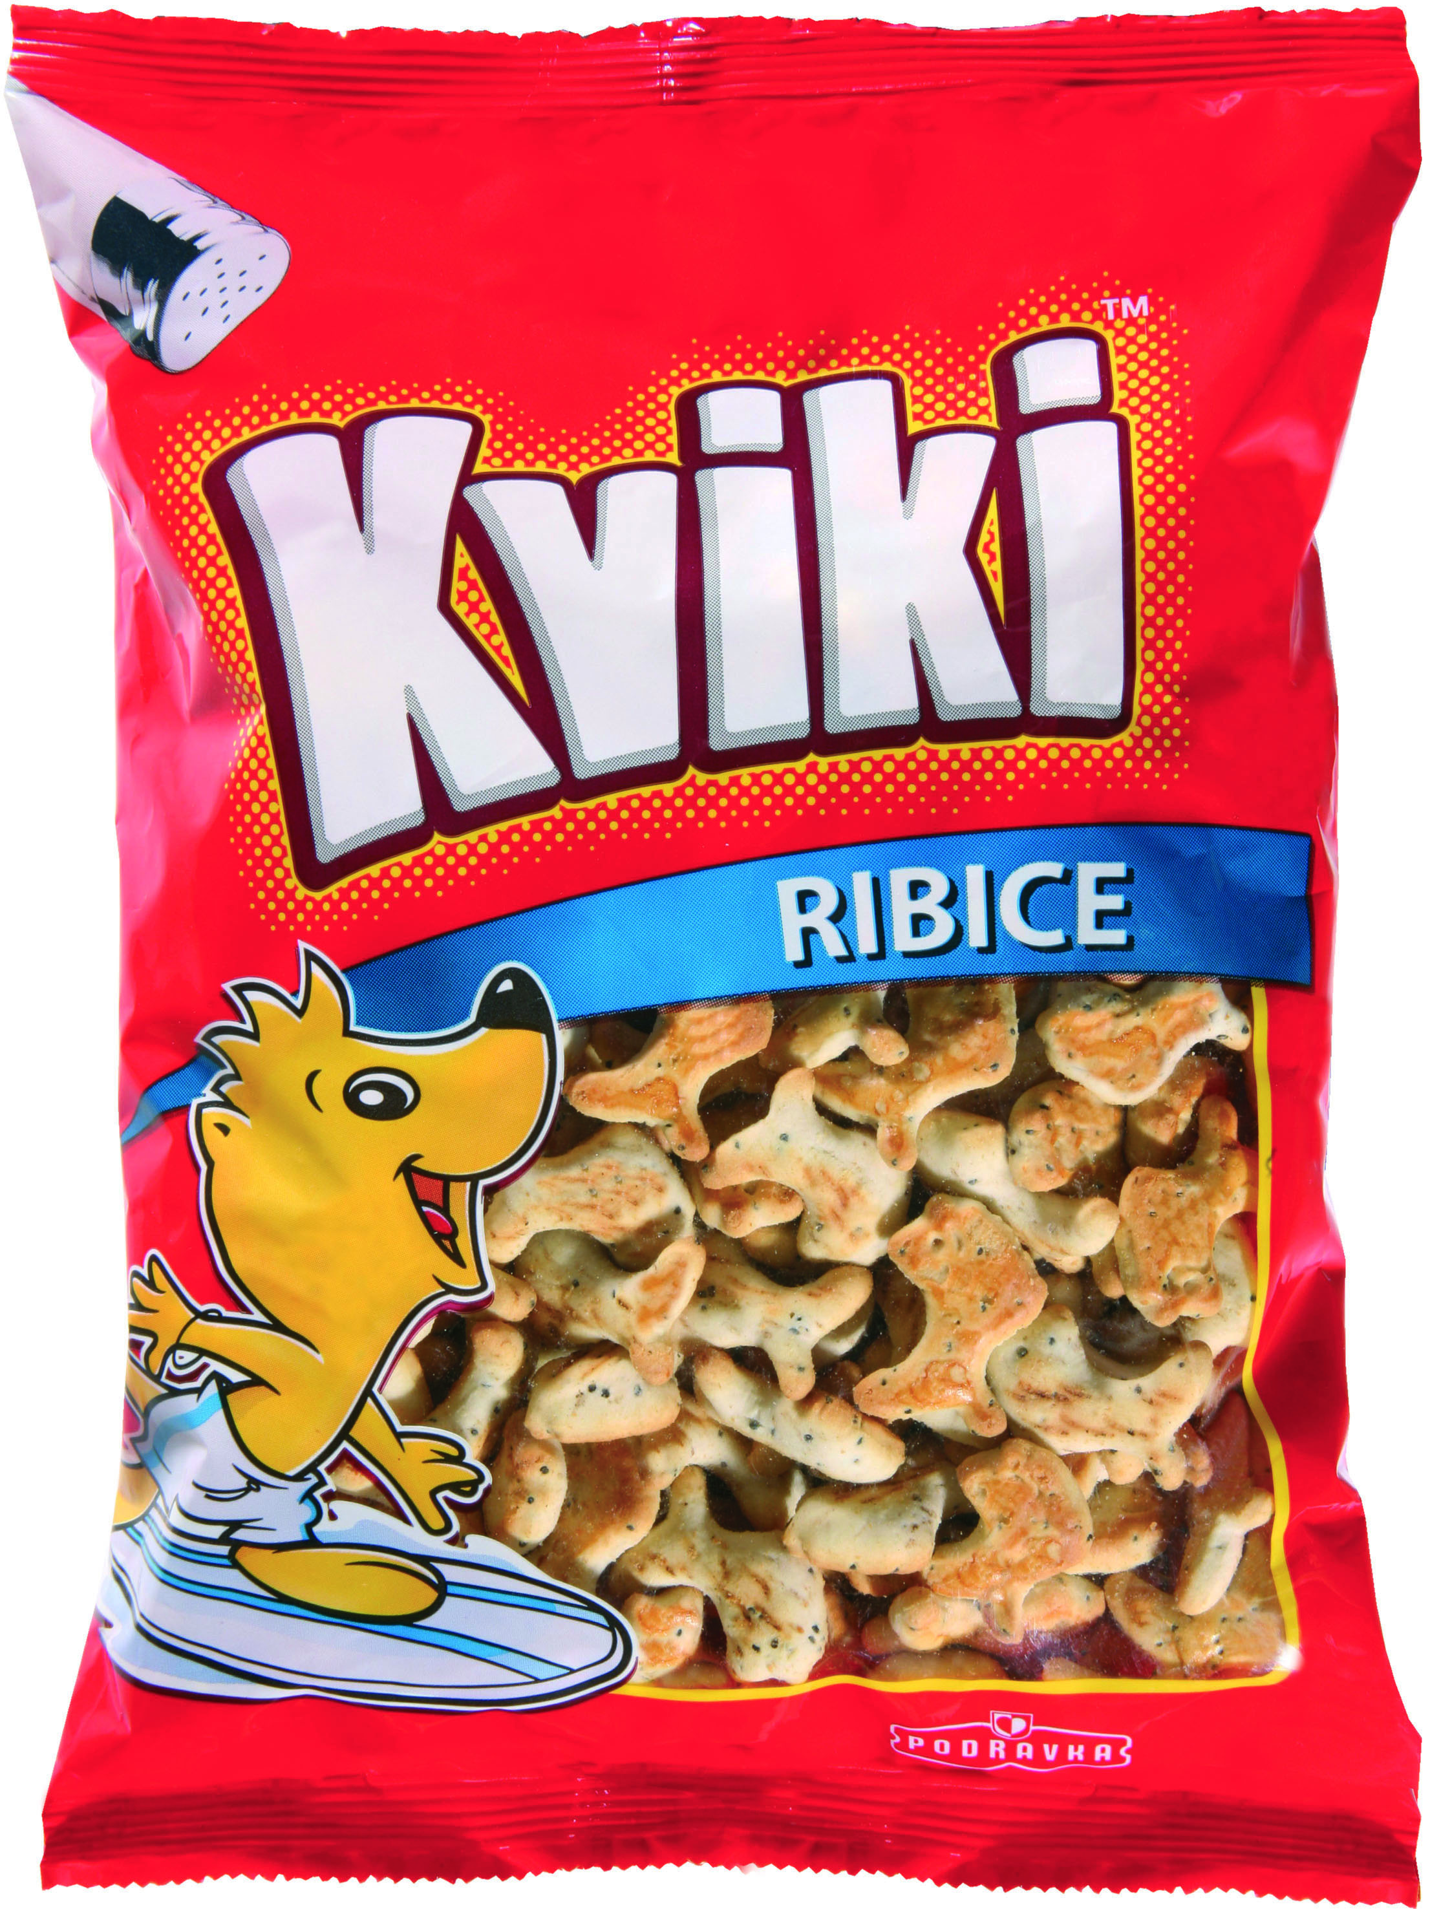
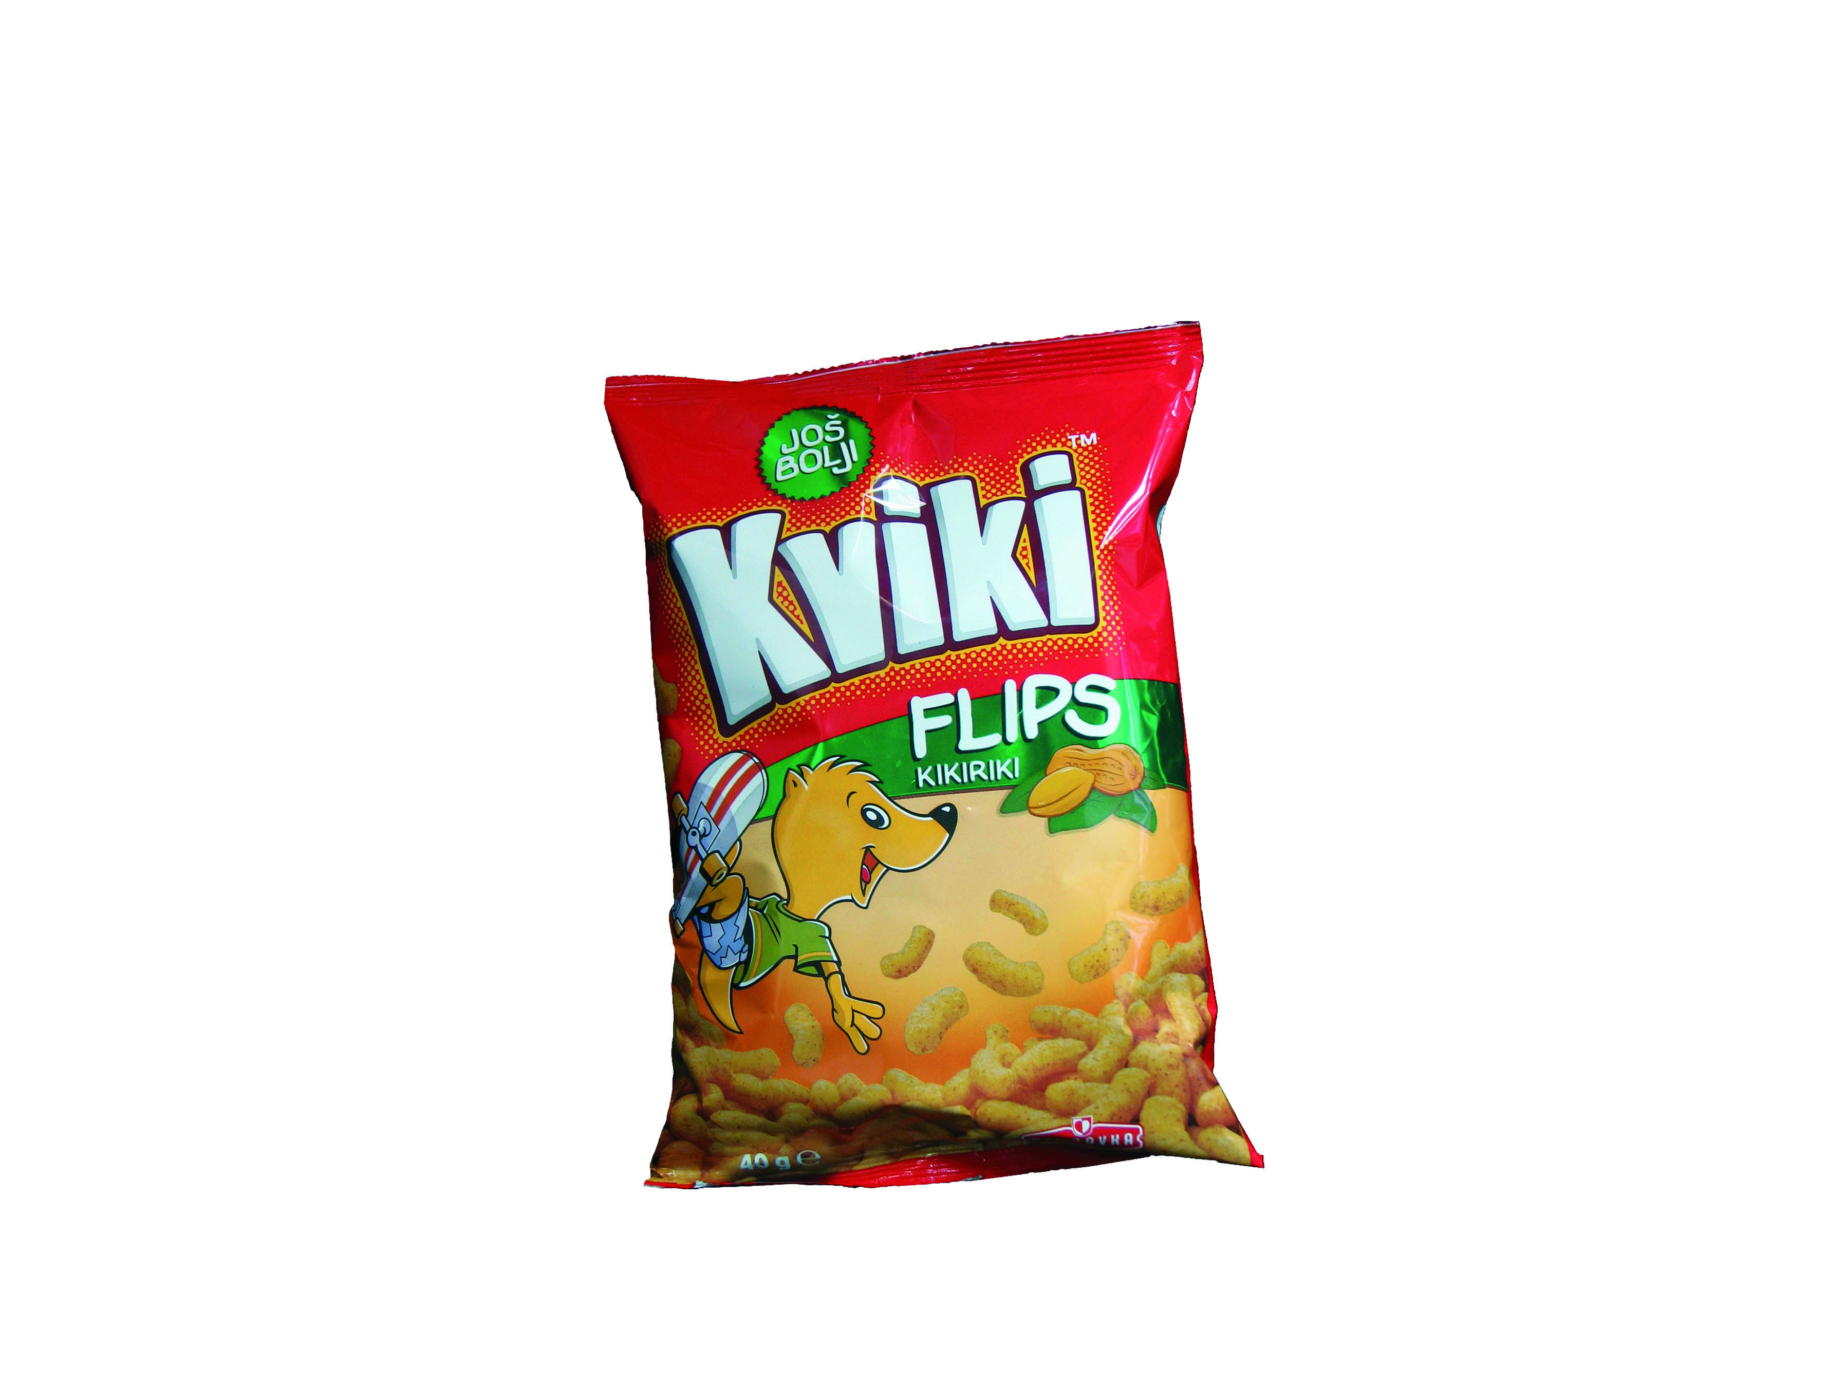
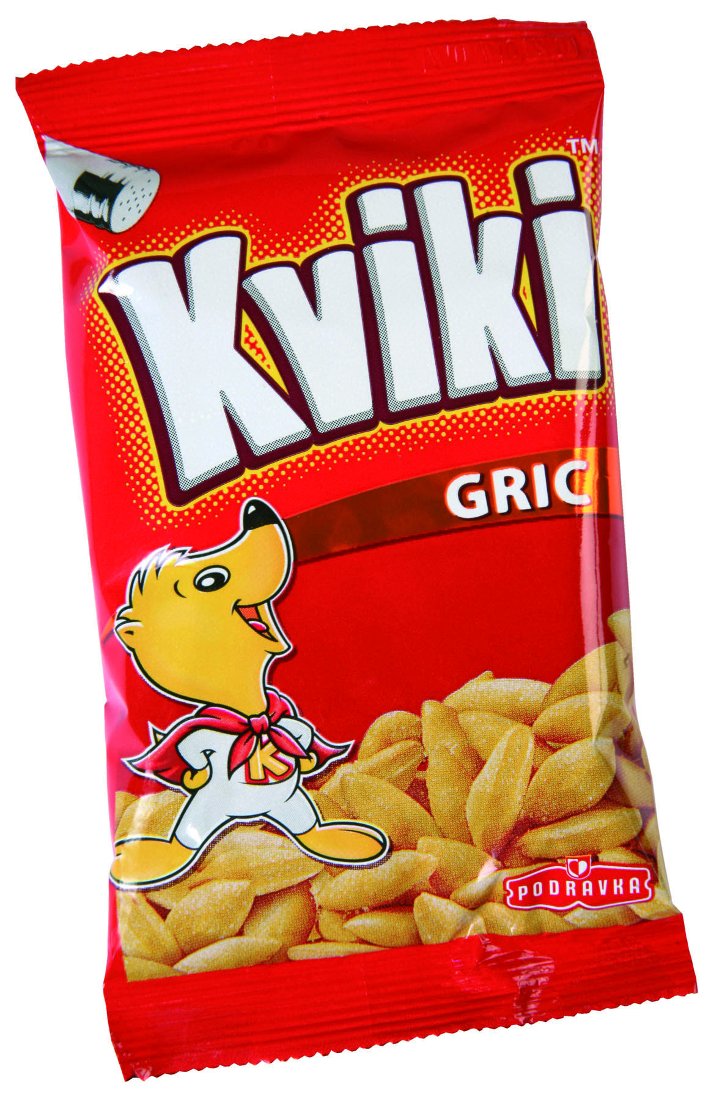
STUDENT CREATIVE WORKSHOP
CROPAK 2012
CREATIVE ASSIGNMENT:
Redesign of Kviki Line of Snacks

Slide 4
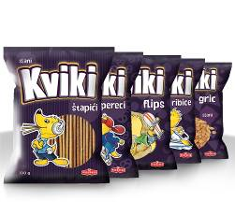
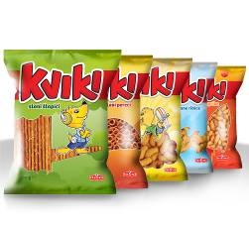
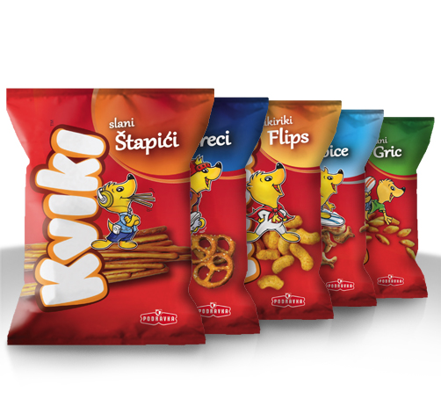
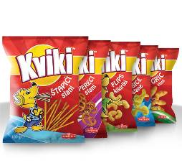
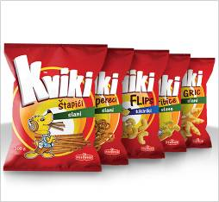
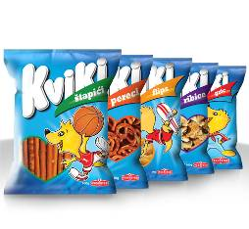
STUDENT CREATIVE WORKSHOP
CROPAK 2012

Slide 5
STUDENT CREATIVE WORKSHOP
CROPAK 2012
Student: Nensi Benazić, University of Rijeka, Academy of Applied Arts
Mentor: Aljoša Brajdić
Assistant: Sanjin Kunić

Slide 6
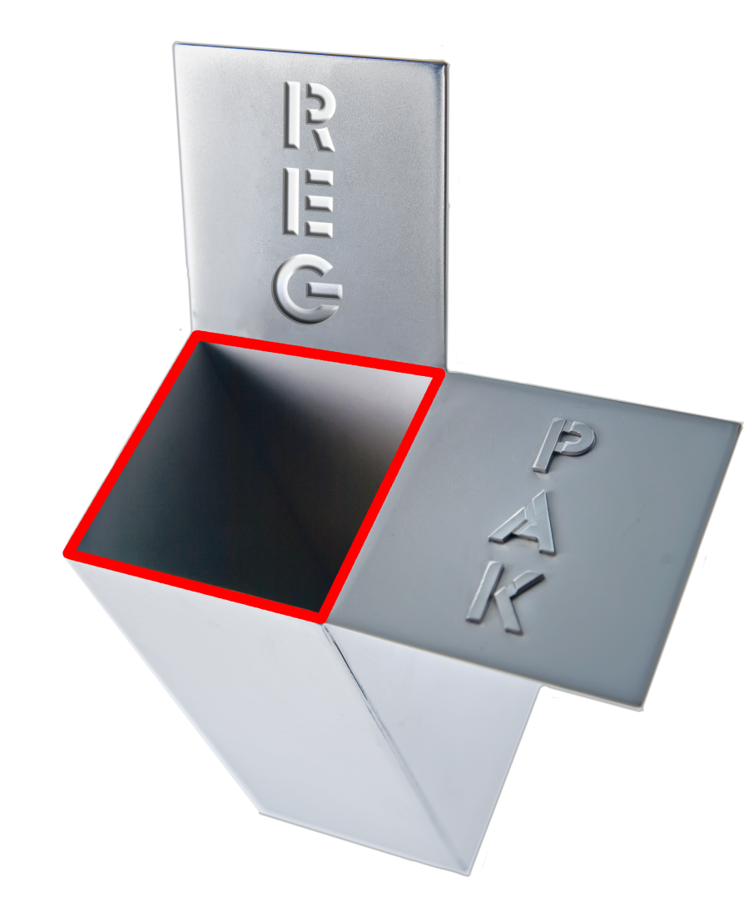
Good mark!
REGPAK

Slide 7

Series: Grandma's secret
Brand owner: Foodland Ltd, Serbia
Design: Peter Gregson, Ltd, Serbia
Packaging manufacturers: Vetropack Straža d.d., Croatia, Promedia Ltd., Serbia

Slide 8
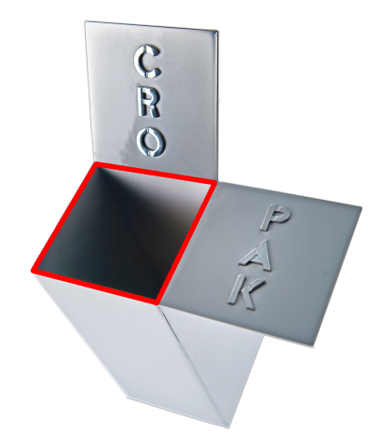
REGPAK
CROPAK
Good mark!

