Slide 1
Package Design Economic, Social & Ecological Aspects
Daniel A. Abramowicz, Ph.D.
EVP Technology and Regulatory Affairs
Crown Holdings
World Packaging Congress
June 2012

Slide 2
Crown Holdings

Slide 3
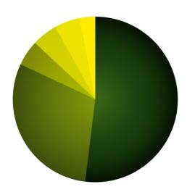
2011 Crown Figures
Net Sales
$8.6 billion
Asia
10%
Geographic
Split
Manufacturing in
41 countries
Employing 20,700 people
Europe
51%
Americas
39%
#1 producer of food cans and aerosol cans in the world
Other
3%
Speciality
5%
#2 producer of metal vacuum closures in the world
Closures
5%
Aerosols
5%
Beverage
52%
#3 producer of beverage cans in the world
Food
30%
Products
Over 100 billion cans and closures produced annually

Slide 4
Role of Packaging
Physical protection
Shock, vibration, temperature, etc.
Barrier protection
Oxygen, water, etc.
Containment
Provide information
Transport, recycling, ingredients, etc.
Marketing
Security
Tamper resistance, traceability, anti-counterfeiting, etc.
Convenience
Stacking, handling, displaying, opening, reclosing, etc.

Slide 5
Sustainability
Mega-Trend with Staying Power
Often viewed narrowly along only 1D
Environment
Generally viewed even more narrowly as Carbon Footprint
3D View
Environment
Social
Economic
Role of Primary Packaging
Reduce the “Product Footprint”
Reduce product waste and spoilage

Slide 6
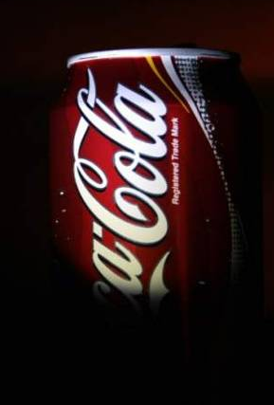
Total LCA View of Packaging
“Far from being a burden and waste, packaging adds value to products by extending the shelf-life of goods, minimizing breakage, reducing transportation and handling costs, safeguarding public health and providing product-use information and convenience to the consumer.”
“The negative perceptions of packaging simply as a troublesome byproduct are at direct odds with the significant role it plays in society.”
The Coca-Cola Company website
Primary Role of Packaging
Reduce the “Product Footprint”
Reduce product waste and spoilage

Slide 7
Economic Dimension

Slide 8
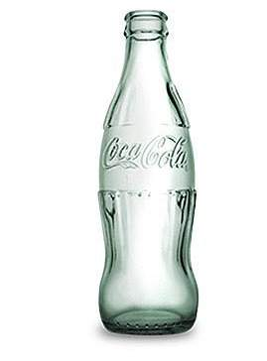
Coca-Cola
Notes:
Brand recognition

Slide 9
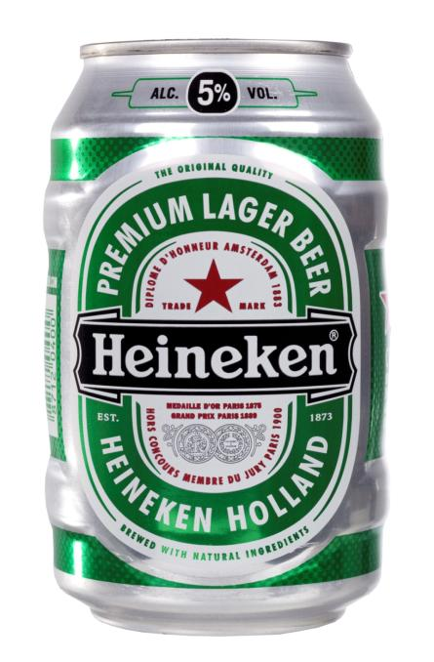
Heineken

Slide 10
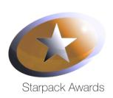
Wera
Notes:
Name: The WERA “Screwdriver Can”
Entrant: CROWN Aerosols Europe
User: WERA
“A thorough approach to delivering a branded 3D
identity in a retail category that is not as brand focused
as fast moving consumer goods” – judges’ comment.
Metal shaping comes into its
own with this can body and
cap from CROWN Aerosols
Europe for WERA’s hand-tool
range. The asymmetrical can
is made using a proprietary ‘blowforming’ shaping technology, which uses highpressure air inside the can to expand and shape. The final touch for this aesthetically pleasing pack is a bespoke overcap design in the shape of a screwdriver head.

Slide 11
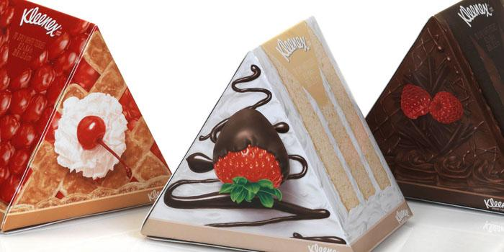
Kleenex

Slide 12
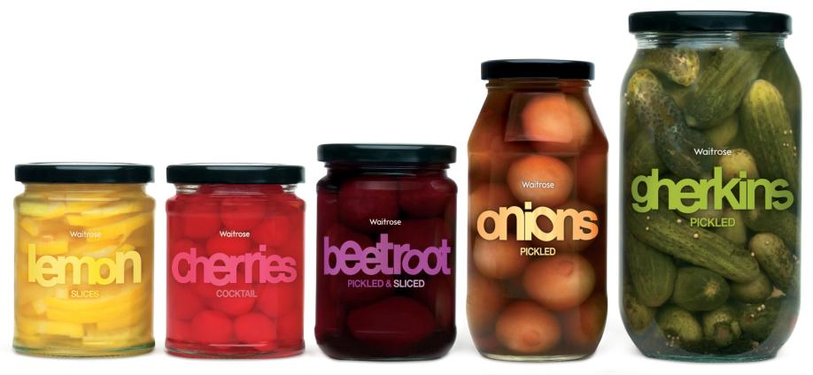
Waitrose Private Label

Slide 13
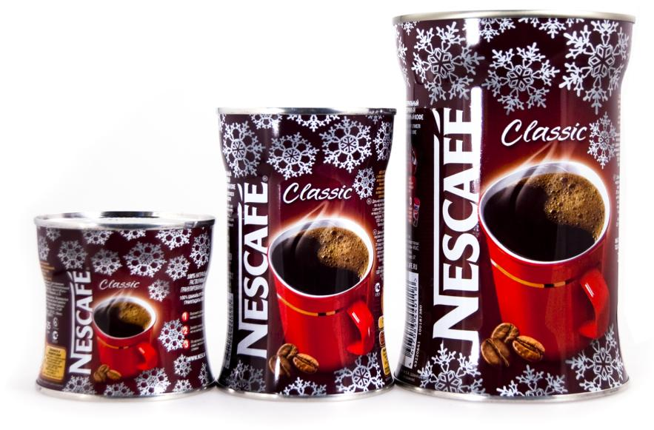
Nescafé
Notes:
Standard Can
Small trial
Larger trial
Permanent packaging change

Slide 14
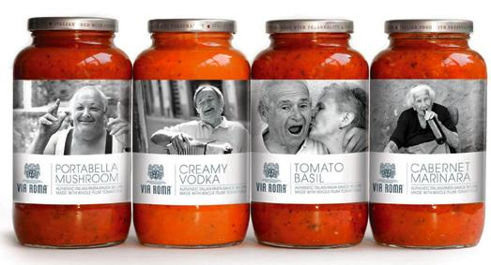
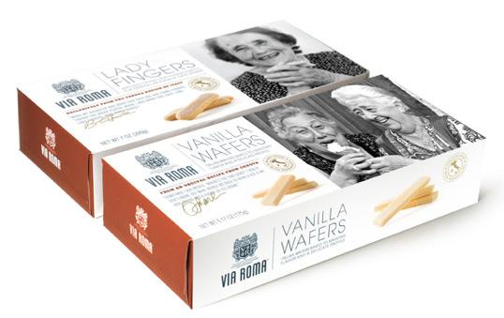
Via Roma
Notes:
Designed by united* | Country: United States
“There are 3 million people in Tuscany. All different & all unique. This authentic Italian brand shows their true character, expression & emotion, in a way that has not been seen before in U.S. retail design.”

Slide 15
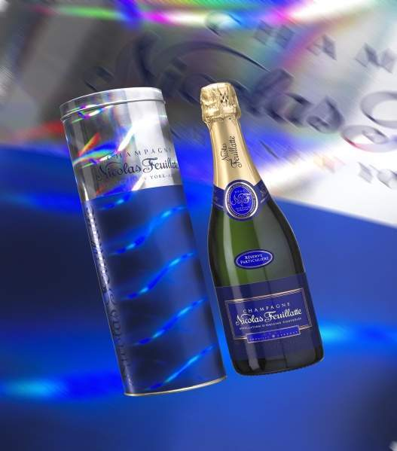
Nicolas Feuillatte

Slide 16
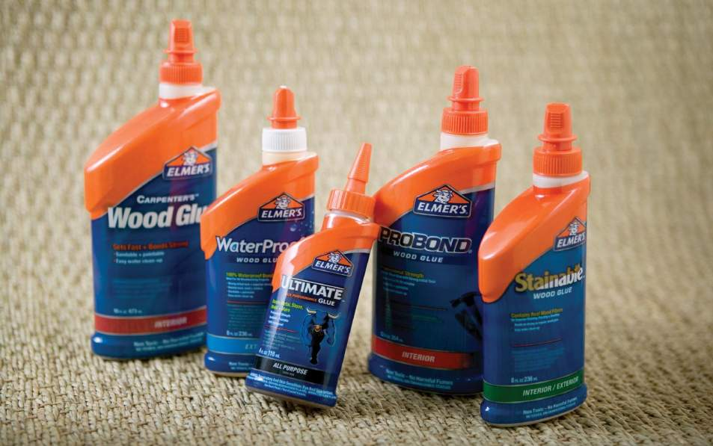
Elmer’s Glue

Slide 17
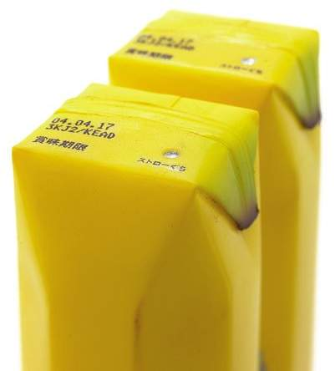
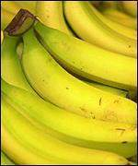
Cues from nature

Slide 18
Diesel Cologne

Slide 19
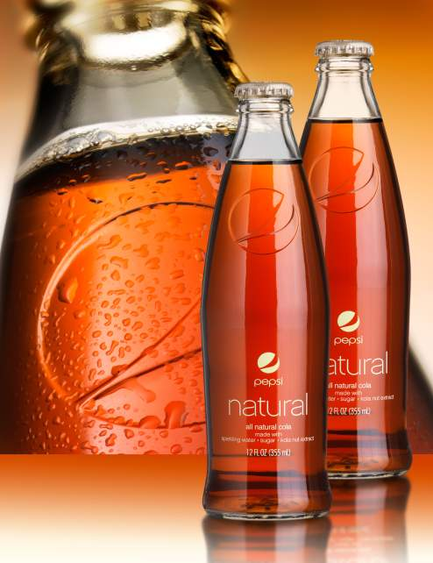
Pepsi Natural
Notes:
Glass Container Supplier: Anchor Glass
New Product Trend: Combining product and container for coherent brand messaging
Packaging Description: In a world of artificial flavors and colors Pepsi Natural is a new and refreshing difference. The glass package has a smooth contemporary look and feel in one’s hand. Its simplicity in form and label accentuates the simplicity and natural qualities of the product contained within.

Slide 20
Snookums

Slide 21
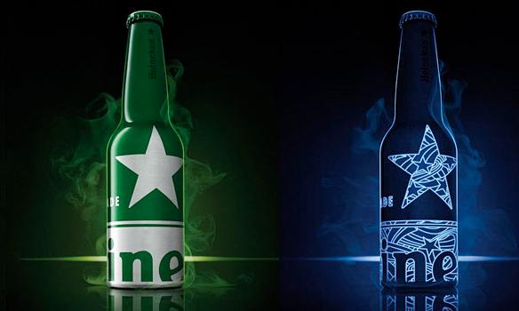
Heineken Aluminum Bottle

Slide 22
Jammy Dodger Biscuit Tin for Marks & Spencer

Slide 23
Zealong Tea

Slide 24
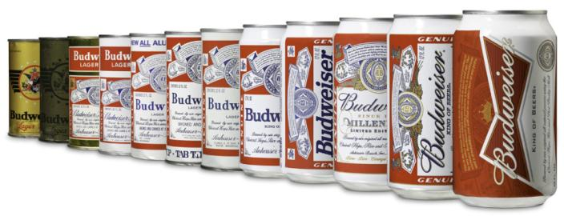
Budweiser

Slide 25
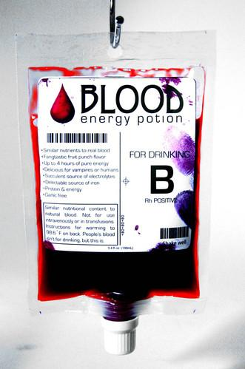
Blood Energy Potion

Slide 26
Environmental Dimension

Slide 27
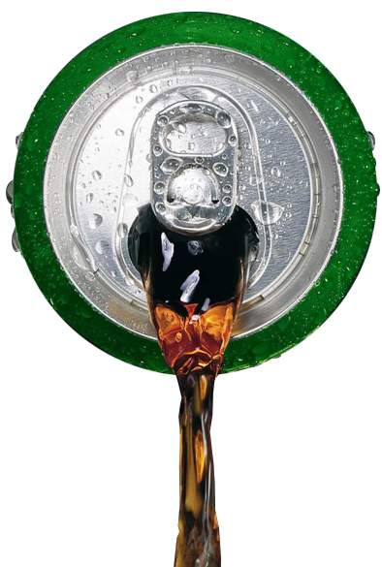
SuperEnd ®

Slide 28
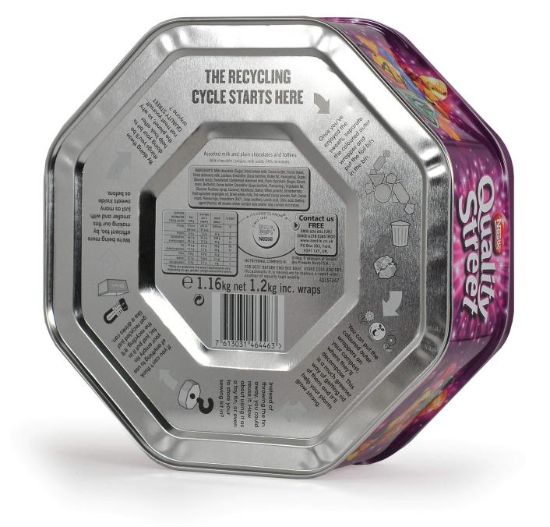
Quality Street

Slide 29
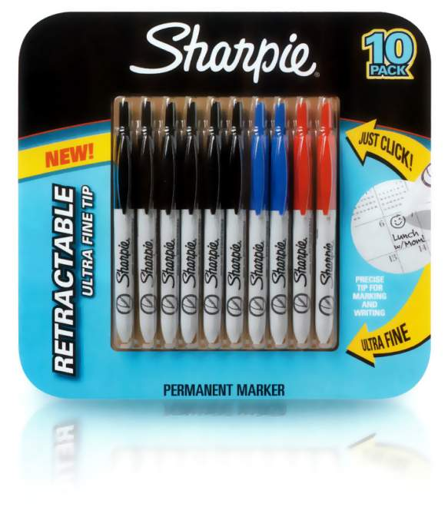
Sharpie

Slide 30
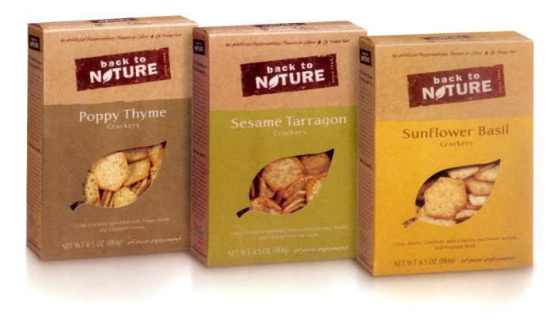

Slide 31
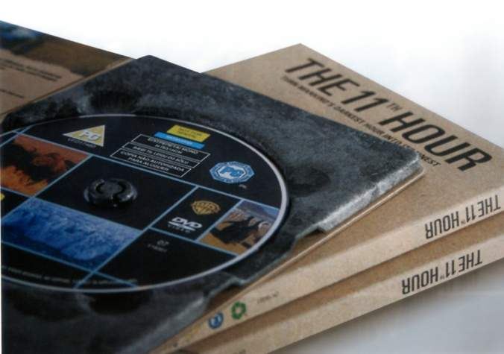

Slide 32
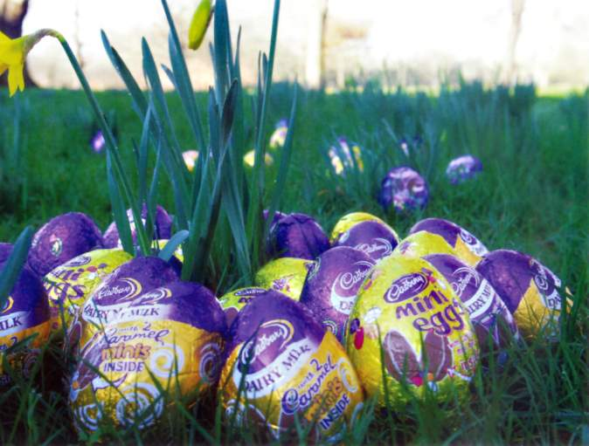

Slide 33
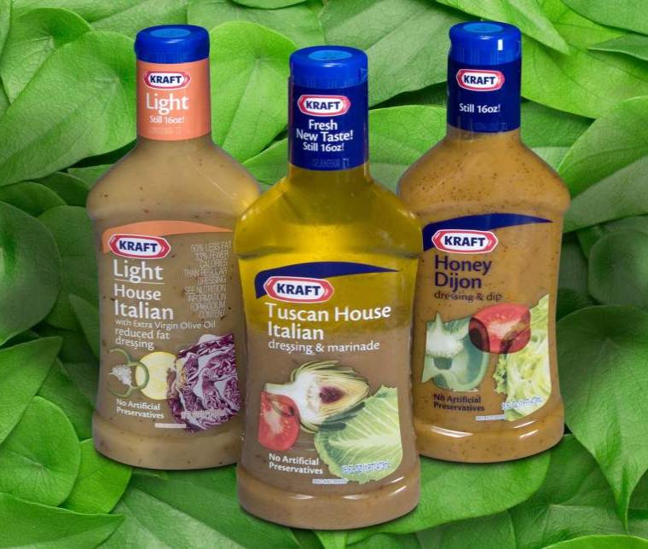
Kraft

Slide 34
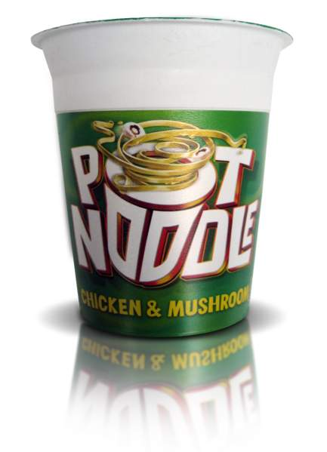
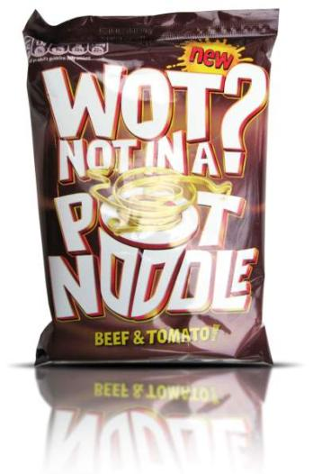
Pot Noodle

Slide 35
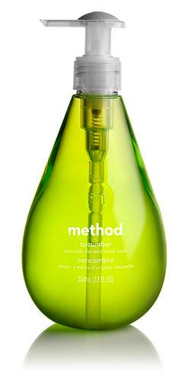
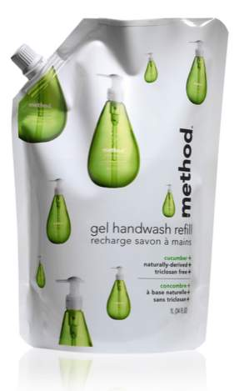
Method

Slide 36
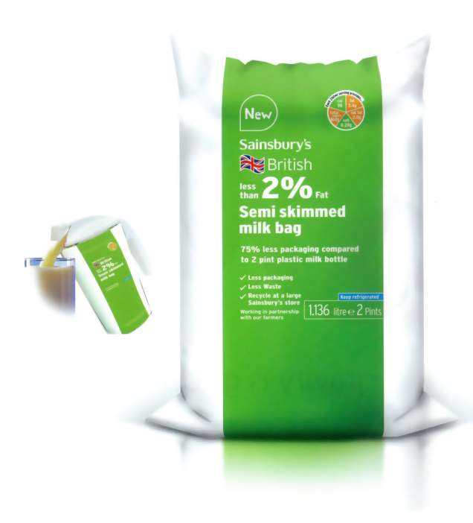
Sainsbury’s

Slide 37
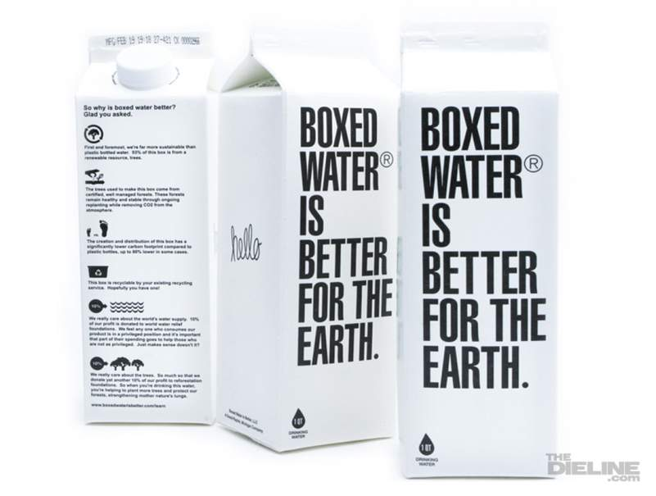
Boxed Water
Notes:
I've sort of developed a crush on these guys over at Boxed Water is Better. Kevin Hockin sent in these photos of their sustainable, recyclable water carton. They were designed by founder Benjamin Edgar (who is also one of the guys behind thebrilliance.com). Here's what they have to say about rethinking bottled water:
"[We] started with the simple idea of creating a new bottled water brand that is kinder to the environment and gives back a bit. We found that water shouldn't be bottled at all, but instead, boxed. So we looked to the past for inspiration in the century old beverage container and decided to keep things simple, sustainable and beautiful.
About 90% of the Boxed Water container is made from a renewable resource, trees, that when harvested in a responsible, managed and ethical way serve as an amazing renewable resource that benefits the environment even as it's renewed. Our carbon footprint is dramatically lower because our boxes are shipped flat to our filler and filled only as demand is created, as opposed to most bottled water companies that ship their empty bottles across the globe to be filled, then ship them back for consumption. The flat, unfilled boxes can fit on 2 pallets, or roughly 5% of a truckload. Empty plastic or glass bottles would require about 5 truckloads. Our cartons can also be broken down to their original flat state, are recyclable in most areas and will be recyclable everywhere shortly. We're also giving 20% of our profits back to the resources our product is composed of--water and trees. Not only does it simply make sense, but we really enjoy supporting water and forestation organizations as it's part of our company's ethos and way of thinking to give back and participate. All that and an over-arching focus on simple and beautiful design that compliments our brand as well as the spaces it's sold and consumed in."

Slide 38
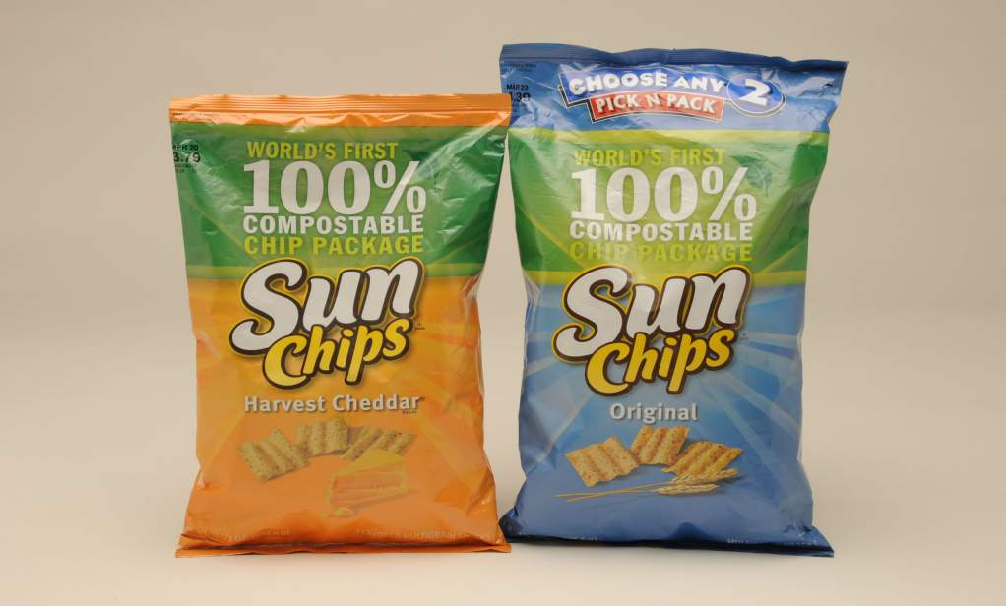
Sun Chips Bag

Slide 39
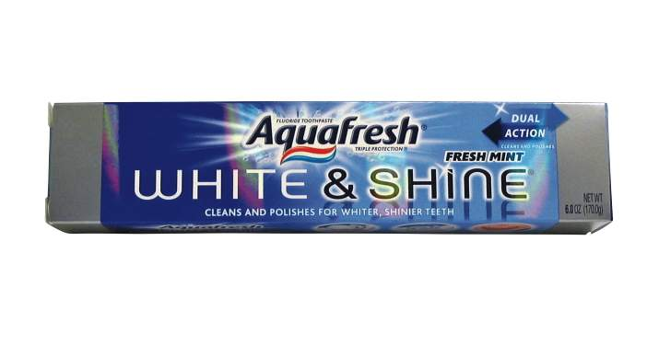
Aquafresh White & Shine
Notes:
GlaxoSmithKline Consumer Healthcare’s new 6-oz Aquafresh White & Shine toothpaste carton was chosen as the winner of the Personal Care/Cosmetics Packaging category due to its use of a technology that at least one Greener Package Awards judge, John Bernardo of Sustainable Innovations LLC, says has the “potential for a huge impact.” HoloBrite™ filmless holographic technology from The Specialized Packaging Group (SPG) is used to achieve a shimmering holographic appearance without the use of a film lamination. This process results in a package that can be recycled in traditional paperboard recycling streams without the concerns of contamination due to a polyester layer and metal content.
According to Mike Larocca, packaging development manager for GSK Consumer Healthcare, one of the main challenges in developing the carton was achieving a high-end finish comparable to that of a traditional holographic laminated carton. “As a consumer product in a competitive environment in the oral care category, premium aesthetics and shelf presence are important keys to success,” he says. “To match the high-end finish, this required extensive development work with various inks, surface treatments, and holographic finishes using stock and custom applications. The final product had to meet tight specifications for high-speed automation, scuff-resistance, and the distribution environment.”
Holographic effects on the Aquafresh carton are created when the HoloBrite printing process is combined with Henkel North America’s MiraFoil® metallic coating. The coating is applied to the SBS carton before it is printed in a single pass on a hybrid printing press using several proprietary processes. Typically, holographic decoration on an SBS carton requires a complex supply chain involving manufacturing and metallization of the holographic film, shipping to a facility for lamination to paperboard, then shipping to the folding carton facility for printing and converting. “This [HoloBrite] folding carton is produced using a simplified supply chain with fewer manufacturing and shipping steps,” explains Larocca. The finished carton also is 5% lighter than its predecessor.
Larocca concludes: “The application of the step-change technology for this package could start a trend to obsolete—or significantly reduce—laminated paperboard cartons and the associated recycling challenges.”

Slide 40
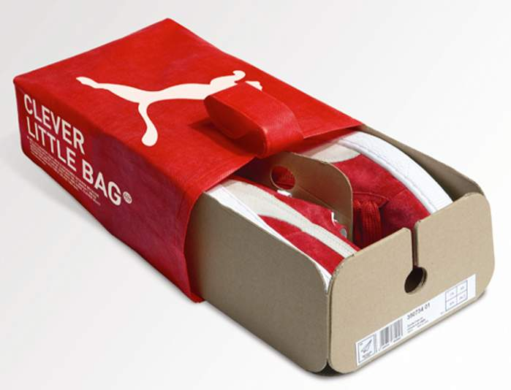
Clever Little Bag
Notes:
Designed by Yves Behar of Fuseproject | Country: United States
“For the last 21 months we have been thinking about shoeboxes: how to fold them, how to ship them and how to reduce them. In the end, we decided to get rid of them altogether because along the way we discovered a new design solution….a “clever little bag”.
Why so clever? By providing structure to a cardboard sheet, the bag uses 65% less cardboard than the standard shoe box, has no laminated printing, no tissue paper, takes up less space and weighs less in shipping, and replaces the plastic retail bag. Now happy Puma customers will take home the clever little one instead. Oh, and that little bag is non-woven which means less work and waste (it is stitched with heat), and after accompanying you in your suitcase wherever you may go, our little friend is even recyclable.
With our “clever little bag”, Puma kicks-off the next pivotal phase of its’ sustainability program. The tens of millions of shoes shipped in our bag will reduce water, energy and diesel consumption on the manufacturing level alone by more than 60% per year. In other words: approximately 8,500 tons less paper consumed, 20 million Megajoules of electricity saved, 1 million liters less fuel oil used and 1 million liters of water conserved. During transport 500,000 liters of diesel is saved and lastly, by replacing traditional shopping bags the difference in weight will save almost 275 tons of plastic.
That such a little bag can have such a big impact…you can see why we called it clever.”

Slide 41
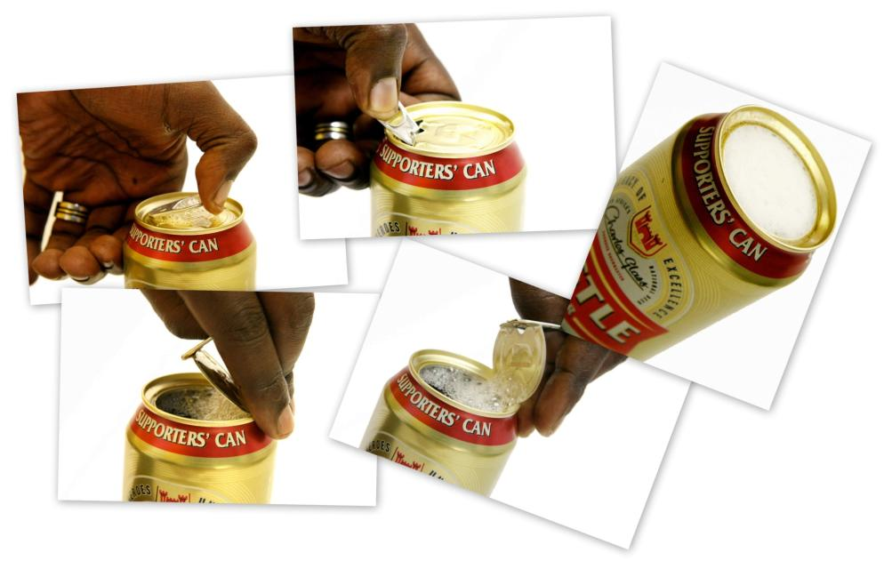
Castle Lager “Supporters’ Can”

Slide 42
Social Dimension

Slide 43
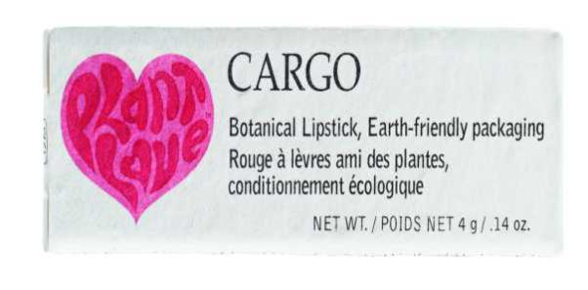
Cargo Lipstick

Slide 44
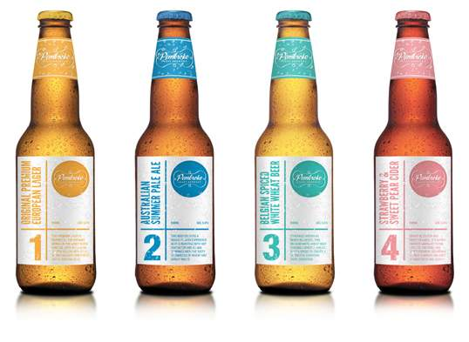
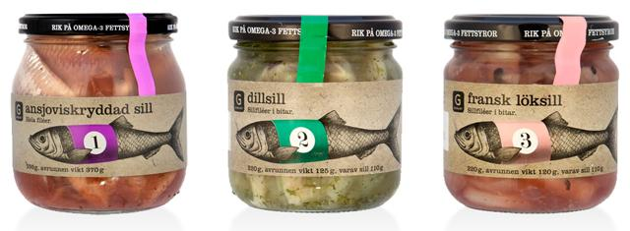
Easier To Shop - Pembroke Craft Brewery / RIK
Notes:
Designed by Gary Head Design | Country: Australia
“What started as a love for beer and the need for more packaging pieces in a growing portfolio, this project developed into creating a brand for two guys who brew more beer than they can drink.
Pembroke Craft Brewery was born and the simple task for this job was to develop a labeling system for their ever expanding brew collection while sticking to their slick brand which highlights their outstanding work ethic to produce premium beer and beverages.
The labeling system is based on a focus toward a numerical labeling rather than traditional simple beer names. Resulting in the name of the beverage varieties being able to be more descriptive than the traditional naming of beers such as Dry or Drought.
All varieties have a template style design with the only point of difference being replaceable copy and colour to reflect the style of each beer/beverage.
You can just imagine going to the bar and ordering a Pembroke 2″

Slide 45
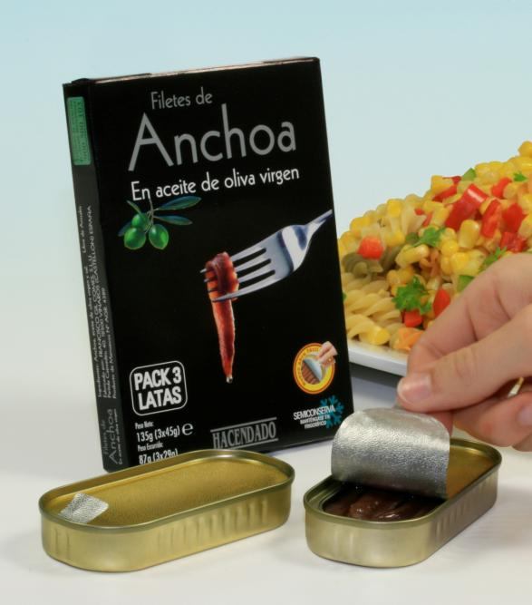
Easier Opening

Slide 46
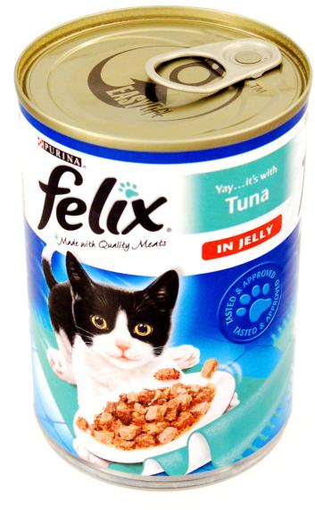
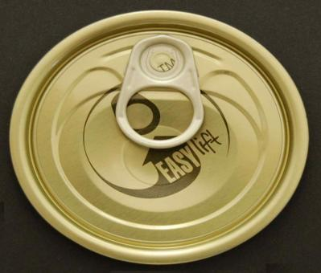
Nestlé Purina Felix with EasyliftTM End

Slide 47
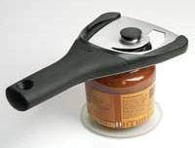
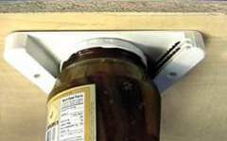
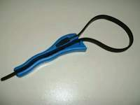
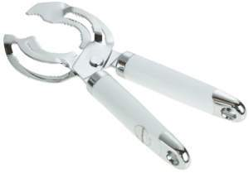
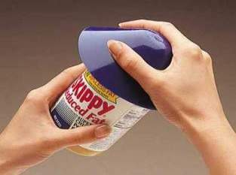
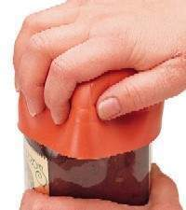
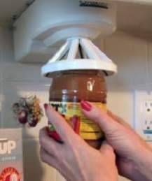
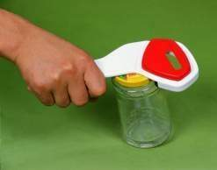
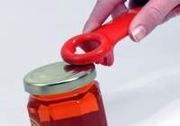

Slide 48
Duerr’s …with OrbitTM

Slide 49
Domino Sugar

Slide 50
Teisseire
Notes:
Brand recognition

Slide 51
Royco

Slide 52
…on the go…

Slide 53
Black Box

Slide 54
Nespresso – Customization

Slide 55
Dutch Boy

Slide 56
Tikkurila

Slide 57
HotCan Self-Heating Can

Slide 58
Target Prescription Drugs

Slide 59
Faller Wallet Pack
Education to Improve Compliance

