Slide 1
Packaging as a Marketing Tool Global approach
Luciana Pellegrino
Executive director
ABRE – Brazilian Packaging Association
Vice President of Marketing
WPO – World Packaging Organisation
Split - Croatia
June, 6th, 2012

Slide 2
AGENDA
Key points of effective packages
Understanding the consumer
The impact of the virtual world

Slide 3
To be considered
Global view x cultural aspects
Analyze global trends
Implement according to local culture, demands, market scenario!
Cost effectiveness is key
Packaging performance, sustainability and efficiency in production and supply chain are intrinsic

Slide 4
The Consumer Goods Industry goal:
To delight consumers
R&D goal:
Invent “delight”
Packaging goal:
Shape and deliver “delight”

Slide 5
The marketing strategy of a brand has to be materialized to consumers through its packages

Slide 6
“Silent”
sales tool
90% of products

Slide 7
The global market scenario brings a bigger challenge to the FMCG industry on have winning products.

Slide 8
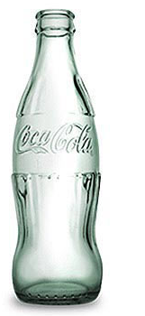
Iconic Packages
Imagine if consumers can recognize your product just by a line

Slide 9
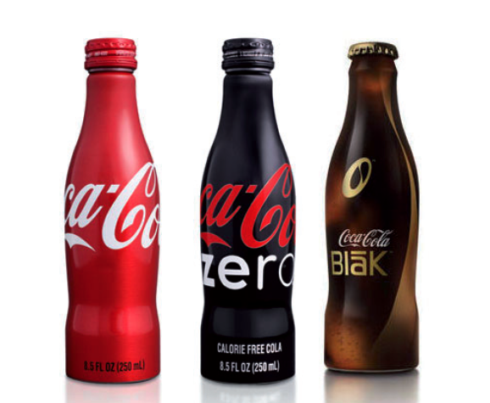
Imagine if consumers will by the packaging itself

Slide 10
Exploring recognition over a range of products

Slide 12
Benefit
Value
Cost
Cost
Cost
reduction
Adding
value
Adding
more value

Slide 13
Delivering value to consumers:
Key points for more effective packages

Slide 14
You need to to know your product and your market
Analyse your competitors
Satisfy the custmer: listen to him, watch him
Adjust your packaging to markets, changes and trends (repositioning , resizing , promotional packages)
Introduce new products and new design, always

Slide 15
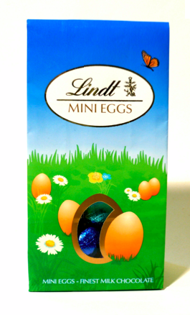
Project your packaging for the consumer you are targeting

Slide 16
Project your packaging for the consumer you are targeting

Slide 17
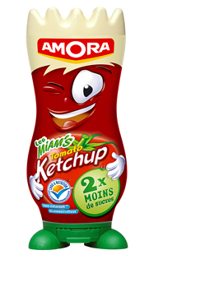
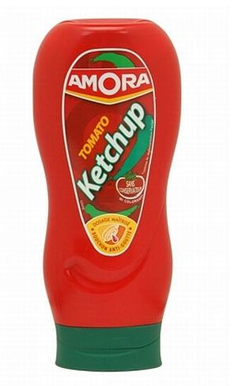
Make your product be part of the consumption moment
Notes:
Make

Slide 18
Make your product be part of the consumption moment
Notes:
Make

Slide 19
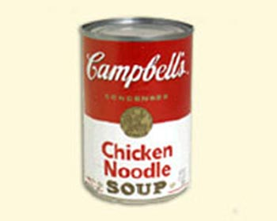
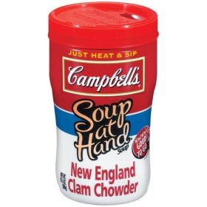
Target the occasion of consumption
or
Offer choices to your consumer

Slide 20
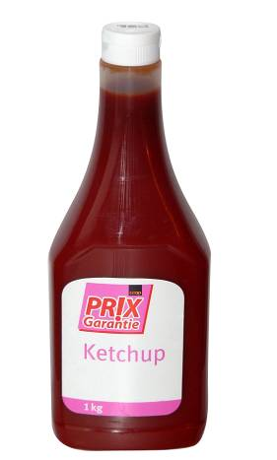
Highlight the quality of the product

Slide 21
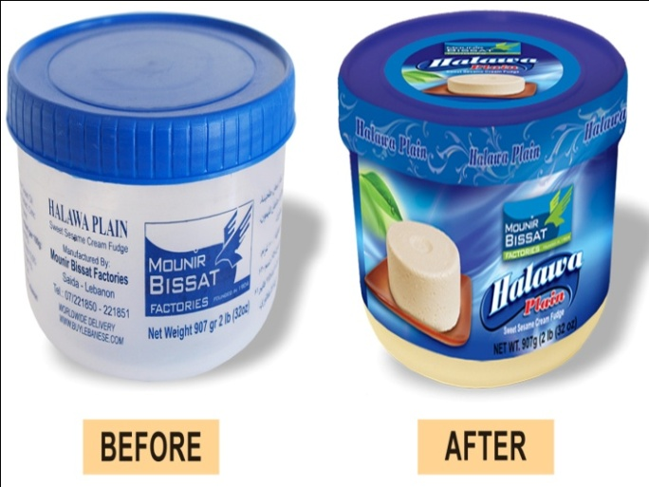
Even small companies can seem bigger through their packaging

Slide 22
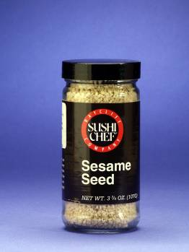
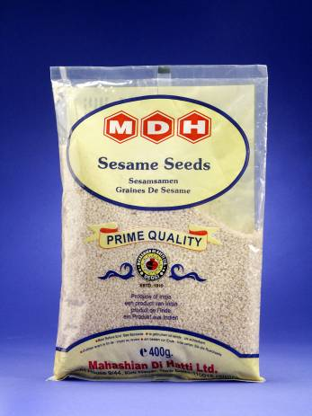
Raise the expectation over your product

Slide 23
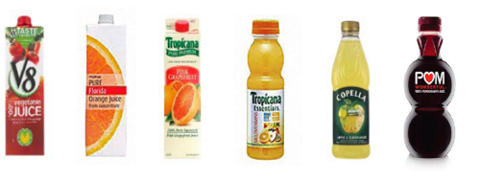
Guarantee eye catching design

Slide 24
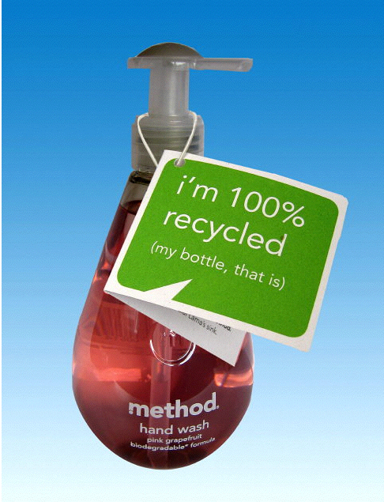
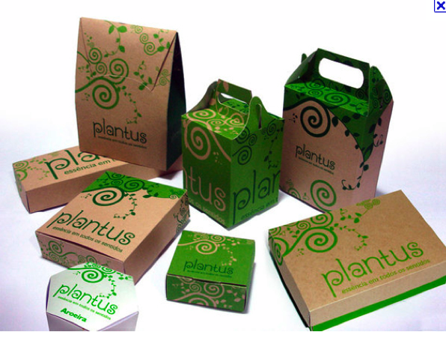
If your brand holds sustainability values, show them through your packaging

Slide 25
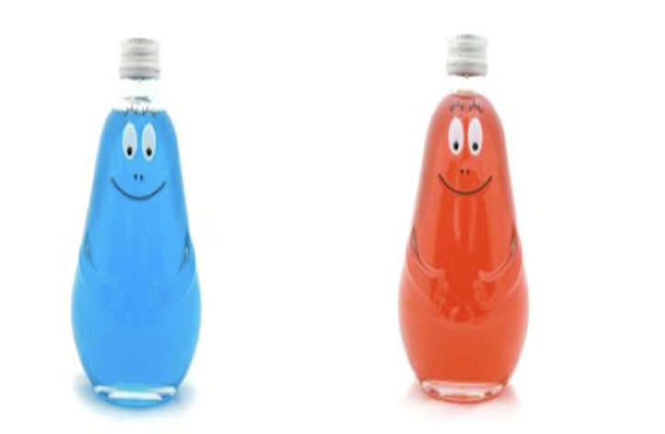
Connect with your consumer by personalizing your packaging

Slide 26
Explore the consumers' senses when consuming my product

Slide 27
Consumers are more likely to experimentation
and to recommendation

Slide 28
Interact

Slide 29
Technology is driving the purchase moment to new experiences

Slide 30
And it is driving a right here, right now demand

Slide 31
Impact for the packaging industry?

Slide 33
Packaging
Your marketing tool
Anything, Everywhere, Very quickly

Slide 34
Thank you !
www.abre.org.br/ luciana@abre.org.br

