Slide 1
The American Market
Economic, Social and Ecological Aspects of Packaging
Patrick Farrey
Executive Director
Institute of Packaging Professionals (U.S.)

Slide 2
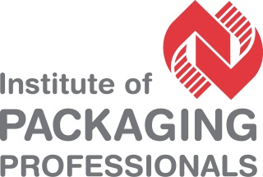
U.S. packaging market size
2011: U.S. = $142 billion, worldwide = $696 billion
2016: China will overtake U.S. as #1
Source: Smithers Pira
Notes:
Smithers Pira says U.S. still #1 in packaging consumption at about $142B in 2011, accounting for roughly 20% of worldwide consumption. China was #2 at a little more than $80 billion. With China’s economy’s rapidly increasing thirst for consumer products, the forecast is that China will overtake the U.S. in 2016 as #1 in the world.

Slide 3
U.S. packaging market size
• Corrugated and paperboard packages will continue as #1 segment: 2% annual growth to $36.5 billion in 2016
• Converted flexible packaging is slowly narrowing the gap; 4% annual growth through 2015
Source: Freedonia Group
Notes:
Corrugated and paperboard dominant in food and beverage. Converted flexible growth is led by emergence of pouches in more categories.

Slide 4
Sustainable packaging market
■ $88 billion in 2011 (global)  $142 billion to $170 billion by 2015 (global)
Mostly of concern in U.S., Europe, which hold 70% of market combined
2012: 27% of major U.S. retailers’ products will contain flexible packaging; by 2017: 37%
Sources: Global Industry Analysts Pike Research, EL Insights
Notes:
Estimates for sustainable packaging growth over the next five years are varied, by it’s safe to conclude that the worldwide market will just about double to between $142b and $170b, depending on whose estimates prove correct. Driving the growth in the US: Increased awareness about environmental hazards related to the disposal and recycling of packaging waste, government initiatives to minimize greenhouse gas emissions and stringent regulations.
Recycled material accounts for most of the market—about 90% of the demand in the U.S. However, biodegradable materials are growing in packaging, and represent the fastest growing segment because they decompose easily and reduce packaging waste.
In the U.S., one area that really lags behind in the sustainable market is the medical sector, due to cost and regulatory concerns, and poor recycling infrastructure.

Slide 5
American Focus: Speed to Market
Range of Tactics
Social Media Interaction With Consumers
Sophisticated Package Customizing
Digital
Printing
Retail-Ready
Packaging
Automate or
Semi-Automate
Contract
Packaging
Services
Notes:
American product and packaging development today is all about speed-to-market. Meeting ever-shorter sales windows with an increasing array of products, which often can be customized or semi-customized so Americans feel like the product was made just for them.
Social media interaction = Through iPhones, etc., direct contact and quick feedback from consumers that could bring new and in-demand products into production more quickly (customized flavors, short-run promo packages tied to special events).
Sophisticated Package Customization = Change only those parts of the package that are simple, keep complexity to a minimum and provide economies of scale. Example: Changing only the design on digitally produced labels of small batches of coffee beans. The pouch itself stays the same.

Slide 6
Speed-to-Market: Package Change Frequency
Many consumer goods companies were changing their packaging once every 3-5 years.
Today, packaging changes often are more commonly 18 months or less.
Some regional packages changes are occurring every few months.
Print on demand: Package changes could change by the order, by the unit.

Slide 7
Speed-to-Market Drivers
• Americans’ insatiable appetite for new things
• Retailers’ need to differentiate through packaging
• Special, limited-window promotions that spur additional incremental sales.
Notes:
Americans love the idea of the “treasure hunt” in stores—the anticipation that they’ll find something new and useful and unexpected each time they visit. American retailers love this cultural attitude because it enables them to generate impulse sales that increase “ring” at the register.
Different “unit of sale” packages for various retailers. Example: A 48-pack of batteries in a warehouse club vs. a 24-pack in a discount store vs. a six-pack or 12-pack in a dollar store. The need for simplifying the complex is driving the need for speed-to-market strategies in operations, warehousing and logistics.

Slide 8
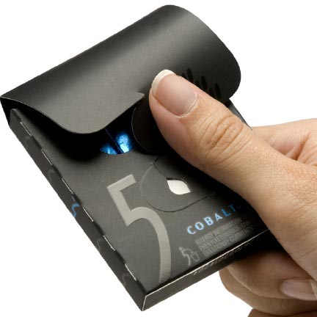
American trend: Convenience
Consumers are becoming a ‘one-handed world’
2011 study: Insight Farm
Notes:
A two-year study of U.S. consumers focused on both arm amputees and two-handed consumers, and how they interact with 250 everyday objects, including packaged products, across 18 categories. The study found that these consumers spend 40% of their waking hours with one hand occupied (iPhones, holding a baby, etc.). Multi-tasking, including doing many things with one hand while doing something with the other hand, is a pervasive cultural phenomenon in the hectic daily life of North American consumers.
As a result, the next trend for American packaged product manufacturers may be redesigning and re-engineering more of their packaging to accommodate one-handed operation, such as the one-handed opening pack you see here for Wrigley’s 5 brand of gum. Manufacturers who don’t adapt could be left behind.
If this trend interests you, IoPP will have much more information to share on it in one of our presentations at Pack Expo coming up in October in Chicago.

Slide 9
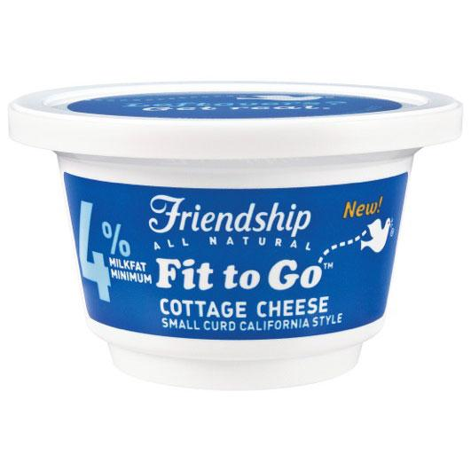
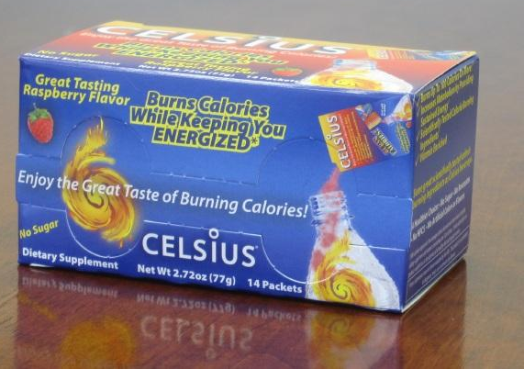
Americans = On-the-go consumers
• Multi-taskers want to use products right here, right now
• Stress-free is essential
Notes:
Extending Americans’ propensity to multi-task and for on-the-go consumption, this is also having significant impact in the need for more stress-free, on-the-go packaging, particularly in food. For Americans, the mantra is “right here, right now.” That is how they want to be able to consume more products, from daily-dose drinks to energy boosters and even probiotics.

Slide 10
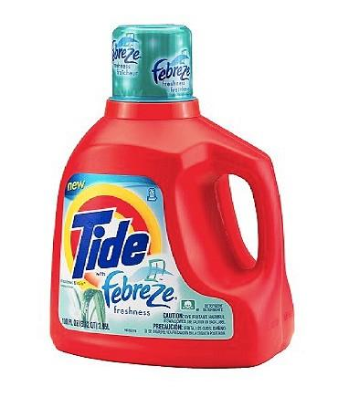
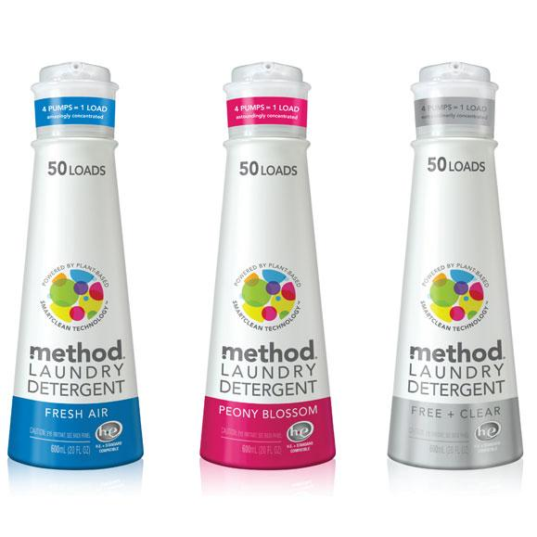
America: Packaging getting smaller
Vs.
Smaller pack sizes enhancing convenience, presenting economies of scale, benefiting environment
Notes:
In the U.S. and Canada, package sizes are becoming smaller in many categories. They’re easier for consumers to carry, and in many cases, consumers are willing to pay a bit more per ounce or serving for convenience.
At the store level, in categories such as laundry detergent, smaller packages also enable more package units on the shelf, thereby increasing sales per square foot. More product units also make out-of-stocks less likely.
For environmental benefit, smaller packages require less material and often less energy to product. They often pack out a truck or warehouse better, providing distribution benefits (savings on fuel, etc.).

Slide 11
America: Growing private label market
▪ Penetration creeping toward European p/l share, which is 40% or more in many categories ▪ 15% to 20% share in many American markets; some categories approaching 25%
Notes:
Studies from Nielsen Company and other firms are finding that Americans believe private-label products, in more cases, are as good or even better than the national brands. This is a seismic shift from a few years ago, when prevailing American perception was of private label goods as cheap and low in quality.

